Slide 1
Virtual Net Metering and local network charges in Australia: an update
Smart Future Cities Conference 2015, Newcastle, NSW, October 1st 2015

Slide 2
Session Overview
Dr Andrew Mears (moderator), CEO, SwitchDin Pty Ltd (moderator)
Jay Rutovitz, Institute for Sustainable Futures Context Valuing local energy: the concepts The project (Facilitating local network charges and VNM)
Mark Byrne, Total Environment Centre The Rule Change proposal
Sandi Middleton, Byron Shire Council A local Council perspective
Panel session

Slide 3
Where are electricity’s costs?
}
Dr Andrew Mears (moderator)

Slide 4
Virtual Net Metering (VNM) – Location matters
An electricity customer with on-site generation is allowed to assign their ‘exported’ electricity to other site(s).
‘virtual’ because there is no direct physical interconnection … it’s a matter of accounting of these transactions.
VNM and local network charges both have a big impact on the economics of local generation
Dr Andrew Mears (moderator)

Slide 5
Context

Slide 6
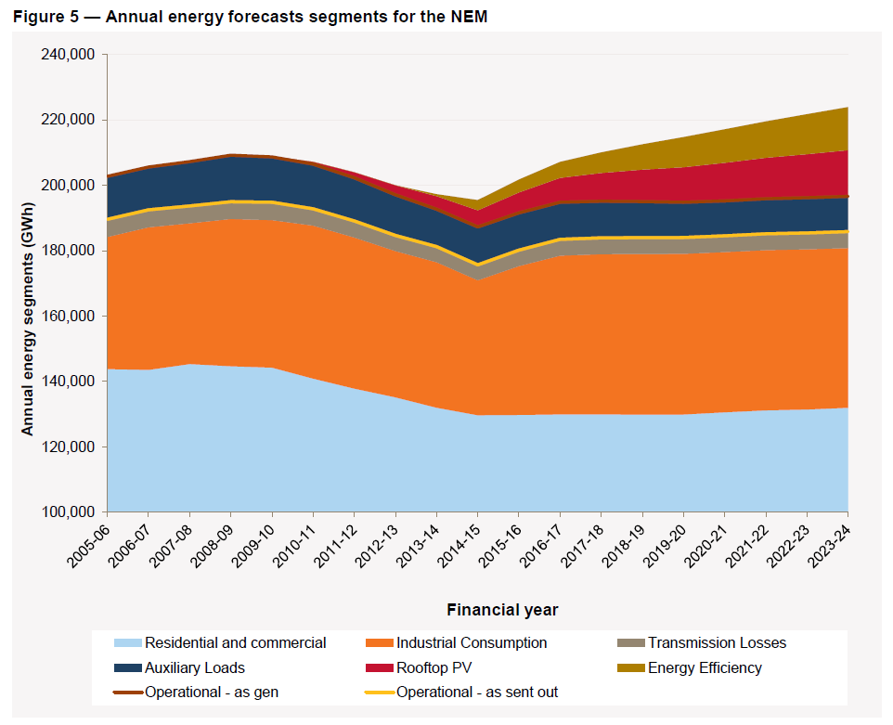
HISTORIC POINT OF TRANSFORMATION
Centralised electricity supply falling, already peaked?
Energy efficiency
Rooftop solar PV
Behaviour change (price effect)
ANNUAL ENERGY FORECAST FOR THE NEM (June 2014 NEFR)

Slide 7
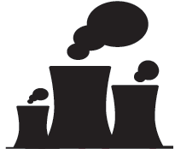
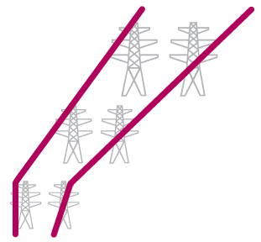





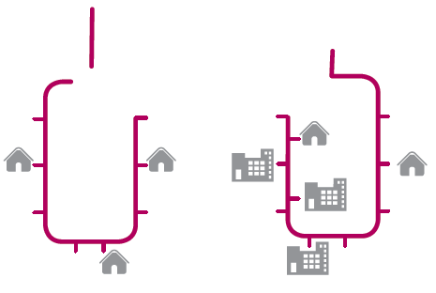




Today:
Highly centralised network

Slide 8


















The future: decentralised network

Slide 9
…WITh far more
LOCAL ENERGY
Local
Energy

Slide 10
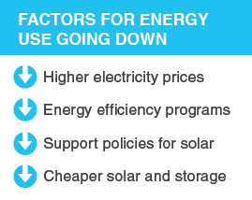
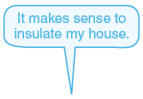
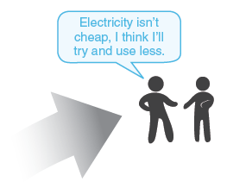



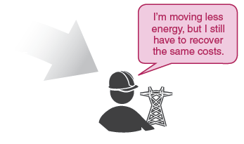


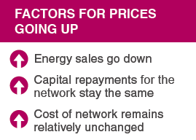



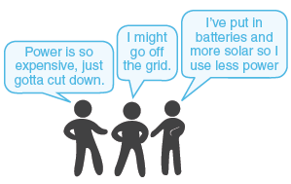


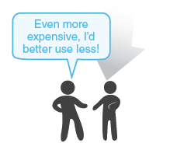
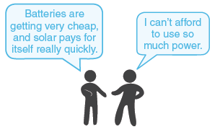








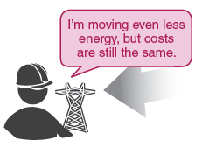

Possible outcome - the death spiral
Notes:
Key drivers for consumption falling:
Price
Solar PV
EE and RE policies
Key drivers for prices
Energy sales down
Captial repayment stay the same
Cost of network relatively unchanged

Slide 11
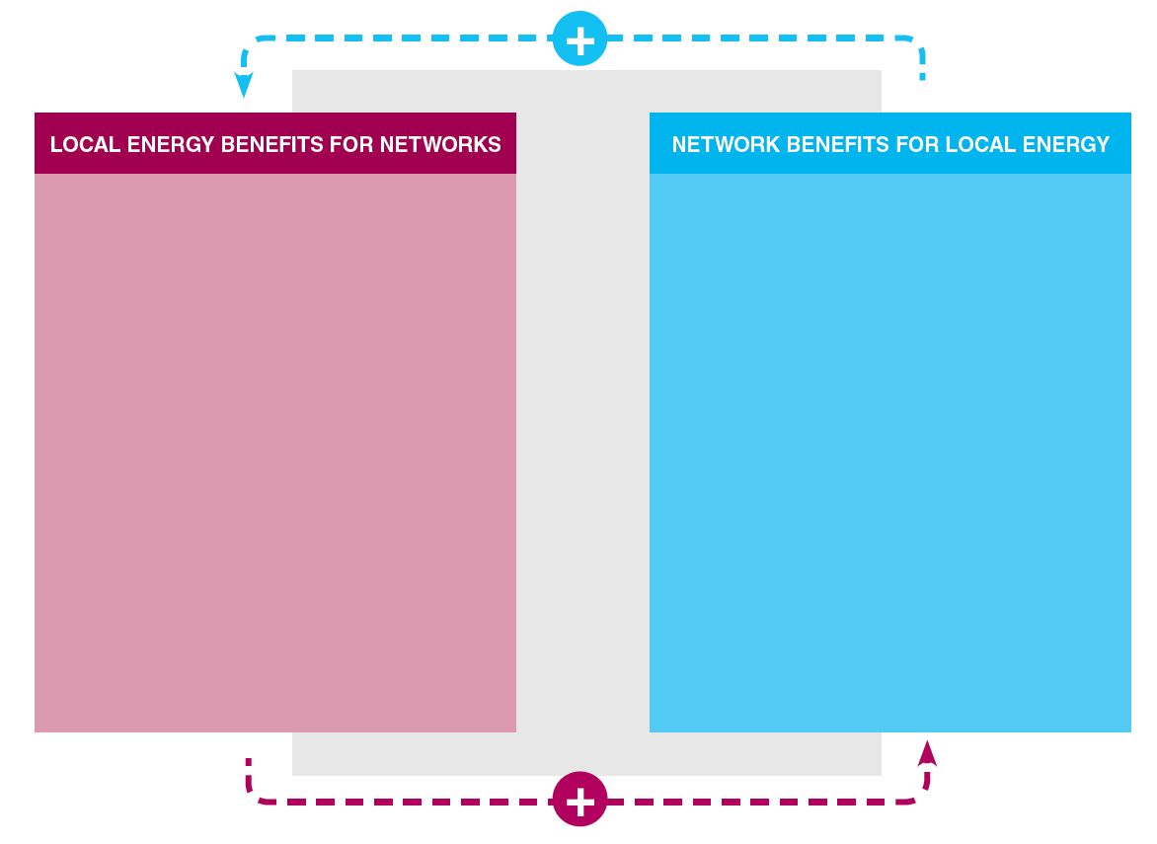
Possible outcome : MUTUAL BENEFITS
Reduced transmission and distribution losses
Potential to save money on network investment
Emissions reduction
Increased resilience of system
Technical network services
Provides local generators access to bigger markets
Keeps high level of reliability
Allows local generator to run system for maximum efficiency
Supports technical requirements of consumers

Slide 12
VALUING LOCAL energy :
Local network charges and local electricity trading

Slide 13
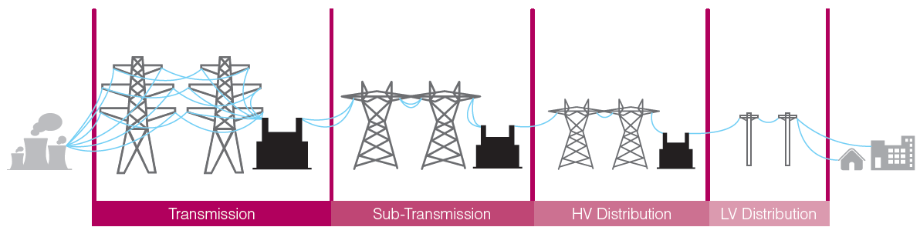
Network Charges - What happens now
Local Energy
Current network charges for local energy

Slide 14
The problem
DGs sell at wholesale and buy back at retail prices
Strong incentive for customers (and product developers) to focus “behind the meter” & reduce grid consumption
Perverse incentive to duplicate infrastructure
Sub optimal sizing of generators and little incentive to supply grid services
Increases costs for consumers left using only grid electricity, as infrastructure costs are recouped from smaller sales volume
Notes:
1 Already happening (e.g. Willoughby Council)
2 Constrains potential cost effective DG
3 Reduced network revenue > Defensive pricing strategies

Slide 15
The concepts
TYPICAL MAKEUP OF ELECTRICITY BILL
Local network charges: reduced tariffs for electricity generation used within a defined local network area
$ network charges
affects this part
Local Electricity Trading”** requires netting off generation from one site at another site on a time-of-use basis, so that Site 1 can ‘sell’ or assign generation to nearby Site 2
** also known as VNM
$ retail
affects this part
$ energy costs
Notes:
BARRIERS
In theory no regulatory reason to stop NSPs offering local network charges and retailers offering VNM
…BUT no requirement, and no methodology
Retailers may offer VNM on case by case basis, but costly to do that way
Rule change required to introduce Local Network Charges, and may be required for VNM

Slide 16
The project: FACILITATING Local network charges AND LOCAL ELECTRICITY TRADING**
** Virtual Net Metering (VNM)

Slide 17
The project
Objective: To facilitate the introduction of local network charges & Local Electricity Trading**
Five case studies, or “virtual trials”
A recommended methodology for calculating local network charges
An assessment of technical requirements and indicative costs for Local Electricity Trading
Economic modelling of benefits & impacts
Increase stakeholder understanding and support for rule change(s)
** also called Virtual Net Metering or VNM

Slide 18











PARTNERS: A BROAD COALITION
PROJECT
LEAD
MAIN
SPONSOR
Networks NSW
Energy Australia
Electricity Retailers Association
Electricity Networks Association
Clean Energy Council
Coalition for Community Energy
CITY OF
SYDNEY

Slide 19




virtual
FRINGE OF GRID
Tech | Bioenergy (TBC)
Network | Ergon Energy
Retailer | Ergon Energy
Model | One →Several
THE TRIALS
^
BYRON
Tech | PV
Network | Essential
Retailer
Model | Council 1 → 1
MOIRA/SWAN HILL
Tech | PV
Network | Powercor
Retailer | AGL
Model | 1 → Many OR Many → 1
WILLOUGHBY
Tech | Cogen
Network | Ausgrid
Retailer | Energy Australia
Model | Council 1 → 1
WANNON WATER
Tech | Wind
Network | Powercor
Retailer | AGL
Model | 1 → 1 OR 1 → 2

Slide 20
Stay in touch – project website & sign up for newsletter
or email: jay.rutovitz@uts.edu.au
http://bit.do/Local-Energy

Slide 21
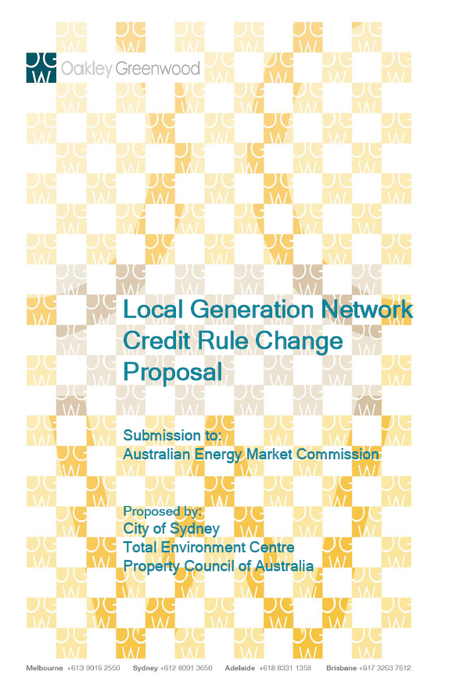
The Rule Change proposal
Mark Byrne,
Total Environment Centre

Slide 22

Virtual Net Metering Trial in the Byron Shire
Sandi Middleton
Sustainability Officer

Slide 23

Key benefits to Council and our community
New financial incentive for generating renewable energy in the Byron Shire
Increased energy resilience & reduced greenhouse gas emissions hence helping to meet our Zero Net Emissions target
Social equity - mitigate the potential effect of spiralling customer loss from the network

Slide 24




Why the Byron Region?
2

Slide 25
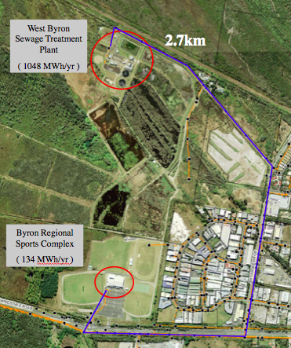
How will the trial work?
Technology: PV
Network: Essential Energy
Retailer: Energy Australia
Model: Council to Council

Slide 26
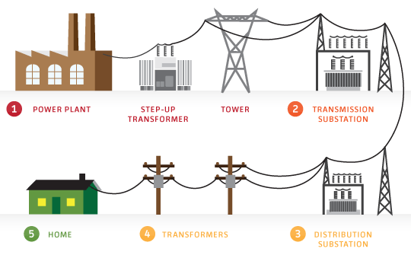


Byron Shire Council Trial
Energy Australia
Essential Energy
Council Sewerage Treatment Plant
Council Sports Centre
Solar Gen.
100 kWh / day
Total Usage
2860 kWh/day
Notes:
STP?

Slide 27

Willoughby City Council
Generator: Willoughby Leisure Centre - existing co-generation
Consumer: Council’s main administration building
Parties:
  Customer: Willoughby City Council
  Network provider: Ausgrid
  Energy retailer: Energy Australia
Notes:
Willoughby City Council:
A medium sized council on Sydney’s north shore
A progressive council with renewable energy and other sustainable initiatives: 2011 installed 166kW solar farm with private wire supplying 2 community buildings – recently upgraded to supply free a public EV charging station!
Council owned and run leisure and indoor pool centre
160kW cogen installed in 2010
Administration building ~ 3km distant

Slide 28
Any questions
  Byron Shire Council
    Sandi Middleton
    Sustainability Officer
    sandi.middleton@byron.nsw.gov.au
  Willoughby City Council
    Peter Lisle
    Sustainability Projects Officer
    peter.lisle@willoughby.nsw.gov.au

