Slide 1
Building Financial Models
Vivian Quinn & Richard Stewart 24th August 2022

Slide 2
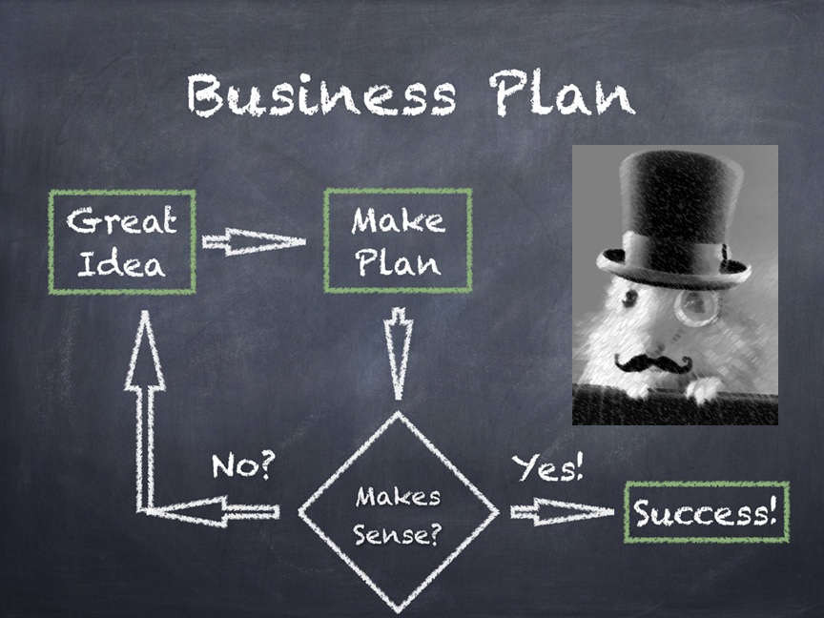

Slide 3
Today’s sessions with your mentors
Implementation and Financing Consultations
Competitor analysis on your idea
Research and document the possible market size and scalability of your ideas
Is it financially viable?

Slide 4
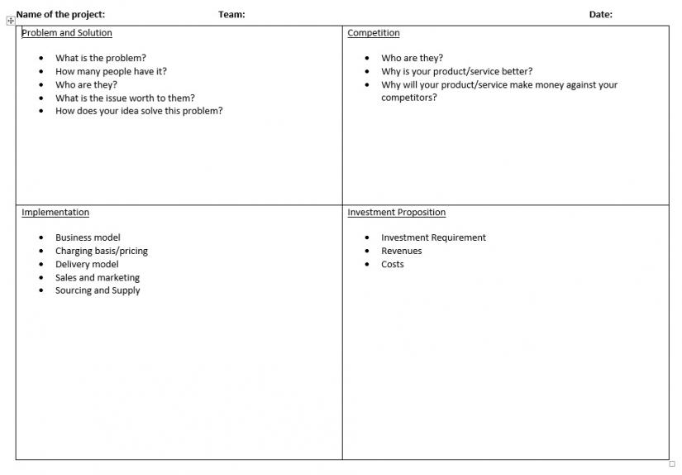
Lean Canvas

Slide 5
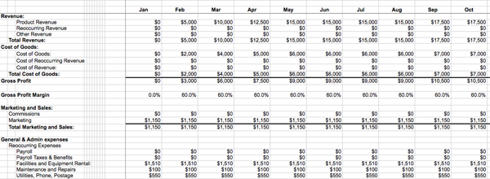
Financial Models
Why do we do them?
How can they be used?
What do the judges look for?

Slide 6
Business Plan Assessment Criteria
1. Quality of the idea – 25% weighting
a) What problem does your offering solve?
b) What is your product or service offering and how does it work?
c) What is the market for this idea?
d) What is your unique value proposition and why does your offering solve the problem better than its potential competitors?
e) Can the associated intellectual property be protected?

Slide 7
Business Plan Assessment Criteria
2. Implementation of the idea in a business context - 25% weighting
a) How will you market the offer?
b) What is the intended manufacturing or service delivery process?
c) How will it be distributed or provided?
d) Is there any environmental impact associated with the product or service?
e) What are the key strengths/weaknesses of the team proposing the idea?

Slide 8
Business Plan Assessment Criteria
3. The investment (from a potential investor's point of view, would I put my money into this?) - 50% weighting
a) How much investment is required?
b) How will your business make money?
c) What return on investment is forecast?
d) How long will it take to pay back the investment?
e) What are the key risks as you see them and how do you intend to mitigate against those risks?

Slide 9
Financial Modelling
Document the rationale for the key assumptions
Prepare a base case scenario using the most likely key assumptions
First 12 months is detailed, subsequent 2-4 years less detailed
Test the sensitivity of key assumptions e.g., growth; price sensitivity; FX
Run scenarios based on variations to the key assumptions
Calculate Net Present Value and Payback on each of the above scenarios
Provide a financial perspective of the business

Slide 10
Best Practice
Separate worksheets for:
Contents (with links to other worksheets);
Executive Summary;
Assumptions;
Sensitivity Analysis on key assumptions;
3-5 year projected Profit & Loss;
3-5 year projected Balance Sheet;
3-5 year Cash Flow projections.

Slide 11
Appendices - max 10 pages
Start-up costs
Projected sales
Personnel plan
Start-up funding
Projected profit and loss statement
Projected balance sheet
Projected cash flow statement

Slide 12
Financial Templates
Start-up costing A start-up costing sheet can help determine how much money you need to start.
Cash flow statement A cash flow statement tracks all the money flowing in and out of your business and can reveal payment cycles or seasonal trends that require additional cash to cover payments.
Profit and loss statement A profit and loss or income statement lists your sales and expenses and helps you work out how much real profit you're making.
Balance sheet A balance sheet is a snapshot of your business on a particular date. It lists all of your business' assets and liabilities and works out your net assets.
Financial calculators Use this template to calculate your key financial ratios and help you analyse the financial health of your business.
Glossary of key financial terms Find definitions for financial terms that you may come across when you are dealing with accountants and financial institutions, or while running your business.
Source: https://www.business.gov.au/info/plan-and-start/templates-and-tools

Slide 13
Financial Templates
Google “business plan excel template” to search for useful sites such as:
http://www.spreadsheet123.com/ExcelTemplates/financial-plan-projection.html for a standard five year financial projection
http://www.buzinga.com.au projections specifically for App Development
https://www.ato.gov.au/Business/Small-business-benchmarks/In-detail/Related-information/Small-business-benchmarks-methodology-and-ratio-calculations/ for small business benchmarks

