Slide 1
Unpacking opportunities for language learning in the new NSW K-2 curriculum: The “academic view”
Associate Professor Robyn Cox
Head of Department Curriculum, University of New England
Immediate Past President, PETAA
Life Member PETAA
Member of the NSW DET Technical Advisory Group NSW K-2 English Syllabus

Slide 2
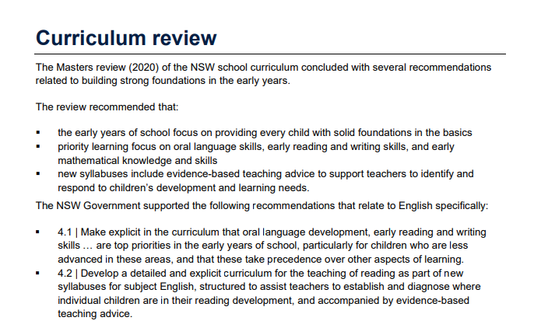

Slide 3
EAL/D and the new NSW K-2 Syllabus
Writing and reading can only be intimately interrelated by floating both on a sea of talk; but to achieve this requires time and patience on the teacher's part. (1988, p15)
Britton, J. N. (1988). Writing and reading in the classroom. Center for the Study of Reading Technical Report; no. 425.
Always one for a History lesson

Slide 4
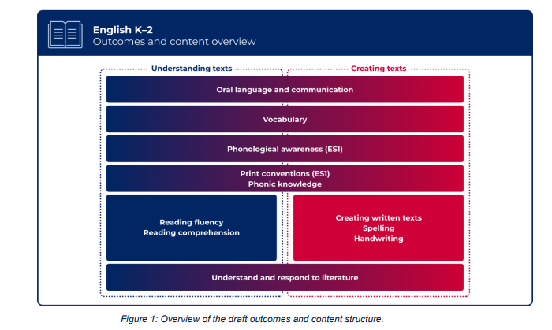
Celebrating the new NSW English K-2 Syllabus

Slide 5
The syllabus development process
Writing of syllabus
Consultation
2 rounds of “have your say”
Preparation and implementation
Approval

Slide 6
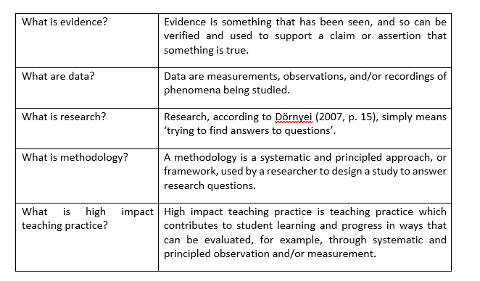
Evidence (the NSW Syllabus has been called upon specifically to provide evidence based teaching advice.)
In the legal system, during a criminal trial in a court of law, the task of the trial judge and jury is to weigh up the evidence before coming to a decision about the guilt or otherwise of the defendant.
A comparable task falls to teachers when they are asked to weigh up the evidence before deciding whether to apply a particular practice in their classrooms, and to school leaders as they decide whether to provide the resources and support needed to implement a particular practice in their school.

Slide 7
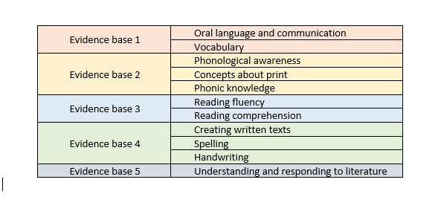
Reviewing the evidence for EAL/D teaching practice for the 5 main content groups in new NSW K-2 Syllabus
These are my five groupings:

Slide 8
BICS and CALP based on oral language first followed by written language (Cummins, 2000, 2008, 2016)
Dual language use in early school years (Krashen 1999, 2000, 2004, 2009, 2021)
Drawing on existing language skills (Genesse et al 2005, Genesse 2016)
Words that students need to be taught are those that are crucial to their comprehension of texts and should be not the technical words but rather those all-purpose academic words central to understanding texts within a series of topics (Snow, Lawrence & White 2009).
The high cognitive load associated with learning new words is compounded by curriculum demands and students who received no L1 language support found that the materials were too difficult. (Snow, Lawrence & White 2009).

Slide 9
Meta-reviews of research in teaching early have found that the most success for EAL/D learners is dual language instruction in reading (Slavin & Cheung, 2005)
However, where this is not possible best gains in early reading instruction for EAL/D learners was found that quality of instruction is at least as important as language of instruction. (Klingner & Vaughn 2004)
A further meta-analysis of studies with struggling readers including EAL/D struggling readers found that one-to-one tutoring works. An emphasis on phonic knowledge greatly improves tutoring outcomes and teachers are more effective as tutors than paraprofessionals or volunteers, and (Slavin et al 2011).

Slide 10
A meta-analysis found studies with success for EAL/D learners where instructional techniques that emphasized meaning and language development. (Shanahan et al 2014)
Enriched book environments within the school day (Elley, 1991; Koskinen et al., 2000)
Meaning-oriented instruction had a greater impact on reading comprehension than decoding-oriented interventions, although these also worked, highlighting the need for comprehensive approaches to instruction for ELLs.
Repeated oral reading, the instructional approach found effective with native speakers of English was also effective with ELLs. (VanWagenen, Williams, & McLaughlin, 1994)
Six studies found positive fluency outcomes for ELLs taught in small groups or one-on-one settings with tutors (Denton et al., 2008)

Slide 11
EAL/D students' writing can be improved by explicit instruction on how to revise (Sengupta, 2000).
A study of word processing found that using a computer to complete writing assignments improved the quality of beginning EAL/D students' writing in comparison with their peers who used a pencil and paper. (Silver & Repa, 1993)
Collaborative writing was found to be effective when combined with explicit teacher-directed instruction, including providing models of effective writing and targeted feedback to support writing revision. (August, McCardle, Shanahan & Burns, 2014)
the elements of effective writing instruction emphasized by they also included special design elements aimed at the needs of ELLs. (Graham and Perin 2007).

Slide 12
Research found that instructional routines include previewing and reviewing storybook reading in students' first language was effective (Liang et al., 2005)
Conducting instructional conversations that permit some interpretation to take place in the home language was useful (Saunders & Goldenberg, 1999),
Bilingual glossaries for the targeted vocabulary both oral and written was effecgive (Carlo et al., 2004)
Instruction on the transfer of cognate knowledge from a first language to a second (Carlo et al., 2004).

Slide 13
EAL/D and the new NSW K-2 Syllabus
Writing and reading can only be intimately interrelated by floating both on a sea of talk; but to achieve this requires time and patience on the teacher's part. (1988, p15)
Britton, J. N. (1988). Writing and reading in the classroom. Center for the Study of Reading Technical Report; no. 425.
plus les choses changent plus elles restent les mêmes

Slide 14
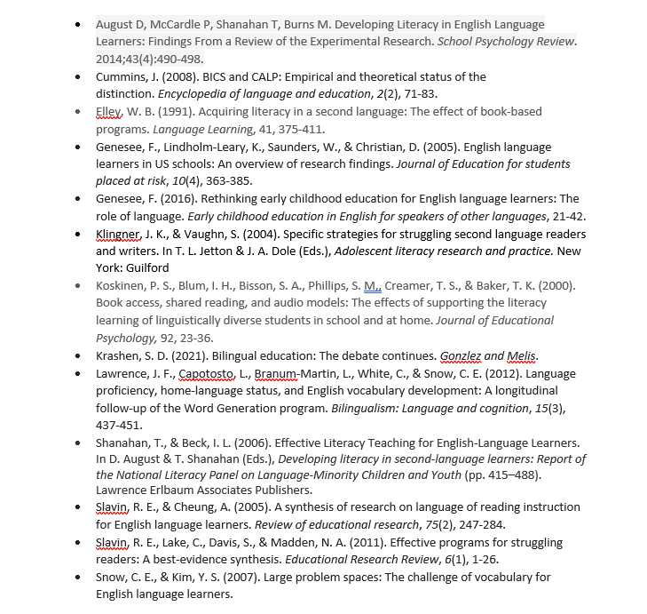
Reference List

