Slide 1
HELPS Workshop
Preparing for Exams

Slide 2
Workshop Objectives
To examine strategies for revising more effectively.
2. To analyse techniques for
answering various types of
exam questions.

Slide 3

How do you study for exams?
Image Source: Wikimedia Commons
Notes:
Group discussion

Slide 4
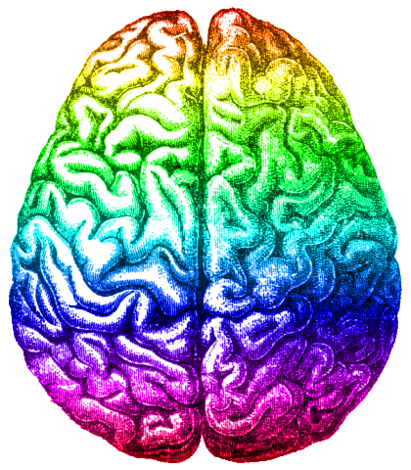
Prioritisation, Attention and Focus
First you need to have paid enough attention for something to be stored in memory.
Source: Wikipedia.org
Notes:
This video demonstrates how easy it is for us not to notice things that are right in front of us if we are not paying attention: https://www.youtube.com/watch?v=ubNF9QNEQLA
So when you’re studying, remove as many distractions as possible, keep your study sessions short, and keep your focus. If you’re losing focus take a break, but make sure you come back to it.

Slide 5

Prioritisation, Attention and Focus
Read / listen actively:
Identify the key points as you go
Think about how it connects to what you already know
Critically evaluate what you are reading – do you agree with it?
Source: Wikipmedia Commons
Notes:
Taking good notes is essential for:
Getting the information to go into your working memory, and starting the process that will help it be stored in long-term memory
Organising information into a logical structure to help you understand how different parts of the topic fit together

Slide 6
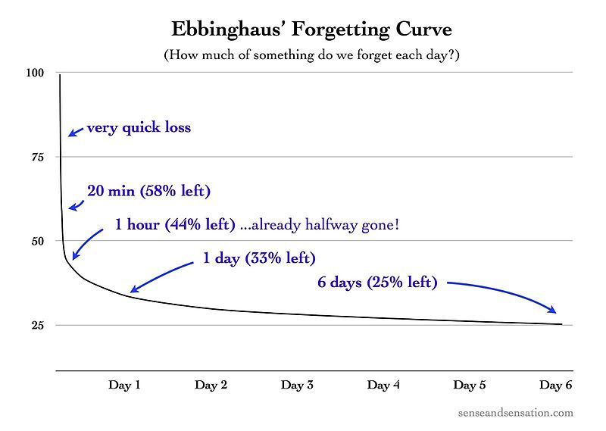
Image Source: Wikimedia Commons
Notes:
But even if you pay attention to incoming information, there’s still a very strong chance you’ll forget most of it very quickly unless you actively do something to avoid this happening.

Slide 7
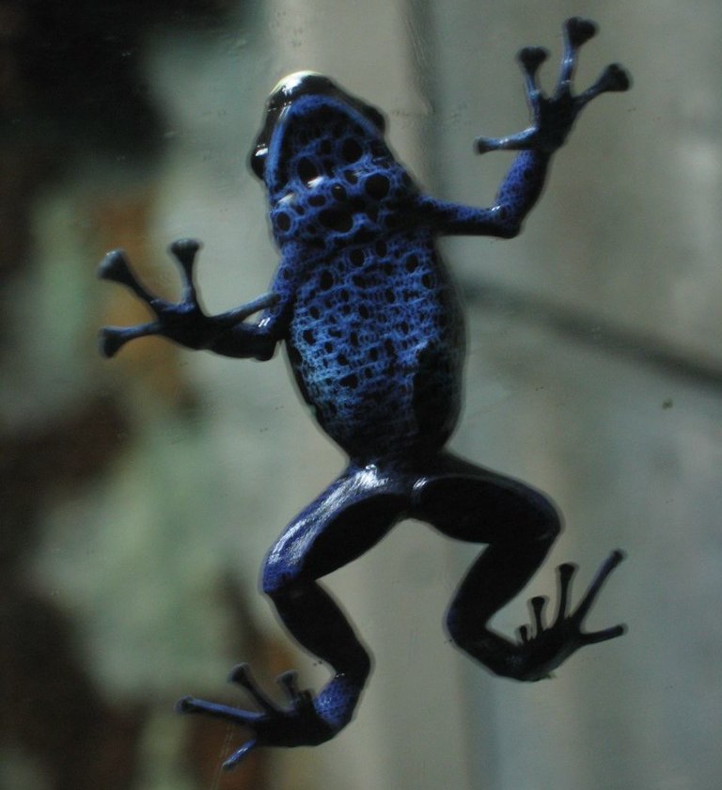
How do you get stuff to stick?
Image Source: Flickr
Notes:
So the question is…..

Slide 8
Revising your notes
Immediately after the lesson/reading, check how much you can remember.
Read your notes again to remind you what you’ve already forgotten.
Then write a one paragraph summary of the main points.
Notes:
No matter how good your original notes are, if you don’t revise them frequently and effectively, you still won’t remember most of it for the exams.
What does it mean to revise effectively? It means actively doing something with the information.

Slide 9

Our brains don’t work like this………
Image source: Wikimedia Commons
Notes:
The reason we need to process the information is because our brains don’t just take a snapshot of something that can be filed away until we need it.

Slide 10

They work more like this………
Image Source: Pixabay.com
Notes:
Instead, our brains work by connecting new information and experiences to existing information and experiences.
So the first step when learning a new topic is to actively think about what you know about that topic already, and how it connects to any other topics you’ve learnt about, or better yet, how it connects to your life.

Slide 11
Connecting information is a powerful way to learn
When learning a new topic:
What do you know about that topic already? Try brainstorming.
How does it connect to other topics you’ve learnt about?
How does it connect to your life?
Notes:
So the first step when learning a new topic is to actively think about what you know about that topic already, and how it connects to any other topics you’ve learnt about, or better yet, how it connects to your life.

Slide 12
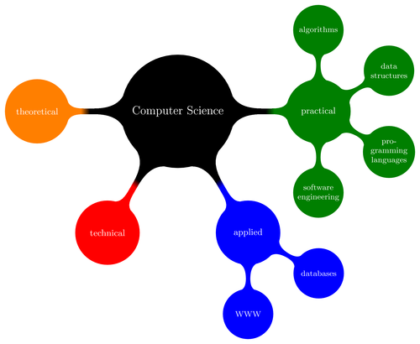
Transforming information is a powerful way to learn
Create concept maps or diagrams
Write examples of theories or concepts
Explain it to someone
Notes:
The next step is to actively do something with the information by transforming it into another format.
These are just some examples of how you can transform a written text into a different format. The act of transforming the information helps you both understand it better and remember it better.
You may have heard of the learning styles theory, which says that some people are visual learners, and other people are, for example, aural learners (learn by hearing things). There hasn’t really been any credible research that's proved this theory. Instead, the research suggests that using as many different senses and different strategies as possible is the most effective way of studying.
So if you read about the concept and write a brief summary AND create a visual concept map AND explain the concept to someone, that will greatly enhance your chances of understanding it and remembering it well.

Slide 13
Rereading your notes
Highlighting the key parts of a text as you read
Studying the same material once for a long block of time
Studying the same material regularly over short study sessions
Answering quiz questions
Mixing different topics within the same study period
Using keywords and mental imagery to aid memory recall
Thinking of explanations for why something is true
Notes:
Breakout rooms – in a group, list these in order from most effective to least effective study strategies
Rereading your notes
Highlighting the key parts of a text as you read
Answering quiz questions
Studying the same material regularly over short study sessions
Studying the same material once for a long block of time
Writing summaries of what you’ve learnt
Mixing different topics within the same study period
Mnemonics – using keywords and mental imagery to aid memory recall
Thinking of explanations for why something is true

Slide 14
More effective
Less effective
Answering quiz questions
Studying the same material regularly over short study sessions
Mixing different topics within the same study period
Thinking of explanations for why something is true
Rereading your notes
Highlighting the key parts of a text as you read
Using keywords and mental imagery to aid memory recall
Studying the same material once for a long block of time
Notes:
NOTE:
Answering quiz questions based on your existing knowledge/memory of the information is by far the most effective study strategy because:
a) it forces you to actively think about what you know about that topic (and/or how to apply it);
b) it gives you the practice of retrieving the information from your long-term memory, and the more frequently you retrieve it from memory, the more readily it will come to you during an exam;
c) it forces you to notice and admit when you don’t know something (i.e. when you can’t answer the question). This is important to avoid "false knowledge", which is when we think we "know" something when we're reading about it, but actually when asked to explain it we realise we don’t know is as well as we think we did.
2. Using mental imagery can be a very powerful way of helping you remember things BUT it tends not to be very useful when you’re learning complex and interconnected concepts.
3. Cramming can help you pass an exam (maybe) but it won’t help you remember the information beyond the exam, which means you won’t be able to apply it in the workplace.

Slide 15
Questions
Why are answering quiz questions and proposing explanations more effective than re-reading and highlighting your notes?
Why is it more effective to mix different topics within the same study period?
Notes:
Because they require active recall and application of the information, requiring you to demonstrate whether you actually do know the information, and how to apply it.
Because our brains then try to find links between the different topics we study, thus more actively thinking about and applying the information we’re trying to learn.

Slide 16
Subject
1
Subject
2
Subject
2
Subject
3
Subject
3
Subject
4
Subject
4
Subject
1
Subject
2
Subject
4
Notes:
So when planning out your study periods, try to plan it so that different topics are being covered in the same study session, or different revision strategies are being used in the same study session.
And dedicate extra time to the subjects that you know are the hardest, or that have the biggest exams.

Slide 17
Effective revision sessions
Image Source: Wikimedia Commons

Slide 18
Have a clear goal and time limit
S = specific
M = measurable
A = achievable
R = relevant
T = time-bound
e.g.
In the next half hour I will revise the process of photosynthesis by using my lecture notes to create a diagram of the process.

Slide 19
Have a clear goal and time limit
S = specific
M = measurable
A = achievable
R = relevant
T = time-bound
e.g.
In the next half hour I will revise the process of photosynthesis by using my lecture notes to create a diagram of the process.
Notes:
This goal is specific because it focuses on the process of photosynthesis

Slide 20
Have a clear goal and time limit
S = specific
M = measurable
A = achievable
R = relevant
T = time-bound
e.g.
In the next half hour I will revise the process of photosynthesis by using my lecture notes to create a diagram of the process.
Notes:
It’s measurable because you’ll either create a diagram of the process or you won’t.

Slide 21
Have a clear goal and time limit
S = specific
M = measurable
A = achievable
R = relevant
T = time-bound
e.g.
In the next half hour I will revise the process of photosynthesis by using my lecture notes to create a diagram of the process.
Notes:
And it’s time-bound because it has a definite end time.
Whether it’ achievable depends on how well you understand the concept of photosynthesis, and whether it’s relevant depends on why you need to know it – if it’s in the exam then it’s definitely relevant.

Slide 22
Exam revision session
output
input
output
Write a summary of what you already know.
Review your notes and add to your summary if required.
Answer some quiz questions – make up your own if necessary.
Notes:
What do you think an “output – input – output” based study session is, and what might it look like?
Essentially, it means first actively doing something yourself using what you already know/remember about the topic (output), then doing a reading, watching a lecture recording or revising your notes (input), then again doing something with the information, such as answering some quiz questions (output).

Slide 23
An example prep template
Key Concept | Meaning in your own words | Application example | How / Why does it happen?
Spontaneous Recovery
Memory phenomena stating that a failed attempt at recalling may produce a delay recall.5
Sense of familiarity with a question in exam, but unable to answer, then ‘remember’ as leaving the exam.
Other information or stimuli interfere at the moment when recall is required. Recall occurs when interference is removed.
Notes:
If you need to remember concepts e.g. (opportunity cost in Economics), always make sure that you think of examples or applications of the concept, not just the meaning.
Most assignments and most exams expect you to evaluate and/or apply theories and concepts to various situations as practice for using it in the workplace, so just understanding what something is will not usually be enough.

Slide 24
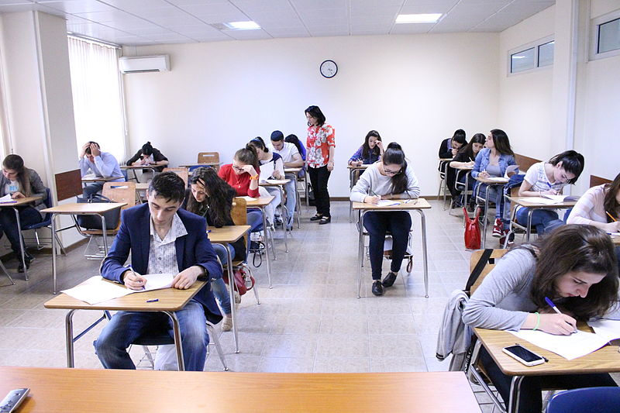
Exam Day
Image Source: Wikimedia Commons

Slide 25
On the day…
Don’t revise your notes.
This is only loading information into short term memory.
Practice recalling key information.
You may get spontaneous recovery in the exam.
Notes:
In the last minutes before the exam, don’t look over materials but instead practice recalling information from memory. Even if you're unsuccessful, you may get spontaneous recovery in the exam (i.e. it won’t come to you when you're revising, but will suddenly come to you during the exam.)

Slide 26


Which is better….
Starting with the easy questions or the hard questions?
Notes:
Counter-intuitively, it’s better to start with the hard questions.
Q: Why do you think this is the case?
A: Because even if you can’t think of the answer to the hard question, by starting to think about it, you give your brain time to work on it in the background while you’re then answering some of the easier questions. When you later come back to it, there's a chance your brain will have worked it out (or at least some of it).

Slide 27
Multiple Choice Questions
Work out the answer BEFORE you look at all the options​.
This will ensure you don’t get influenced by a tempting wrong answer.
Those with absolute words (e.g. all, none, always, never) usually make a statement false.

Slide 28
Short answer questions
You need to demonstrate your understanding, not just your memory.
Pay close attention to what the instruction word is asking you to do
e.g. define, explain, compare
Use some of the key words from the question in the first sentence of your answer to help you stay on task.

Slide 29
Essay-style questions
Develop a plan:
- key points and which order they should go in
- relevant examples to support your points
If you think of a new idea as you’re writing, go back to your plan and work out where it fits in.
If you run out of time, use bullet points to show the marker what else you intended to discuss.

Slide 30
QUESTIONS?
???

Slide 31
UTS HELPS
 9514 9733
 helps@uts.edu.au
 www.helps.uts.edu.au
.

