Slide 1
UTS HELPS
How to Manage Course Readings

Slide 2
Workshop Objectives
To examine effective reading strategies
To practise evaluating sources
To discuss note-taking techniques

Slide 3
Reading effectively
1. Find appropriate texts to use in your assignments
2. Have a clear purpose for your reading
3. Use good reading strategies
4. Take notes of key points
Notes:
PURPOSEWhat is the purpose of the text?
Journal article presenting the results of a recent research study.
CONTENTWhat is the overall message (or what is the writer trying to convince me of)?
What evidence is given to support the message?
Are there any problems with the evidence given to support the message?
Students who revise over regular short study periods perform much better in exams than students who study in one long session.
120 students from an Accounting subject split into two groups. One group revised for 30 minutes per day for 4 weeks; the other group revised for one full day. The students who studied every day got higher grades.
The research didn't examine which study methods the students used when studying.
Only looked at Accounting - the results may not apply to subjects that require more critical interpretation of concepts.
YOUR VIEWDo you agree or disagree with the overall message? Why?
How does this text relate to your assignment?
What are some connections you can make between ideas in this text and other texts you’ve read for this assignment?
There seems to be a lot of evidence that supports the idea that regular short study periods are an effective way of revising materials.
This article will help support my claim that studying regularly over a period of time is an effective method.
Smith (2018) and Wang (2016) did similar studies and obtained similar results, although both with smaller sample sizes. Williamson's (2013) findings contradict this study, but the students self-selected their study method, so the results are less valid.

Slide 4
Reading effectively
1. Find appropriate texts to use in your assignments
2. Have a clear purpose for your reading
3. Use good reading strategies
4. Take notes of key points
Notes:
We’ll look at each of these aspects of reading effectively in more detail, starting with evaluating your sources.

Slide 5
How to do C.R.A.P. research
Currency
How recent is the information?
Authority
Who is the creator?
What are their credentials?
Reliability
What kind of information is included?
Does it include references or sources for information?
Purpose / Point of View
Is this fact or opinion? Is it biased?
What is the intent of the text (e.g. to sell you something)?
Notes:
As a general rule, websites and blogs are usually best avoided. Books are usually ok, but check the expertise of the author. Government reports are good sources of information, and peer-reviewed journal articles are the best source of all.

Slide 6
Activity
Look at the following sources:
https://www.trueeducationpartnerships.com/schools/science-of-learning-six-strategies/
https://srcd-onlinelibrary-wiley-com.ezproxy.lib.uts.edu.au/doi/full/10.1111/cdev.13393
Notes:
Look at the following sources:
https://www.trueeducationpartnerships.com/schools/science-of-learning-six-strategies/
This is not a good academic source because the author is a trainee teacher, and therefore not an expert on the topic, and also we don’t know anything about whether the information was reviewed, and therefore we don’t know if the information is valid and reliable.
https://srcd-onlinelibrary-wiley-com.ezproxy.lib.uts.edu.au/doi/full/10.1111/cdev.13393
This is a good academic source because it is a peer-reviewed journal article, so we know it is written by an expert and has been reviewed by several experts to ensure its relevance, validity and reliability
https://ebookcentral.proquest.com/lib/uts/reader.action?docID=4438568&ppg=108
This is a reasonable academic source. The author is a professor in a related area, and therefore has credibility, although the book itself is focused on teaching rather than learning, so we would have to be careful how it is used.

Slide 7
Reading effectively
1. Find appropriate texts to use in your assignments
2. Have a clear purpose for your reading
3. Use good reading strategies
4. Take notes of key points

Slide 8
Before You Read
How much of the text looks relevant to your purpose and how?
- Helping you understand a concept?
- Providing a different perspective on the topic?
- Providing evidence to support your argument?
Notes:
Can you locate the part of the text that tells the reader the main ideas and points in the text?
Use the introduction and conclusion to identify the position being presented/hypothesis being tested/problem being examined.
Use the topic sentences to identify the way the argument develops, the main points being made and the type of evidence presented.
Can you locate the ‘thesis’?
What do headings, diagrams, graphs, tables, charts or any other visuals tell you?

Slide 9
Before You Read
Reading course readings
Read through your lecture notes for anything related to this topic.
- Think about what you already know about this topic from classes, other readings or your own experience.
Notes:
Connecting new information to what you already know is one of the most powerful ways to learn, so always prepare for a new reading by thinking about, or revising, what you already know about the topic.

Slide 10
Before You Read
Reading for assignments
Always keep your assignment question in front of you.
What type of information are you looking for?
Something to help explain the topic or define a key term?
Evidence to help you decide your perspective on the topic?
Alternative perspectives to provide a counter-argument?
Notes:
Knowing what you need the information for will help you more quickly find relevant information and work out where and how to use it in your assignment.

Slide 11
Reading effectively
1. Find appropriate texts to use in your assignments
2. Have a clear purpose for your reading
3. Use good reading strategies
4. Take notes of key points

Slide 12
Skimming
What is the text about?
And how does it relate to what you’re learning?
How is the text organised?
Use the headings and sub-headings to understand the main sections.
What is the author’s main message/argument?
What point are they trying to make (or convince you of)?
Notes:
Look at the structure of the example journal article from slide 6 and answer each of the above questions: https://srcd-onlinelibrary-wiley-com.ezproxy.lib.uts.edu.au/doi/full/10.1111/cdev.13393

Slide 13
Scanning
Which particular aspect of the topic do you need to know more about?
Scanning means looking through the text for keywords (i.e. important sub-topics) and then reading those sections in more detail.
You may be looking for:
A particular concept (e.g. ‘opportunity cost’ or ‘treatment methods’)
The name of a person (e.g. a famous researcher in that field)
Different theoretical frameworks to explain an issue (e.g. ‘behaviourism’ versus ‘constructivism’)

Slide 14
Focused Reading
You often don’t have to read the whole text but you’ll need to read some parts closely and take notes.
Keep asking yourself: How will I use this information?
30 mins of quiet reading is better than 3 hours of constant distractions.
Schedule your reading time, set a timer and remove distractions.
Notes:
In journal articles, it’s often the introduction and/or the discussion section that you’ll have to read closely.
The introduction often has a literature review which summarises the existing research and/or theories relating to this topic.
The discussion usually explains what the results of their research mean, how they’re relevant and how they link to existing research and/or understandings of the topic.

Slide 15
Reading effectively
1. Find appropriate texts to use in your assignments
2. Have a clear purpose for your reading
3. Use good reading strategies
4. Take notes of key points

Slide 16
Taking Effective Notes
THE CONTENT
What is the overall message (or what is the writer trying to convince me of)?
What evidence is given to support the message?
YOUR VIEW
Do you agree or disagree with the overall message? Why?
How does this text relate to other texts you’ve read?
Notes:
THE CONTENT
Do What is the overall message (or what is the writer trying to convince me of)?
What evidence is given to support the message?
Are there any problems with the evidence given to support the message?
YOUR VIEW
Do you agree or disagree with the overall message? Why?
How does this text relate to your assignment?
What are some connections you can make between ideas in this text and other texts you’ve read for this assignment?
There seems to be a lot of evidence that supports the idea that regular short study periods are an effective way of revising materials.
This article will help support my claim that studying regularly over a period of time is an effective method.
Smith (2018) and Wang (2016) did similar studies and obtained similar results, although both with smaller sample sizes. Williamson's (2013) findings contradict this study, but the students self-selected their study method, so the results are less valid.

Slide 17
NOTES | MY COMMENTS
SUMMARY
Notes:
The Cornell Note-taking System divides the page into three sections by drawing a horizontal line across the bottom quarter of the page, and a vertical line about three-quarters of the way across the page.
The biggest section is for taking your notes as you read, trying to write them in your own words where possible.
The section on the right side of the page is for you to write questions or comments related to what you’re reading.
The bottom section is for you to write a brief summary once you’ve finished the text – one paragraph or a few bullet points.

Slide 18
NOTES Interleaving - switching between different topics in the same study session. Several studies show better exam results using interleaving compared with studying the same topic throughout each study session. Several theories proposed to explain this, including….. | MY COMMENTS
SUMMARY
Notes:
Here’s an brief example of The Cornell Note-taking System

Slide 19
NOTES Interleaving is switching between different topics in the same study session. Several studies show better exam results using interleaving compared with studying the same topic throughout each study session. Several theories proposed to explain this, including….. | MY COMMENTS Need to look for a source that explains why interleaving works
SUMMARY
Notes:
Here’s an brief example of The Cornell Note-taking System

Slide 20
NOTES Interleaving is switching between different topics in the same study session. Several studies show better exam results using interleaving compared with studying the same topic throughout each study session. Several theories proposed to explain this, including….. | MY COMMENTS Need to look for a source that explains why interleaving works
SUMMARY Interleaving is an effective study strategy but no-one is quite sure why it works so well.
Notes:
Here’s an brief example of The Cornell Note-taking System

Slide 21
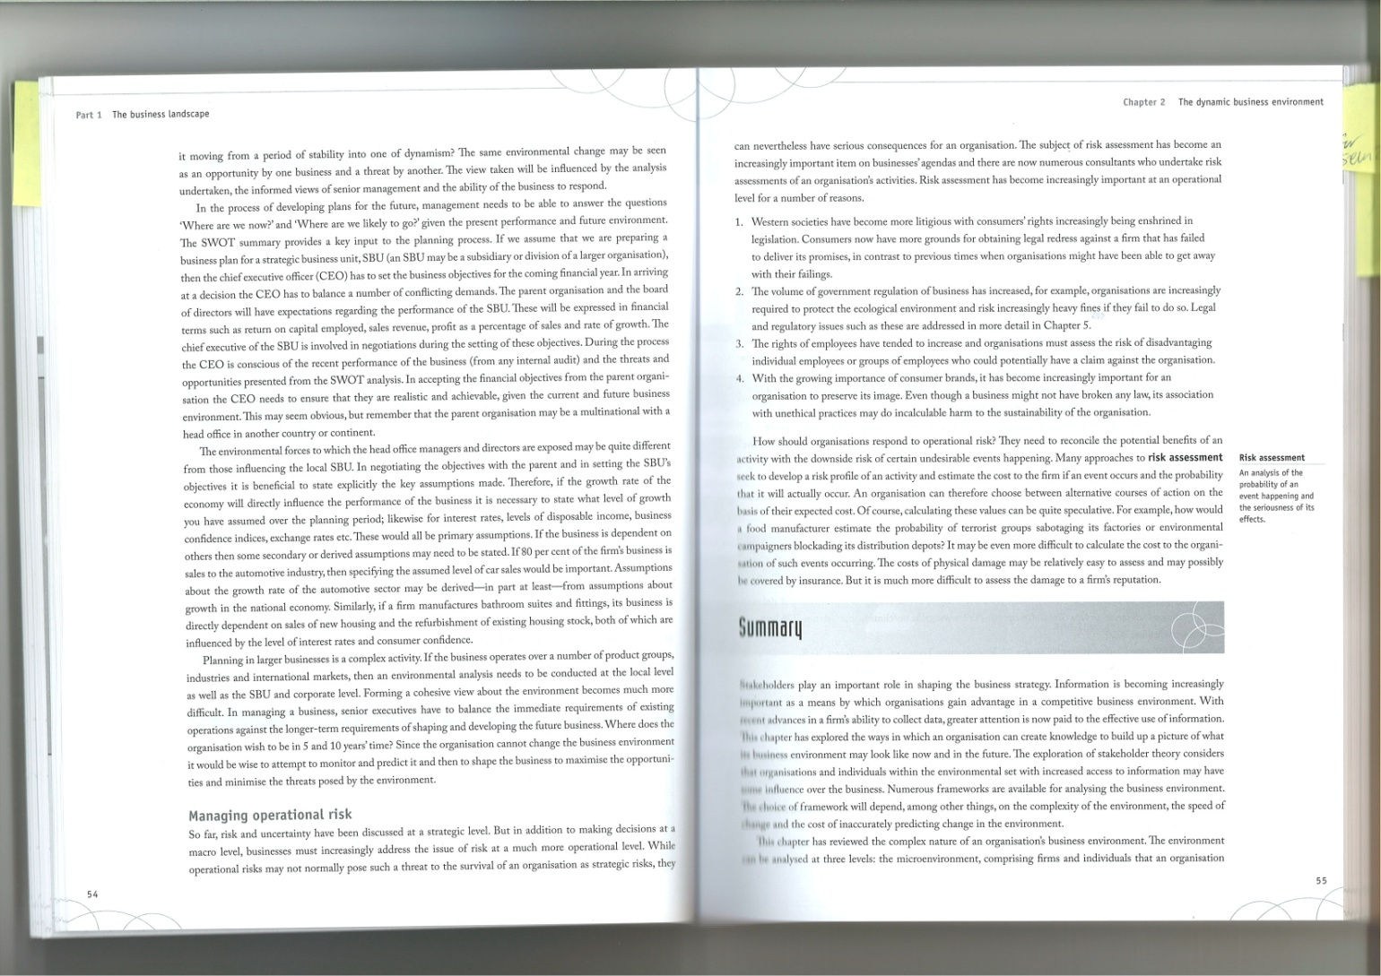
Annotating the Text
This information seems to focus only on one perspective
Useful quote here
This section disagrees with other authors I have read
This theory is the same as Smith (2017) and Allen (2019)

Slide 22
Reading Log
 | My Notes
Author’s main point/argument | Claims that regular short study sessions are more effective for learning than one long study session.

Slide 23
Reading Log
 | My Notes
Author’s main point/argument | Claims that regular short study sessions are more effective for learning than one long study session.
Supporting evidence | A study based on a sample of 100 high school students found that those who revised regularly for short periods got average grades 12.5 percent higher than those who studies the same content once for a whole day.

Slide 24
Reading Log
 | My Notes
Author’s main point/argument | Claims that regular short study sessions are more effective for learning than one long study session.
Supporting evidence | A study based on 100 high school students found that those who revised regularly for short periods got average grades 12.5 percent higher than those who studies the same content once for a whole day.
Strength/weakness of supporting evidence | + The sample size was quite large - There was not enough control over the type of study done within the study sessions

Slide 25
Organising your Notes
If they’re for weekly readings:
- Revise them within 24 hours
- Revise them again prior to the following week’s reading
If they’re for an assignment, group them according to theme (e.g. which readings have the same perspective on the topic?)
Notes:
YOUR VIEW
Do you agree or disagree with the overall message? Why?
How does this text relate to your assignment?
What are some connections you can make between ideas in this text and other texts you’ve read for this assignment?
There seems to be a lot of evidence that supports the idea that regular short study periods are an effective way of revising materials.
This article will help support my claim that studying regularly over a period of time is an effective method.
Smith (2018) and Wang (2016) did similar studies and obtained similar results, although both with smaller sample sizes. Williamson's (2013) findings contradict this study, but the students self-selected their study method, so the results are less valid.

Slide 26
Grouping your readings
Readings that support Interleaving | Readings that question the effectiveness of Interleaving

Slide 27
Grouping your readings
Readings that support Interleaving | Readings that question the effectiveness of Interleaving
Smith & Lee (2018) Exam results of 50 students were better than 50 students who didn’t. | Pizzaro (2016) Study found no statistical difference in exam results for students who used Interleaving compared with a control group.
Weston et al. (2020) Metastudy that found the majority of studies showed that Interleaving is a successful study strategy. | Wang et al. (2019) Found that Interleaving was mildly successful but far less effective than self-testing

Slide 28
SUMMARY
Be clear about your purpose for reading.
Schedule weekly reading time, set a timer and remove distractions.
Skim the text before you read to look at the structure, then scan to see what the author’s main message is.
Choose a note-taking strategy that suits you and stick with it.

Slide 29
More Resources
Online self-help resources: Reading Critically
Drop-ins & 1:1 consultations
UTS Library Services
Workshop: ‘How to Think, Read and Write Critically’
 www.helps.uts.edu.au

Slide 30
UTS HELPS
 9514 9733
 helps@uts.edu.au
 www.helps.uts.edu.au
.

