Slide 1
UTS HELPS
How to Analyse & Plan your Assignments

Slide 2
Workshop Objectives
To understand & appreciate the academic writing process
To approach academic writing from a methodical, systemic and analytical perspective
To highlight the importance of analysing assignment questions, planning, time management and research skills

Slide 3
Types of Assignments:
Essays – discuss / contrast / compare / argue
Case studies
Reports
Technical reviews
Literature reviews
Journals / Personal Experience (Reflective)
Critical Reviews
Theses

Slide 4

What is your current assignment process? Discuss.
(Chan, 2019)
Notes:
I recommend creating a Jamboard or Padlet for this exercise. However, using breakout rooms is also possible. If delivering in person, discuss in small groups.

Slide 5
Typical Academic Writing Process
PREPARE
RESEARCH
WRITE
Analyse the question
Read broadly
Choose a tentative
Position
Read narrowly
Adopt position
Plan
Draft
More research!
Refine position!
Re-position!
Redraft
Final edit

Slide 6
What lecturers really want...
If you are not sure where to start, take a look at:
UTS Business School Guide to Writing Assignments
Academic Skills Resources (UTS HELPS)

Slide 7
Why should you analyse + plan assignment questions?
It saves time
It increases your chance of a better result or grade

Slide 8
2 DAYS?
6 DAYS?
6 DAYS?
PREPARATION
Unpack and analyse the assessment task
Assignment type
Familiarise yourself with the marking criteria
HELPS drop-ins
Request for a 30-min appointment
RESEARCH & READING
Search engines? Library databases? Google Scholar?
Types of sources? Books? Journal articles? Grey literature?
Number of sources?
Read and make notes
HELPS drop-ins
Library website
WRITING
Make a skeleton plan
1st draft
2nd draft
3rd draft
4th draft
...
Edit and proofread
HELPS 30-min appointment
Online feedback
14 DAYS
Notes:
Understand the question
Brainstorm ideas
Read & research enough relevant, reliable information to answer the question properly
Structure your assignment
Present your main ideas or arguments and support your main ideas or arguments
Edit your writing for coherence and unity
Proofread for grammar, punctuation and spelling mistakes

Slide 9
Typical academic writing process
Preparation
Research
&
Reading
Writing

Slide 10

How much time should I spend on one assignment?
Source: depositphotos
Notes:
Brainstorm with the class
Ideally, two to three weeks if possible
Things to consider:
Complexity of the assignment
Other assignments
Life
Different working/reading/writing speeds of different people

Slide 11
If you had two weeks, how many days would you spend on each phase?
2 days?
6 days?
6 days?
Preparation
Research
&
Reading
Writing
14 DAYS

Slide 12
How many days would you spend on each of the following assignment phases if you had two weeks?
2 days?
6 days?
6 days?
Preparation
Research
&
Reading
Writing
14 DAYS
Notes:
The timing here is a very general estimation!
Very often you should already have notes from your classes and readings that can be used in your assignments, therefore the time required for the middle phase can vary considerably.
Another important point to factor in is procrastination time or disruption time; essentially, any unexpected or expected disruptions to your process.
If you are aiming for extra credit, always try to include sources outside your reading lists UNLESS you have been specifically told not to

Slide 13
Preparation
Work out what genre is required
  Essay?
  Report?
  Reflection?
  Annotated bibliography?
Unpack the question/assignment task
Understand the marking rubric
Brainstorm and mindmap
Ask for assistance:
  HELPS Drop-in - 15 minutes on campus; no booking
  - 30 minutes online; booking
Notes:
You may wish to remind students that this stage is a good time to ask for a consultation in advance

Slide 14
Research & Reading
Search engines? Library databases? Google Scholar?
Types of sources? Books? Journal articles? Grey literature?
Number of sources?
Read and make notes
Ask for assistance:
  HELPS Drop-in - 15 minutes on campus; no booking
  - 30 minutes online; booking
  UTS Library

Slide 15
Be a Master of Time Management!
ACTIVITY
Try these assignment planning calculators for your current topic →
https://www.student.uwa.edu.au/learning/studysmarter/assignment-calculator
Assignment Calculator (uow.edu.au)

Slide 16
Analysing the assignment question

Slide 17
Analysing the task or assignment question:
INSTRUCTION WORDS
Are usually verbs
Tell you what to do to answer the question
CONTENT WORDS
Tell you what the topic areas are
Help you focus your research
LIMITING WORDS
Narrow a broad topic
Indicate aspects to focus on

Slide 18
Unpacking the assignment question

Slide 19
Unpacking the assignment question
Discuss the factors that contribute to childhood obesity in Australia. You should use at least 5 academic sources from the last 5 years.

Slide 20
Unpacking the instruction words
Discuss the factors that contribute to childhood obesity in Australia. You should use at least 5 academic sources from the last 5 years.

Slide 21
Unpacking the content words
Discuss the factors that contribute to childhood obesity in Australia. You should use at least 5 academic sources from the last 5 years.

Slide 22
Unpacking the content words
Discuss the factors that contribute to childhood obesity in Australia. You should use at least 5 academic sources from the last 5 years.

Slide 23
Unpacking the content words
Discuss the factors that contribute to childhood obesity in Australia. You should use at least 5 academic sources from the last 5 years.

Slide 24
Unpacking the content words
Discuss the factors that contribute to childhood obesity in Australia. You should use at least 5 academic sources from the last 5 years.
TIP!
Write down some synonyms for these words. This will come in handy later

Slide 25
Unpacking the limiting words
Discuss the factors that contribute to childhood obesity in Australia. You should use at least 5 academic sources from the last 5 years.

Slide 26
Unpacking the limiting words
Discuss the factors that contribute to childhood obesity in Australia. You should use at least 5 academic sources from the last 5 years.

Slide 27
Unpacking the limiting words
Discuss the factors that contribute to childhood obesity in Australia. You should use at least 5 academic sources from the last 5 years.

Slide 28
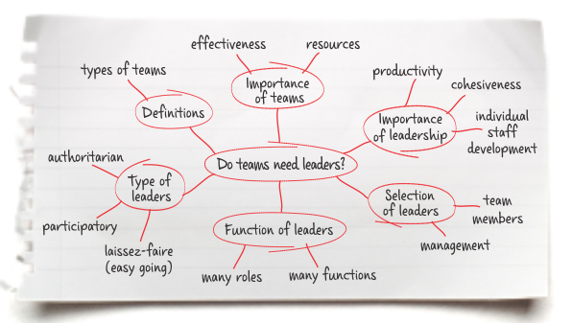
Planning
Use planning diagrams, lists, charts, sheets and/or mind maps to help you brainstorm and construct the ‘skeleton’ of your essay/assignment
Ensure you read the marking criteria carefully, as this is your ‘content’ checklist
Source: https://emedia.rmit.edu.au/learninglab/content/plan

Slide 29
Mind mapping
Topic
Sub-topic or a main idea
Sub-topic or a main idea
Sub-topic or a main idea

Slide 30
Mind mapping
Factors that lead to childhood obesity (Aus)
Sub-topic or a main idea
Sub-topic or a main idea
Sub-topic or a main idea
Notes:
Use the mind map as a checklist, ie. Make sure that each of the orange sections correspond with the main points in the question and/or marking rubric IF possible. In most cases, these main points (orange) will be individual paragraphs
In some cases, you will have to come up with your own points to support your main argument/answer.
The number of main ideas depends on:
The marking question or marking criteria
The word limit of our assignment. For example, if you only have a1500 word limit, having more than 3 or 4 points would lead to overly short paragraphs.

Slide 31
Mind mapping
Introduction AND/OR Conclusion
Factors that lead to childhood obesity (Aus)
Sub-topic or a main idea
Sub-topic or a main idea
Sub-topic or a main idea
Notes:
In some cases, depending on the question, adding one or two parts for your introduction and conclusion may be helpful in your planning
A good mind map can help:
ensure the question is being answered and the criteria is being met
maintain balance in your answer by estimating how many words to attribute to each section (put a number next to each orange circle)
clarify what you know a lot about and not enough about (by seeing how many notes you can write in each section
keep you on track by acting as a visual guide while writing (ie., stop you from waffling)

Slide 32
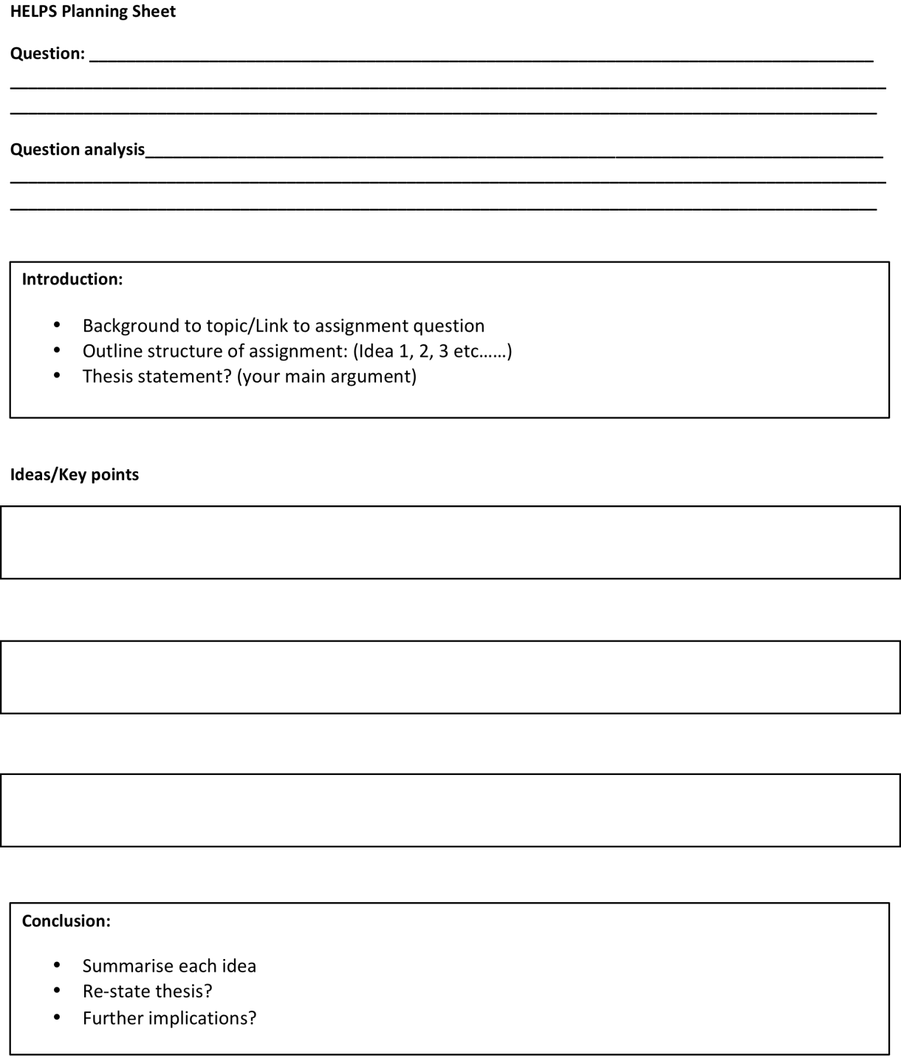
Planning Sheet
Freely available at HELPS!

Slide 33
Stage 1: Prepare to write
Analyse the task for key words
Break down the assignment question
Use the assessment criteria as a checklist
Seek clarification if necessary
  Tutor
  Lecturer
  HELPS
Make an informed choice on the material you need to research
Notes:
Analyse the task for key words – words that identify the topic or issue.
Try to break down the assignment question into a series of questions.
Use the assessment criteria as a checklist:
The marks allocated for each criterion give an indication of how much time should be spent (and therefore how much should be written) on each part of the question, and
ensure that no parts of the question are left unanswered.
Seek clarification if necessary – discuss the interpretation with your classmates, and ask your lecturer/tutor if unsure.
Knowing precisely what content is required will help you make an informed choice on the material you need to read about or research.

Slide 34
Stage 2: Research
Notes:
Read broadly to get an overall picture of the topic in question, starting with your lecture notes, subject learning guide, introductory and general texts. Keep the assignment question in mind while you read.
Formulate a tentative position once you have an overall understanding of the topic, then focus on more detailed texts and your 'possible line of argument'.
Focus your reading to validate your adopted tentative position. Search for texts that detail the issues you have identified as part of the overall picture by referring to the reading list in your subject outline, the reference lists in the introductory/general texts and relevant journal articles, and the library catalogue and databases.
Commit to a position to keep your writing focused, logical and coherent.

Slide 35
Do the Research

Slide 36
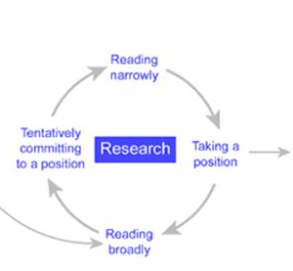
How to Research:
Develop search keywords
What types of information do you need?
Start exploring
Repeat as necessary
Notes:
Read broadly to get an overall picture of the topic in question, starting with your lecture notes, subject learning guide, introductory and general texts. Keep the assignment question in mind while you read.
Formulate a tentative position once you have an overall understanding of the topic, then focus on more detailed texts and your 'possible line of argument'.
Focus your reading to validate your adopted tentative position. Search for texts that detail the issues you have identified as part of the overall picture by referring to the reading list in your subject outline, the reference lists in the introductory/general texts and relevant journal articles, and the library catalogue and databases.
Commit to a position to keep your writing focused, logical and coherent.

Slide 37
Use Boolean Operators
In the library search bar, use the following Boolean Operators to make your search more accurate:
OR
AND
NOT
( )
“ “

Slide 38
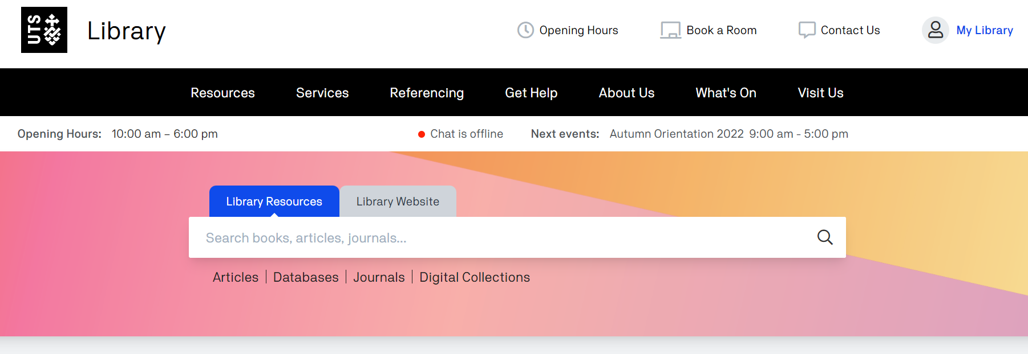
How to use Boolean Operators
Discuss the factors that contribute to childhood obesity in Australia. You should use at least 5 academic sources from the last 5 years.
Notes:
Do not type the entire question in the search bar as this may generate too many hits

Slide 39
How to use Boolean Operators
Discuss the factors that contribute to childhood obesity in Australia. You should use at least 5 academic sources from the last 5 years.
(causes OR contributors) AND (childhood OR youth) AND obesity
Notes:
Do not type the entire question in the search bar as this may generate too many hits

Slide 40
How to use Boolean Operators
Discuss the factors that contribute to childhood obesity in Australia. You should use at least 5 academic sources from the last 5 years.
(causes OR contributors) AND (childhood OR youth) AND obesity AND Australia
Notes:
Notice that synonyms are used to cover more possible hits
Notice how the parentheses are used to separate search groups

Slide 41
How to use Boolean Operators
Discuss the factors that contribute to childhood obesity in Australia. You should use at least 5 academic sources from the last 5 years.
(causes OR contributors) AND (“childhood obesity” OR “obesity in youth”) AND Australia
Notes:
Another example
How to use “ “
Note:
Double or single quotation marks do not really matter in the UTS search engine. This may differ with other search engines such as Google Scholar (Boolean Operators as a whole still works)

Slide 42
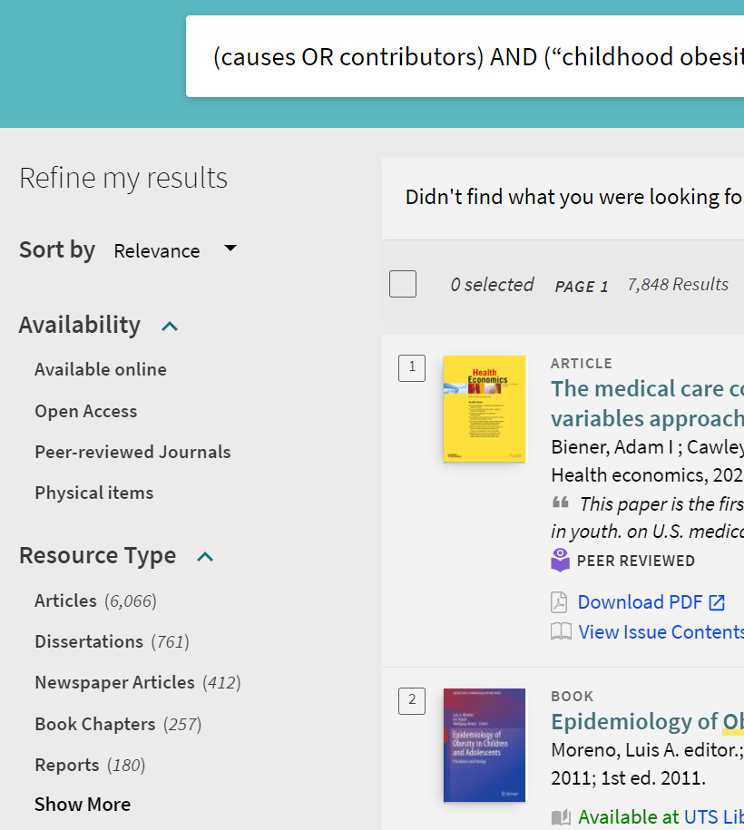
Consider narrowing down your search
Highest quality
Notes:
This can be found on the left hand side.
Check boxes will appear when you hover the mouse cursor over the respective options

Slide 43
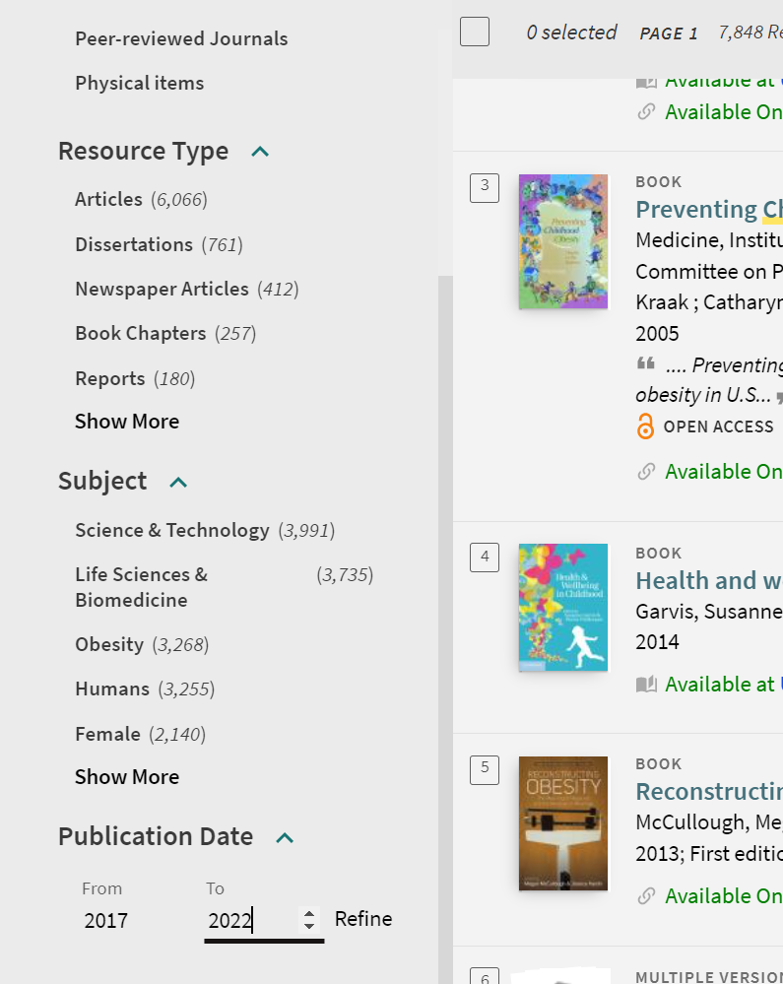
How to limit publication date
Discuss the factors that contribute to childhood obesity in Australia. You should use at least 5 academic sources from the last 5 years
Hit!

Slide 44
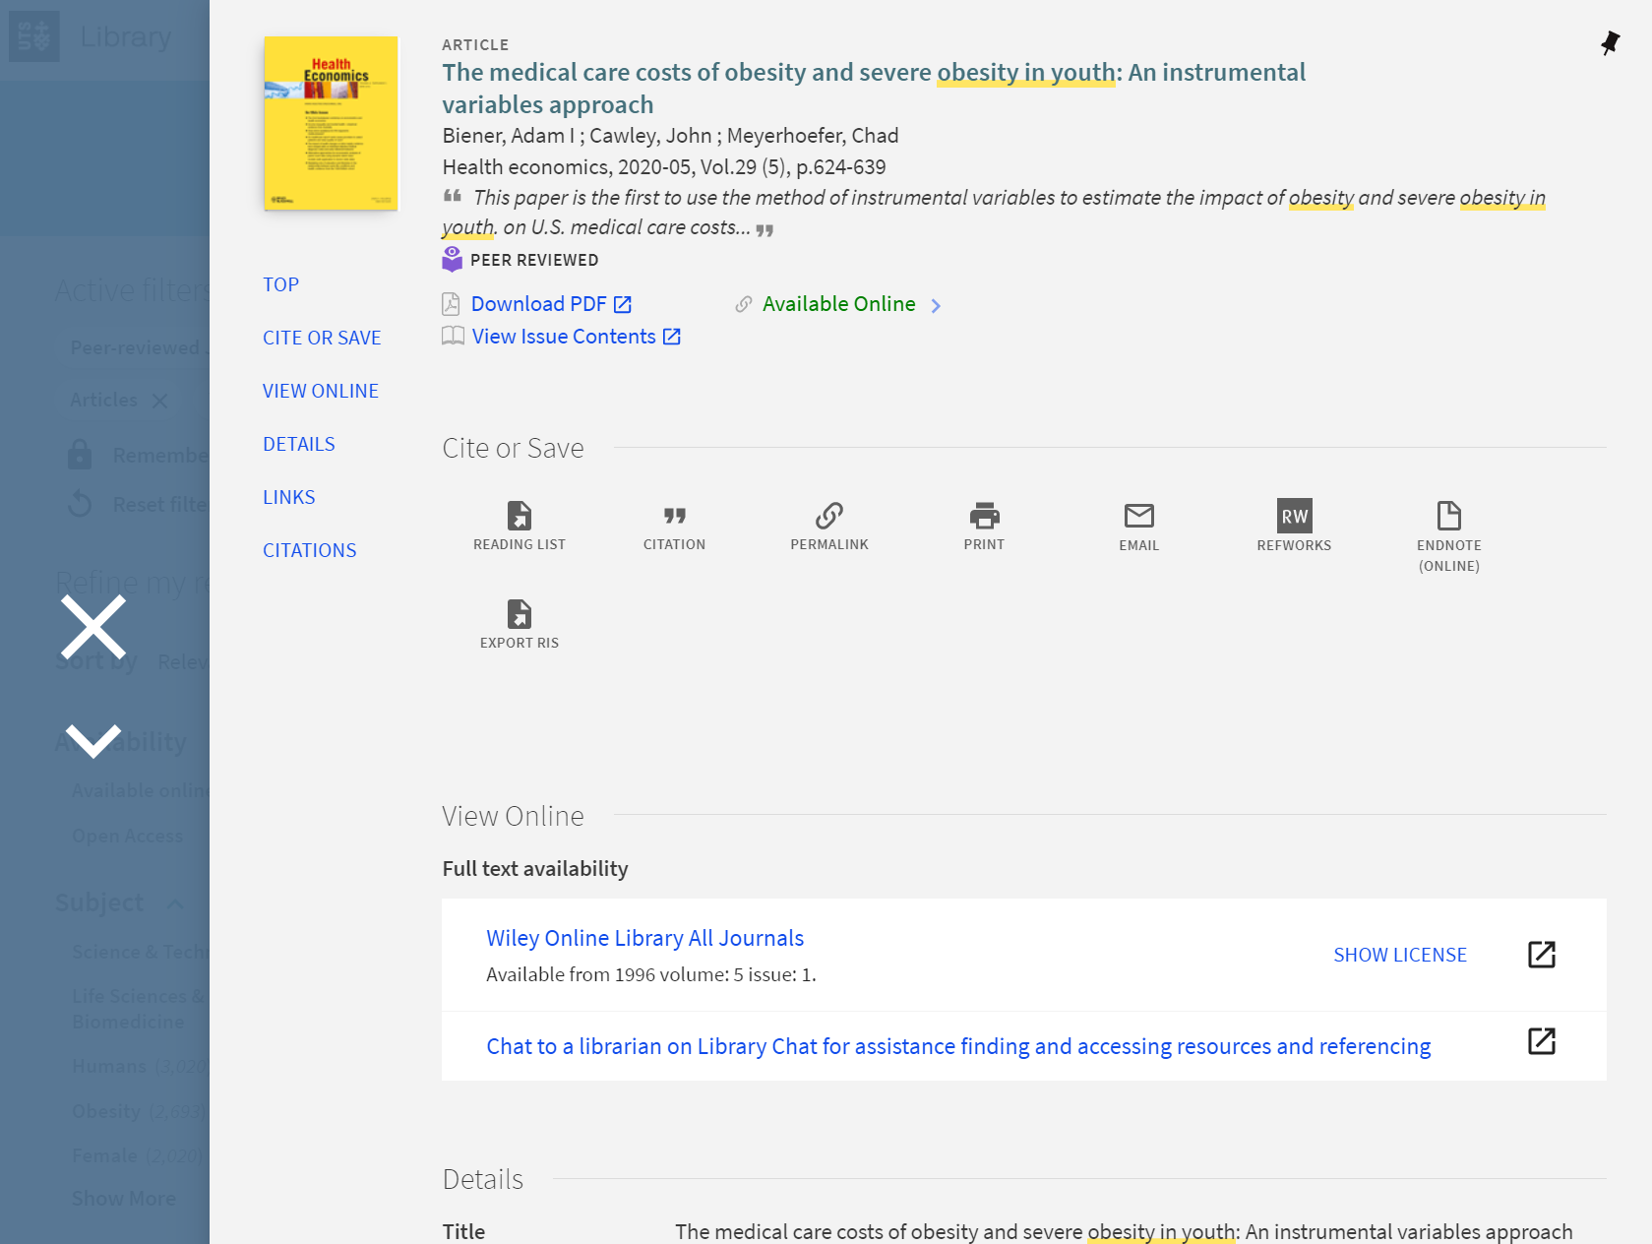
Create a shortlist
Reading stage 1
  Only read the summary
  If it looks good hit this
  Press next
  Repeat

Slide 45
Create a shortlist
Reading stage 1
  Only read the summary
  If it looks good hit this
  Press next
  Repeat
  When done press

Slide 46
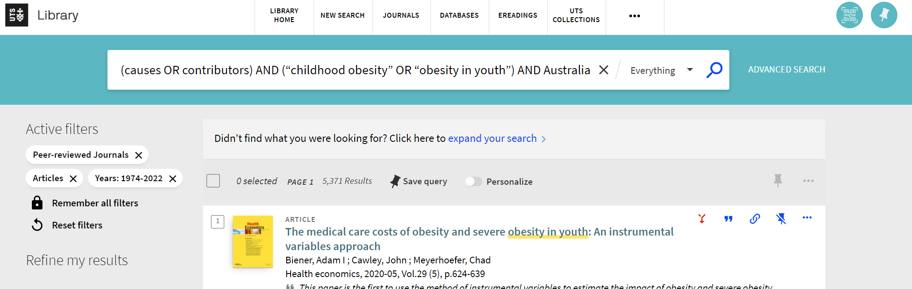
Access your shortlist here

Slide 47
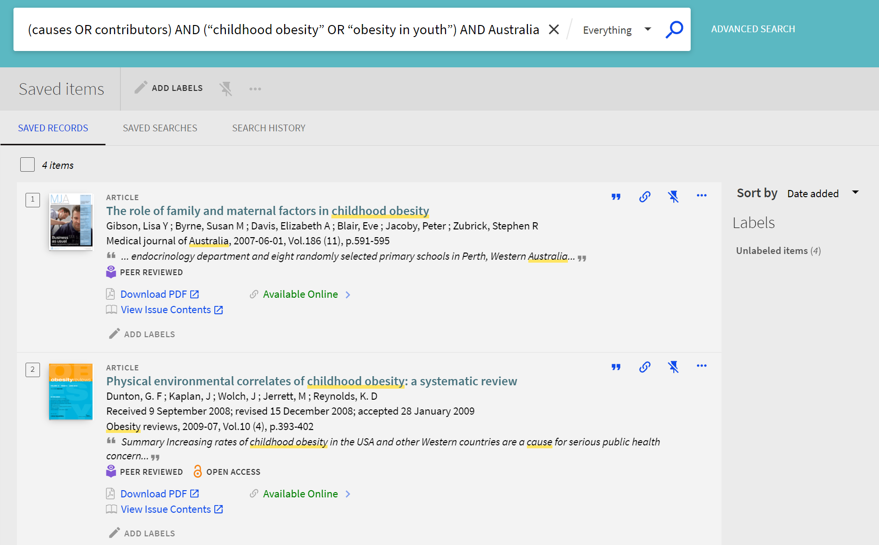
Your shortlist
Reading stage 2
Access each item individually
Read just the introduction OR conclusion OR discussion
Remove if not relevant to your paper
Repeat

Slide 48
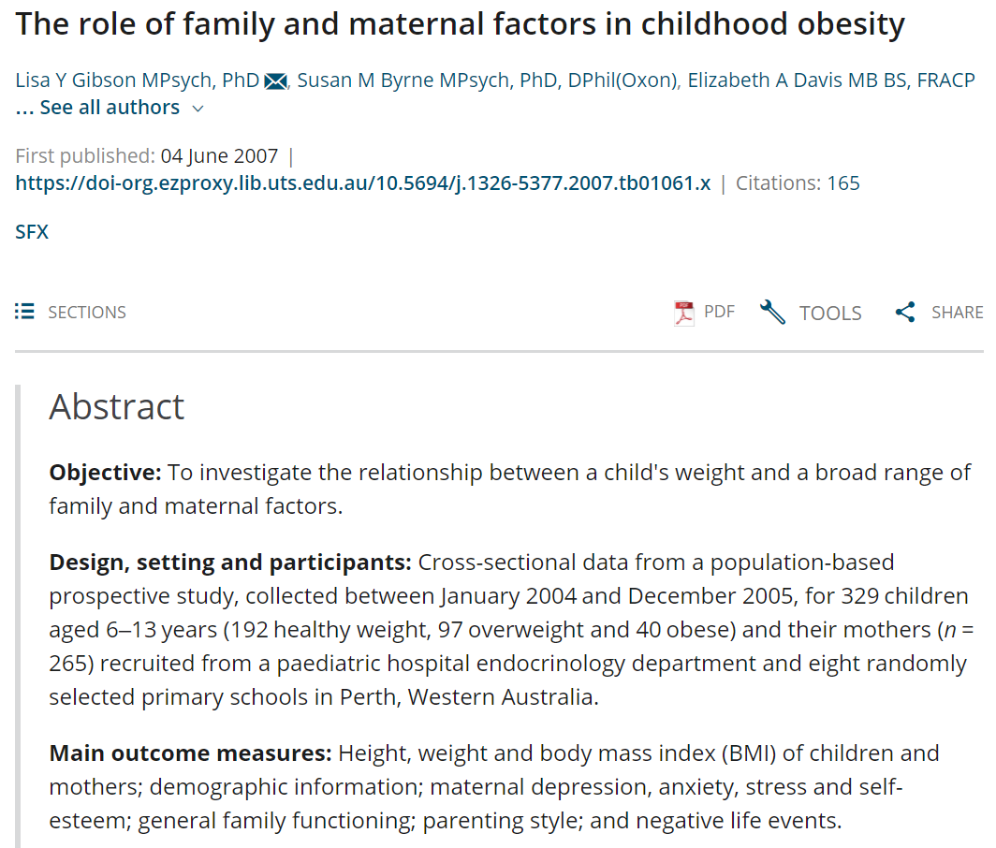
Your shortlist
Reading stage 3
Read each item more thoroughly
Not always necessary to read entire paper

Slide 49
Planning your research
Focus on the relevant information you need
Be selective
Be a critical reader. Use these 5 criteria:
→ authority, accuracy, currency, coverage & objectivity
Use only relevant & reliable information
Ask yourself ‘how will I use this information?’

Slide 50
Reflect on your research
Once you have the relevant information:
What have you discovered and learnt?
How does your new knowledge help your understanding?
What arguments or evidence have you discovered?
How have your ideas/opinions been influenced?
Do you now have a clearer understanding of the task ahead?
Could it help to form your central argument?
Can you use it as evidence?
Will it help you locate other information?

Slide 51
Start Writing

Slide 52
Stage 3: Writing
Plan (use your mind map!)
Draft and redraft (check your mind map!)
Edit
Notes:
Plan ➔ organise your argument and evidence, and establish connections between your points. You may not need a detailed plan prior to writing a draft (a list of headings and sub-headings may suffice). It is essential to have a plan prior to writing as it provides an overview of what your assignment will cover, guides you along the way, and ensures that nothing is left uncovered.
2. Draft and redraft ➔ start writing the first draft. You will probably find that you need to redraft your writing several times. In the process of drafting and redrafting, you may find that you need to do more research or reading in a particular area in order to strengthen an argument or evidence in your assignment.
3. Edit ➔ after you have completed the final draft, leave it for at least a day before you do the final editing. Check for structural, grammatical and technical aspects.

Slide 53
Extra Activity

Slide 54
Activity: What do these task words really mean?
Justify
Contrast
Evaluate
Analyse
Prove
Discuss
Criticise
Define
Summarise
Describe
Explain
Compare

Slide 55
What do these task words really mean? ANSWERS
Justify: | Express valid reasons for accepting a particular interpretation or conclusion, probably including the need to ‘argue’ a case.
Criticise: | Spell out your judgement as to the value or truth of something, indicating the criteria on which you base your judgement and citing specific instances of how the criteria apply in this case.
Contrast: | Point out the difference between two things (but probably point out their similarities as well).
Define: | Make a statement as to the meaning or interpretation of something, giving sufficient details as to allow it to be distinguished from similar things.
Evaluate: | Make an appraisal or the worth of something, in the light of its apparent truth; include your personal opinion.
Summarise: | ‘State’ the main features of an argument, omitting all superfluous detail and side-issues.
Source: https://student.unsw.edu.au/glossary-task-words

Slide 56
What do these task words really mean? ANSWERS
Analyse: | Break an issue down into its component parts, discuss them and show how they interrelate.
Describe: | Spell out the main aspects of an idea or topic or the sequence in which a series of things happened.
Prove: | Demonstrate the truth of something by offering irrefutable evidence and/or logical sequence of statements leading from evidence to conclusion.
Explain: | Tell how things work or how they came to be the way they are, including perhaps some need to ‘describe’ and to ‘analyse’.
Discuss: | Investigate or examine by argument. Examine key points and possible interpretations, sift and debate, giving reasons for and against. Draw a conclusion.
Compare: | Identify the characteristics or qualities two or more things have in common (but probably pointing out their differences as well).
Source: https://student.unsw.edu.au/glossary-task-words

Slide 57
Clarify the Assignment Type

Slide 58

Conducting Research
UTS Library Website:
Studyguides
Getting started
Library chat and FAQs

Slide 59
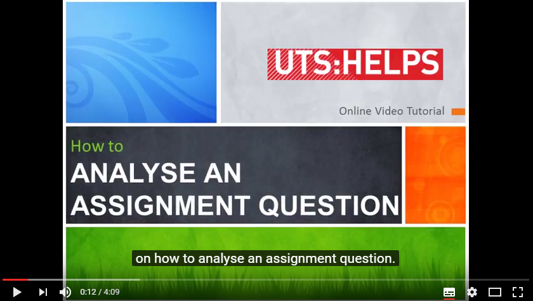
Easy steps to writing an assignment
Let’s take a look at some useful advice and watch a screencast...
http://www.uts.edu.au/current-students/support/
helps/self-help-resources/academic-writing/easy-steps-writing-essay

Slide 60
What can you do if you don’t understand what the assignment question is asking you?
Ask in class
Go see your lecturer personally (take a draft)
Go see another member of faculty
Ask peers/classmates
Email your lecturer for help
See a HELPS advisor (drop-in consultation)
ALWAYS seek help if you need it!

Slide 61
Discover these!
Online self-help learning resources
Drop-in & 1:1 consultations
Conversations@UTS
Intensive Academic English Programmes
Daily Workshops
Volunteer Programmes
 www.helps.uts.edu.au

Slide 62
Thank you

Slide 63
References
Brian, A. J. (n.d.). [Hour glass and calendar concept for time slipping away] [Stock Image]. Depositphotos. https://depositphotos.com/stock-photos/blue-hour.html
Chan, C. (2019, May 03). [Let Us Discuss Speech Bubble Isolated On Blue Background stock photo] [Stock Image]. https://www.istockphoto.com/photo/let-us-discuss- speech-bubble-isolated-on-blue-background-gm1146135500-308738241

Slide 64
UTS HELPS
 9514 9733
 helps@uts.edu.au
 www.helps.uts.edu.au
.

