Slide 1
UTS HELPS
Common Problems with Sentence Structure

Slide 2
Workshop Objectives
1. To examine common problems in academic writing.
2. To analyse possible solutions to these problems.

Slide 3
Discussion
What do you find most difficult about academic writing?

Slide 4
The main reasons students make mistakes in academic writing
Unclear meaning from trying too hard to write in an academic style.
Complex grammatical structures lead to errors with punctuation and sentence structure.
Not enough time spent drafting and proofreading.
Notes:
Trying so hard to write in an academic style that the meaning becomes unclear.
Academic writing uses a unique form of grammar to enable you to concisely describe and evaluate concepts and ideas.
Academic writing frequently uses complex sentences, which leads to errors with punctuation and sentence structure.
Lack of time management means not enough time for drafting or proofreading the assignment.

Slide 5
Sentence types
Simple sentences = one independent clause
e.g. Product awareness is strong.
Compound sentences = more than one independent clause
e.g. Product awareness is strong, but sales are lower than expected.
Complex sentences = an independent clause and a dependent clause
e.g. Although product awareness is strong, sales are lower than expected.
Notes:
It is at the Advisor’s discretion whether they think it is worth reminding students of the 3 basic sentence types (and of course the 4th, which is a mixture of compound and complex).

Slide 6
#1
Common problem number 1:
Unclear meaning

Slide 7
Unclear meaning
Long and complicated sentences:
The colonial forces have for many decades forced, via various and sometimes unintended means, the outright assimilation of the Aboriginal peoples which has a tendency to in many ways violate the subjectivity of Aboriginal peoples by obliterating any trace of their different ontological and epistemological existences.
Notes:
‘Ontological’ and ‘epistemological’ are words that are important within the social sciences, and are not “wrong” in this sentence. But does the student actually understand what they mean? The teacher wants you to demonstrate your understanding of the topic, not your ability to use lots of big words. It would be better here to use simpler terms, or explain in plain language what these words mean (even if it means giving a quote from a dictionary).
But the sentence is still too long and difficult for the reader to follow.

Slide 8
Solution
Break it into two sentences.
2. Simplify the language.
For many decades, colonial forces have used various means to assimilate Aboriginal people. This has violated the subjectivity of Aboriginal people, causing them to lose their cultural knowledge and understanding of the world around them.
For many decades, colonial forces have used various means to assimilate Aboriginal people.
Notes:
Breaking this sentence into two separate sentences reduces the reader’s cognitive load (i.e. it means they don’t have to hold so much information in their short term memory by keeping the first half of a long sentence in their memory while they’re reading the second half of the sentence).
The language here is still sufficiently academic, but considerably easier for a non-specialist to understand.

Slide 9
ACTIVITY
Simplify the following sentence:
Pedagogically proven approaches to learning, based on solid evidence gathered by a variety of means, have tended to be subsumed by unproven and potentially ineffective innovations in the rush to embrace technology, especially during the abrupt switch to online-only learning brought about by COVID-19.
Notes:
This sentence is grammatically correct, but quite hard for the reader to follow. How might you simplify this to make it easier for readers to comprehend?

Slide 10
Example Answer
COVID-19 led to a sudden switch to online learning. This meant that innovative technologies were sometimes introduced despite a lack of evidence to prove their effectiveness for learning.
Notes:
This is just one example. There are many other ways that you could have simplified the sentence. The important thing to keep in mind is that your main job as an academic writer is to ensure that your meaning is clear.
If you have good ideas/arguments, supported by strong evidence and expressed them clearly, then you have done your job well. If the reader struggles to follow your meaning, and therefore isn’t sure whether your ideas or arguments are good or not, then you have a problem.

Slide 11
Unclear meaning
Unclear use of pronouns:
The colonial forces have for many decades forced the assimilation of the Indigenous people which makes them guilty of moral and ethical misconduct and has caused them to lose their connection to the land.
Notes:
A second common problem relating to unclear meaning is misuse of pronouns

Slide 12
Unclear meaning
The colonial forces have for many decades forced the assimilation of the Indigenous people which makes them guilty of moral and ethical misconduct and has caused them to lose their connection to the land.
Notes:
A second common problem relating to unclear meaning is misuse of pronouns

Slide 13
Solution
Don’t overuse pronouns.
2. Consider separating your sentences.
The colonial forces have for many decades forced the outright assimilation of the Aboriginal peoples. This means colonialists are guilty of moral and ethical misconduct which has caused Aboriginal people to lose their connection to the land.
Notes:
Separating this into two sentences, and removing some of the pronouns, has made the meaning clearer in two ways:
The reader knows exactly which group of people are being referred to in each situation.
Removing one of the times the word ‘which’ was used reduces confusion in the cause and effect relationships being described.

Slide 14
Common problem number 2:
Grammar errors caused by long noun groups
#2

Slide 15
Complicated sentences: Nominalisation
Research is useful.
Source: flickr.com
Notes:
This is about as simple a sentence as you can write in English. It’s very clear what the verb is and which subject the verb matches.

Slide 16
Complicated sentences: Nominalisation
Innovative action research is useful.
Notes:
The noun group is getting slightly longer as we more specifically describe the research being referred to, but the verb still sits immediately after the noun that it matches.

Slide 17
Complicated sentences: Nominalisation
Innovative action research based on a clear theoretical framework is useful.
Notes:
This is where things get complicated. The noun group has suddenly become considerably longer in an attempt to be as accurate as possible in our description of the subject. In doing so, the verb (‘is’) has become separated from the subject that it matches (‘research’).

Slide 18
Complicated sentences: Nominalisation
Innovative action research based on a clear theoretical framework is useful for discovering better approaches to online learning.
Notes:
We can make the sentence even more descriptive by explaining why this type of research is useful, although this doesn’t cause subject/verb errors because this information comes after the verb.
The trick with academic writing is to find the balance between being as precise and descriptive as possible, while still keeping our meaning clear by not overcomplicating our sentences.
NB: Sometimes punctuation can easily improve sentence readability. For example, the insertion of commas around dependent clauses: "Innovative action research, based on a clear theoretical framework, is useful for discovering better approaches to online learning.

Slide 19
The most common error with nominalisation
The most useful invention from the many innovations of the last five decades are undoubtedly the internet.
What is wrong with this sentence?
Notes:
What is wrong with this sentence?

Slide 20
The most common error with nominalisation
The most useful invention from the many innovations of the last five decades is undoubtedly the internet.
Notes:
The verb is in the wrong form (i.e. it doesn’t “agree” with the noun that it’s supposed to be matching.)
Why is this mistake so common in academic writing? When students use nominalisation to pack a lot of description into the noun group, they often forget which noun their verb is supposed to match. In this case, the student probably saw the word “decades” immediately before the verb, and chose the verb form based on that. However, the verb is actually matching the subject “invention”, which is singular. So the verb should be “is” rather than “are”.
Solution: When you write sentences with a long noun group at the beginning, look at your verb and then go back and match it with its subject – make sure they “agree”.

Slide 21
#3
Common problem number 3:
Sentence fragments

Slide 22
Complex sentences
Based on the evidence that is available from 20 years of research into online learning.
What is wrong with this sentence?
Notes:
This is called a sentence fragment because it’s not a complete sentence.
It usually happens with complex sentences, which is a sentence that has one clause that depends on another clause to become a grammatically correct sentence.

Slide 23
It is a sentence fragment
Based on the evidence that is available from 20 years of research into online learning,
we know that interaction with peers and teachers is the key to successful completion of studies.
Notes:
The first half of this sentence is a ‘dependent clause’, which means it is dependent on the second clause to have meaning.
Complex sentences like this are common in academic writing because we are frequently describing the relationships between different concepts. The most common relations being described are…… (see following slides)

Slide 24
Complex sentences – cause and effect
because of, due to, as a result of, since
As a result of the coronavirus lockdown, government debt has increased dramatically.
Source: www.vperemen.com
Notes:
Regardless of the discipline or the assignment type, cause and effect relationships are one of the most commonly described phenomenon as we look to explain how and why things happen the way they do. Therefore, we frequently use these sentence structures to describe cause and effect.

Slide 25
Complex sentences – contrast
despite, unlike, in spite of, although
Unlike the first wave of coronavirus, the second wave has not lead to panic buying of essential grocery items.
Source: Wikimedia Commons
Notes:
Similarly, when analysing events, theories or concepts, we frequently seek to explain how they are similar or different (and what implications that might have). A sentence like this might be followed by a sentence describing the possible cause of the phenomenon being described (i.e. why has people’s behaviour changed)?

Slide 26
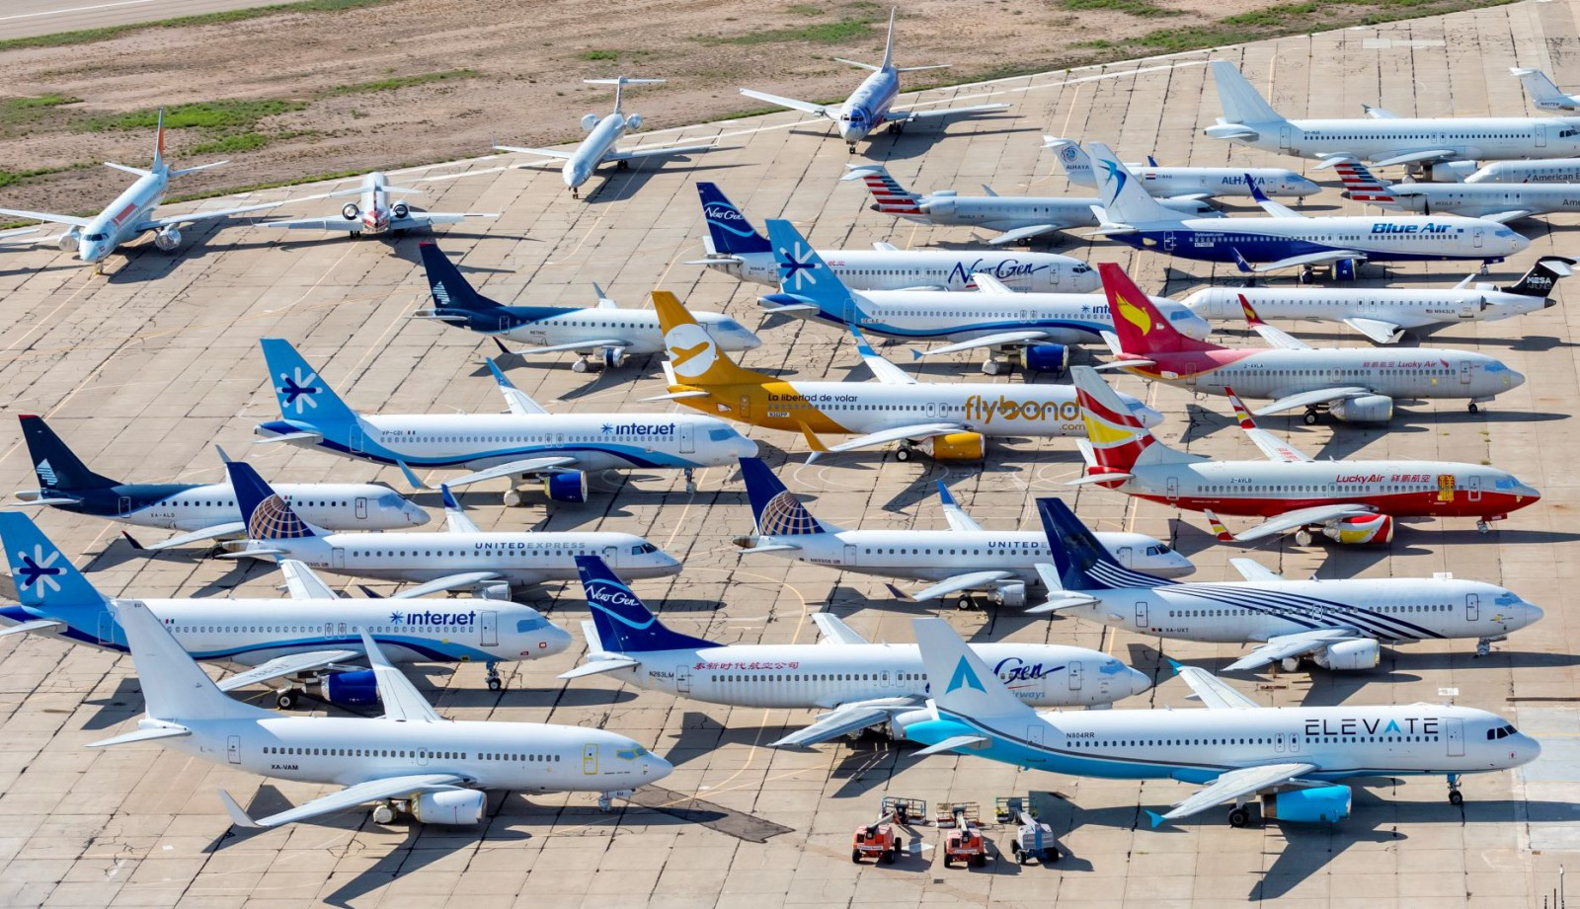
Complex sentences – time sequence
since, during, while, for, before, after
Since the pandemic started, some industries have thrived while others have suffered considerably.
Source: Wikimedia Commons
Source: Wikimedia Commons
Notes:
Time sequences are commonly used when discussing historical events (as is common for case studies in Business and Law) or research procedures (as is common in Science and Engineering).

Slide 27
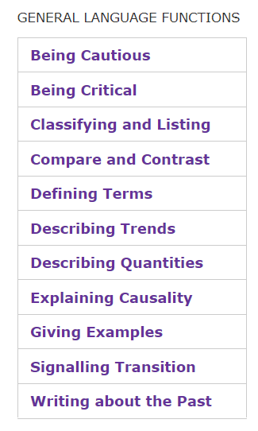
Check out the Academic Phrasebank
Useful phrases for common functions in academic writing.
Notes:
Show students the website, including a couple of examples from various functions e.g. Compare and contrast; Being critical; Signalling transition

Slide 28
#4
Common problem number 4:
Inconsistent verb tense

Slide 29
We usually use present tense to discuss:
facts and general ideas or arguments
e.g. Globalisation is an interconnected set of processes.
research findings or claims from literature
e.g. Smith (2016) claims that technological innovation creates both winners and losers.

Slide 30
We usually use past tense to discuss:
historical events
e.g. The global financial crisis was caused by insufficient oversight of the banking sector.
descriptions of research procedures
e.g. A survey was conducted to gather feedback on students’ views of online learning.

Slide 31
Activity: choose the correct verb tense
1. The liquid is / was heated to 100 degrees celsius.
2. Social media was / is essential to business success.
3. Smith (2020) states / stated that students with good organisational skills are less stressed.
4. Google is not / was not initially the most popular search engine.
Notes:
NB: Sentence #1 could be written in present or past tense depending on the context. If these are instructions for someone else to follow, it would be written in present tense. If it is describing the process used in your experiment, past tense would be used.

Slide 32
ANSWERS
1. The liquid was heated to 100 degrees celsius. – a procedure
2. Social media is essential to business success. – a general idea
3. Smith (2020) states that students with good organisational skills are less stressed. – reference to literature
4. Google was not initially the most popular search engine. – historical event
Notes:
NB: Sentence #1 could be written in present or past tense depending on the context. If these are instructions for someone else to follow, it would be written in present tense. If it is describing the process used in your experiment, past tense would be used.

Slide 33
Tips for proofreading
1. Allow at least 24 hours between drafting and proofreading.
2. Read your work out loud.
Notes:
This gives you time to look at it with fresh eyes. Otherwise your brain will auto-correct because it will read what you were trying to write rather than what you actually wrote.
This slows down your reading and makes it more likely you will notice errors.

Slide 34
Questions?

Slide 35
UTS HELPS
 9514 9733
 helps@uts.edu.au
 www.helps.uts.edu.au
.

