Slide 1
UTS HELPS
Avoiding Plagiarism

Slide 2
Workshop Objectives
Understand the meaning of plagiarism, and why it is to be avoided
Evaluate a variety of scenarios to decide if they can be considered as plagiarism
Review ways to avoid plagiarism

Slide 3
What is academic Integrity?
Requires correct referencing and summarising/paraphrasing of the information you read, which results in:
Trust between students, academic staff, examiners, and the general public;
Continued value of the institution’s reputation and the courses they offer.
Notes:
➔ involves trust between students, academic staff and examiners
➔ helps to continue the value of an institution’s reputation and the value of a degree or credentials
➔ demands personal integrity and respect for scholarship
➔ requires correct referencing techniques to acknowledge the original source of your information

Slide 4
What is plagiarism?
No acknowledgement of the author or its source
Deliberate cheating, or copying and pasting
A type of student misconduct
Results in serious consequences
Notes:
➔ presenting someone else’s work in any format as your own original work without appropriate acknowledgement of the author or its source
➔ can also be deliberate cheating or copying and pasting from sources without correct acknowledgement
➔ is a type of student misconduct and a breach of academic integrity
➔ can result in failing the assessment task, failing the subject and/or being excluded from the university

Slide 5
Notes:
You’d rather not be one of the students at the centre of these headlines!

Slide 6
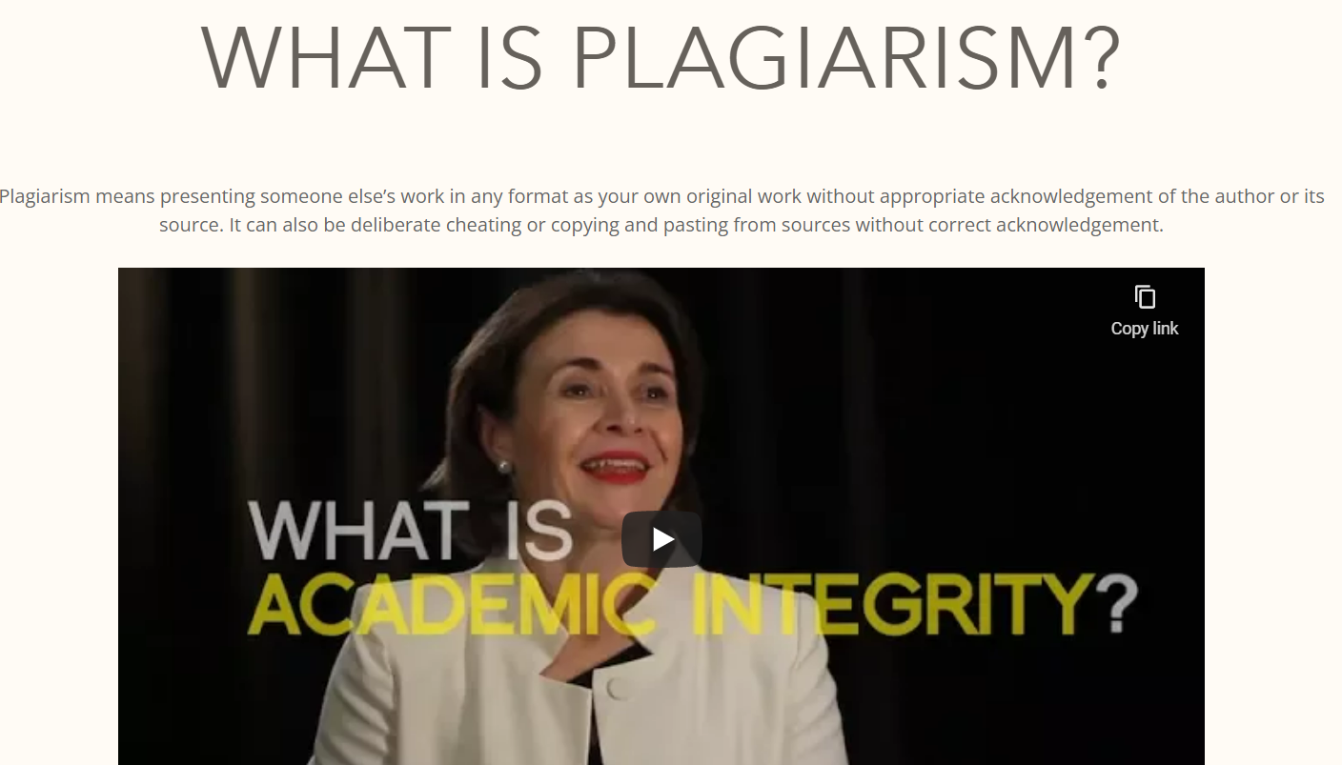
Let's Look at the Avoiding Plagiarism Tutorial
Notes:
Click on the image on the slide to go to the webpage.
https://avoidingplagiarism.uts.edu.au

Slide 7
What should you do instead of copying information?
Paraphrase, summarise, or quote the information.
Visit HELPS to learn more about these!
Notes:
HELPS offers workshops on paraphrasing and summarising, has a range of online resources around avoiding plagiarism, and offers consultations where you can get feedback on aspects of your draft such as citation and referencing, use of evidence to support your argument, and effectiveness of paraphrasing and summarising.

Slide 8
How do you acknowledge a source?
Two elements must be included:
In-text citation or footnote (depending on your referencing style)
A reference list.
Visit HELPS to learn more about these!

Slide 9
Activity
Read the following scenarios and decide if they are examples of plagiarism.
Notes:
Alternatively, you could go straight to the Avoiding Plagiarism tutorial and use some example scenarios from there: https://avoidingplagiarism.uts.edu.au/#

Slide 10
Is this an example of plagiarism?
Directly or indirectly copying out part(s) of any document without acknowledging the source.
Yes.
Q: How can plagiarism be avoided?
A: Acknowledge the source/s and paraphrase/summarise the information.
Notes:
Directly or indirectly copying out part(s) of any document without acknowledging the source.
Yes.

Slide 11
Is this an example of plagiarism?
Buying or acquiring an assignment written by someone else on your behalf.
Yes.
Q: How can plagiarism be avoided?
A: The student needs to write the assignment themselves.
Notes:
Buying or acquiring an assignment written by someone else on your behalf.
Yes.

Slide 12
Is this an example of plagiarism?
Discussing an assignment with classmates.
No.
Q: What needs to be done to make sure that plagiarism still doesn’t happen?
A: Each student should write their assignment separately after the brainstorming stage.
Notes:
Brainstorming ideas with classmates.
No.

Slide 13
Is this an example of plagiarism?
Writing an assignment together with another student on an assignment intended for individual submission.
Yes.
Q: How can plagiarism be avoided?
A: The students can discuss their ideas about the topic but should always write their own assignments separately (unless it’s a group assignment).
Notes:
Working together with another student on an assignment intended for individual submission, and then submitting work which is similar in content and language.
Yes.

Slide 14
Is this an example of plagiarism?
Allowing another person to submit your work as their own.
Yes.
Q: How can plagiarism be avoided?
A: The student should not give their work to another student for submission.
Notes:
Allowing another person to submit your work as their own.
Yes.

Slide 15
True or False?
If your classmate is caught for plagiarism because they’ve submitted your assignment, only your classmate will be punished.
False. Both of you will be punished.
Notes:
If your classmate is caught for plagiarism because they’ve submitted your assignment, only your classmate will be punished.
False. Both of you will be punished.

Slide 16
Is this an example of plagiarism?
Asking a trusted classmate to read your assignment to see if it ‘makes sense’.
It depends. A classmate could give you general feedback about whether the structure of your assignment is clear, but showing your assignment to a classmate always runs a risk that they may decide to copy parts of your assignment.
Q: What should these students do to make sure plagiarism doesn’t happen?
A: Go to HELPS to get feedback on your writing! ☺
Notes:
Asking a trusted classmate to read your assignment to see if it ‘makes sense’.
No.

Slide 17
What would you do?
A classmate has contacted you in a panic: they want to look at your assignment ‘to get ideas’ for the essay due in two days time. They’ve admitted they haven’t started.
Do you share your assignment with this person?
No! Refer them to your tutor for assistance, or HELPS.
Notes:
No! Refer them to your tutor for assistance, or HELPS.

Slide 18
The most important message:
Learn to paraphrase, cite and reference appropriately your work so that you avoid plagiarism.

Slide 19
References
Higher Education Language and Presentation Support (2016). What is plagiarism? University of Technology Sydney.
http://www.uts.edu.au/current-students/support/helps/self-help-resources/referencing-and-plagiarism/what-plagiarism
University of Technology Sydney (2016), Advice to students on good academic practice. University of Technology Sydney.
http://www.gsu.uts.edu.au/policies/academicpractice.html

Slide 20
Discover these!
Online self-help learning resources
Drop-in & 1:1 consultations
Conversations@UTS
Intensive Academic English Programmes
Daily Workshops
Volunteer Programmes
 www.helps.uts.edu.au

Slide 21
UTS HELPS
 9514 9733
 helps@uts.edu.au
 www.helps.uts.edu.au
.

