Slide 1
UTS HELPS
How to Give an
Excellent Presentation

Slide 2
Workshop Objectives
Advice for controlling nerves
The reasons for presentation assessments
How to plan, prepare and structure an oral presentation
Appropriate use of visual aids
Thinking about, and interacting with, your audience
Use of body language

Slide 3
Discuss
Have you given a presentation at university? If so, how did it go?
What’s the purpose of your next presentation assignment?

Slide 4
Discuss: feelings
Is standing in front of a group of people and delivering a presentation one of your biggest challenges at university?
Do you feel your audience switches off whenever you present something?

Slide 5
TOP TEN FEARS
http://www.selfhelpcollective.com/top-10-fears.html
Notes:
People are more scared of public speaking (#2) than of dying (#6)!!!

Slide 6
Tips for helping with nerves
Adrenalin
Be organised
Smile
Treat audience as friends
Breathe deeply
Slow down & use pauses
Practise
HELPS
Notes:
The first few times you make a presentation, you will be nervous. That's quite a good thing—a bit of adrenalin often helps you to perform well.
Be organised. If you are well organised, your task will be easier. If you are disorganised, you may get flustered.
Smile! Your audience will react warmly to you if you smile and at least look relaxed. performance—you have to be like an actor. If you act the part of someone enjoying themselves and feeling confident
Treat your audience like friends.
Breathe deeply. It will calm you down and help to control the slight shaking that you might get in your hands and your voice.
Slow down and make use of pauses: force yourself to stop at the end of a sentence, take a breath, and think before you continue.
Be well-prepared. Practise giving your talk.
*You can ask one of the HELPS Advisors to listen to your presentation

Slide 7
Activity: Discussion & Presentation
Why do we have to give presentations?
What is the organisational/preparation process before giving a presentation?
What visual aids can be used in a presentation? What are some “dos and don’ts” when using these aids?
What makes a good presenter?
Make four groups (or eight).
Each group will discuss one question.
Write your ideas on a big piece of paper.
In groups, present your ideas to the whole class.
After presenting, view the following slides and compare with your ideas.
Notes:
This workshop can be delivered two ways:
This slide can be used and students do group work/ brainstorming. Each group answers one question from the box on the right hand side then presents their ideas to the class (ie students get hands-on practice presenting). Upon completion, the rest of the slides can be viewed and discussed.
This slide can be omitted. Students can view and discuss the rest of the slides. Slide 29 gives a link to a useful activity.

Slide 8
Why do I have to give an oral presentation?
Build confidence in public speaking
Prepare for workplace
Learn to think on your feet
Synthesise material
Know your subject
Notes:
Help build confidence in speaking in public
Ensure that you learn how to appropriately present your own ideas to an audience
Enable you to practise speaking for a particular audience in a professional manner
Prepare you for formal presentations that you may often be required to give in your workplace
Give you the opportunity to think on your feet so you can learn to articulate your thoughts in public
Help you to learn how to synthesise material into a manageable form that is easily comprehended by others
Ensure that you know the subject area

Slide 9
Be organised
Outline
Research
Draft
3-part structure
Choose audio/visual aids
Summarise points for slides
Notes:
Write a rough outline.
Research your topic. Don’t get carried away—remember you have a limited time for your presentation.
Organise your material and write a draft—think about the length of time you have to talk.
In general, follow a 3 part structure:
Introduction - tell them what you're going to tell them.
Body - tell them!
Conclusion - tell them what you have told them!
Summarise your draft into points to write on-screen and/or cards.
Which audio/visual aids will enhance your presentation: PowerPoint slides? Printed handouts? Computer assisted presentation?

Slide 10
Writing: the introduction
Capture your listeners’ attention
Give the purpose
Provide context, ie. background and definitions
Present an outline
When to write it
Notes:
Capture your listeners’ attention: Begin with a question, a funny story, a startling comment, or anything that will make them think.
Give the purpose of your presentation. What are you trying to achieve? What do you want the audience to know at the end of your presentation? ‘I’m going to talk about...’ ‘This morning I want to explain…’
Provide context, ie. background and definitions?
Present an outline of your talk; for example: ‘I will concentrate on the following points: First of all…Then… ‘This will lead to… And finally…
It is often a good idea to write your introduction last as you will have a global picture of what your presentation is about

Slide 11
Writing: the body
Main points
Logical order
Consider your audience
Language less formal
Notes:
What are your main points?
Present your main points one by one in logical order.
What do you want your listeners to do or think? (Are you trying to inform/ convince/ guide/ entertain them?)
What language is appropriate? Oral delivery requires less formal delivery than written presentations, so avoid over-formalised language.

Slide 12
Writing: the conclusion
Clear summary
Make an impact
Use phrases like ‘To sum up...’ ‘So, in conclusion...’ ‘OK, to recap the main points…’
Notes:
It is very important to leave your audience with a clear summary of everything you have covered.
It is also important not to let the talk just “fizzle” out. Make it obvious that you have reached the end of the presentation.
Summarise the main points again, using phrases like: ‘To sum up...’ ‘So, in conclusion...’ ‘OK, to recap the main points…’

Slide 13
Preparation
Practise aloud
Practise and record yourself, or use a mirror, or friends
Check the facilities of the room
Time your presentation using the equipment
Notes:
Practise your presentation aloud (it will not help if you just say it in your head).
Practice giving your presentation in front of a mirror or friends – better yet, record/video yourself on your phone!
Whenever possible, check the facilities of the room where you are going to deliver your talk. Does the projector work? How does it turn on and off? Where is the plug for the computer? Is there a whiteboard? Is the software you are using compatible with that of the venue? Familiarise yourself with the equipment you will use.
Time your presentation using the equipment (it may take longer than just reading aloud).

Slide 14
Visual Aids: Slides
Prompt – not word for word
Font size
Don’t overcrowd
Try animating
Can your audience see the screen?
Pictures and graphs and colour
Notes:
PowerPoint or Prezi software
Use as a prompt (don’t read word-for-word)
Check that font size is readable before presenting (try size 20)
Don’t overcrowd slides with too much detail
Try animating information piece by piece
Make sure your audience can see the screen, maybe use a remote control
Use colour, pictures and graphs to make it more interesting

Slide 15
Visual Aids: Tables and Figures
In 2013, there were 37381 students in UTS: 10887 were enrolled in UTS Business School; 3493 in Faculty of Design, Architecture and Building; 4957 in Faculty of Arts and Social Sciences; 7785 in Faculty of Engineering and Information Technology; 2743 in Faculty of Law; 3310 in Faculty of Health; 3310 in Faculty of Science; and 895 in others.
Notes:
How do you feel when you view this slide?

Slide 16
Visual Aids: Tables and Figures
Notes:
How do you feel when you view this slide?

Slide 17
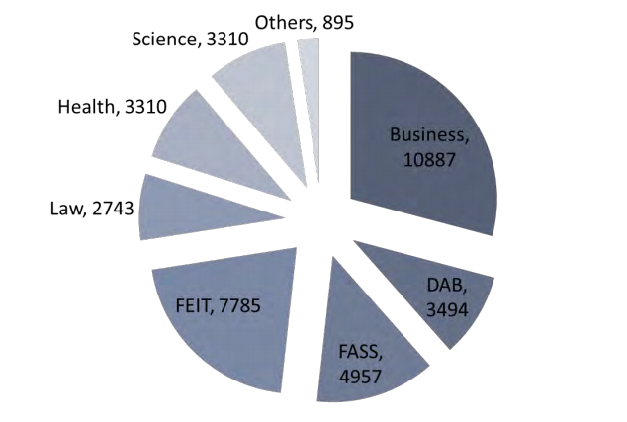
Visual Aids: Tables and Figures
Keep It Short & Simple = KISS
Notes:
Do you have page numbers, your name and student ID number on each page?
Is the font the right size? Have you used appropriate spacing?

Slide 18
Visual Aids: White Board/Butcher’s Paper
Use alternative visual aids wherever possible
Time-consuming ✗
Turn your back on the audience ✗
Write before the talk begins
'Whiteboard Markers‘
Neat and large writing
Notes:
Writing on a board is time-consuming and requires you to turn your back on the audience. Use alternative visual aids wherever possible.
If possible, put your information on the whiteboard before the talk begins, otherwise you break your eye contact with the audience, which is never a good idea.
If you really must use a whiteboard, come prepared with pens clearly marked 'Whiteboard Marker' and write in large neat writing, so that people can read it.

Slide 19
Visual Aids: handouts
References
Distribute before or after presentation?
Notes:
Handouts are ideal for people to take away with them
Good idea to include references
Think about when to give them out - before or after your presentation? Will the handout distract your audience and prevent them from listening to you?

Slide 20
What makes a good presenter?
What do you admire in good teachers/presenters?
Not boring?
Knowledgeable?
Well prepared?
Enthusiasm?
Clear explanations?
Interest in the audience?
Sense of humour?

Slide 21
Plan: think about your audience
Who?
What do they know? Terminology?
What do they want / need to know?
Interests
Getting their attention
How much information? Experts or novices?
How to help them to understand?
How to involve them
Notes:
Who are they?
What do they know about the subject? What terminology would they know? their level of knowledge (assume less than yours)
What do they want or need to know? What is their motivation for listening to you?
What aspects of your subject would they be interested in?
How to gain their attention and interest?
How much information can they absorb? If they are new to the topic, their level of absorption may be lower than for an expert audience.
How to help them to understand?
How are you going to involve them in your presentation?

Slide 22
What are you trying to achieve?
Inform your audience
Inspire them to think about your topic
Convince them of a particular point of view

Slide 23
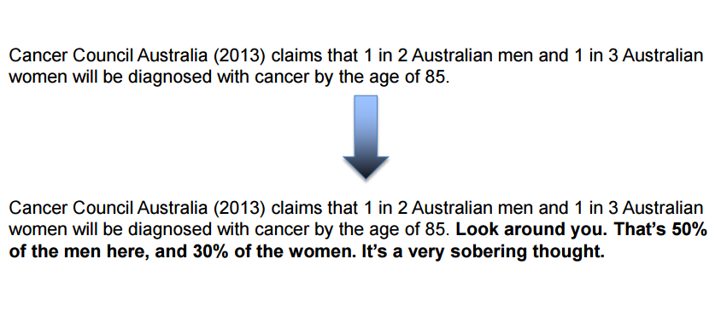
Make it relevant to your audience

Slide 24
Create more impact: numbers and data

Slide 25
Presenting: keeping the audience’s attention
Walk confidently
Establish contact with the audience
Don't read it!
Keep language simple
Check pronunciation beforehand
Break up long sections
Speak loudly
Slow down for key points
Use pauses
Vary your voice quality
Avoid ‘umms', ‘errs', ‘like‘, ‘you know'
Try recording yourself
Notes:
Walk purposefully and confidently to the front of the lecture room.
Establish contact with the audience - talk with them before your presentation.
Don't read it!! A presentation is not the same as an essay.
Keep your language simple. Check the pronunciation of key words if difficult, unusual, or foreign words beforehand.
Audience attention span is short, so break up long sections of information with questions, feedback, activities, and repeat important points.
Speak loudly enough for everyone in the room to hear you. Slow down for key points.
Use pauses—don't be afraid of short periods of silence. (They give you a chance to gather your thoughts, and your audience a chance to think.)
Vary your voice quality. If you always use the same volume and pitch (for example, all loud, or all soft, or in a monotone) your audience will switch off.
Try to avoid ‘umms', ‘errs', and redundant words (‘like'; ‘you know'; 'okay?')
Try recording yourself to pick up any unwanted speech habits.

Slide 26
Presenting: getting your message across
Emphasise key points
When moving to next point, make the move clear
Use clear examples
Not too much content for time allowed
Notes:
Emphasise the key points—and make sure people realise which are the key points. Repeat them using different phrasing.
Make it absolutely clear when you move to another point.
For example: ‘The next point is that ...’ ‘OK, now I am going to talk about ...’ ‘Right. Now I'd like to explain ... ’ ‘Of course, we must not forget that ...’ ‘However, it's important to realise that...’
Use clear examples to illustrate your points.
Do not try to include too much content in for the time allowed.

Slide 27
Presenting: body language
Smile
Even eye-contact
Be visible
Stand/sit upright
Hold your head up
Move freely
Don't rock, pace, or fold arms
No distracting habits or gestures
Don’t turn your back on the audience
Notes:
Smile – a friendly face automatically engages the audience
Practise maintaining eye-contact with a group of people. Try to make eye contact evenly around the room
Be visible (don't hide behind the lectern)
Stand (or sit) upright and balanced
Stand straight and comfortably. Do not slouch or shuffle about.
Hold your head up. Look around and make eye-contact with people in the audience. Do not just address the lecturer! Do not stare at a point on the carpet or the wall. If you don't include the audience, they won't listen to you.
Move freely
Don't rock, pace, or fold arms
Avoid unintentional distractors such as playing with a pen, jingling coins, or nervous gestures.
Try not to turn your back on the audience! You don’t want to break eye contact.

Slide 28
Activities
http://www.ruf.rice.edu/~comcoach/

Slide 29
Presenting: interaction with audience
How is the audience reacting?
Check if the audience is still with you.
Notes:
Be aware of how your audience is reacting. Are they interested or bored?
If they look confused, ask them why.
Always try to “read” your audience. Stop if necessary and explain a point again.
Check if the audience is still with you. ‘Does that make sense?’ ‘Is that clear?’

Slide 30
After presenting
Be open to questions
You can turn the question back to audience
Be ready: what if nobody has questions?
How will you respond to feedback?
Notes:
Be open to questions. Questions are good. They show that the audience is listening with interest. They should not be regarded as an attack on you, but as a collaborative search for deeper understanding.
If you can't answer a question, turn the question back out to the audience and let someone else answer it! Be ready to get the discussion going after your presentation. Just in case nobody has anything to say, have some thought-provoking focus questions or points for discussion ready to ask the group.
Think about how you may respond to feedback.

Slide 31
Remember
Individual or part of group
Time limit
Clear idea of its purpose and content
Deliver what your tutor has asked for

Slide 32
For some good examples of presenters go to:
TED Talks at: https://www.ted.com

Slide 33
References
Canberra University
< http://learnonline.canberra.edu.au/mod/book/view.php?id=164490 >
Monash University
http://www.monash.edu.au/lls/llonline/speaking/presentations/index.xml
University of Melbourne
< http://courseworks.unimelb.edu.au/research_and_writing/oral_presentations >

Slide 34
Discover these!
Online self-help learning resources
Drop-in & 1:1 consultations
Conversations@UTS
Intensive Academic English Programmes
Daily Workshops
Volunteer Programmes
 www.helps.uts.edu.au

Slide 35
UTS HELPS
 9514 9733
 helps@uts.edu.au
 www.helps.uts.edu.au
.

