Slide 1
Cancer Symptom Trials (CST)
About CST

Slide 2
History

Slide 3
Establishment of CST
Cancer symptom trials
Cancer Symptom Trials (CST) was established in 2017 to address the unmet symptom management needs of Australians living with cancer through investigator-initiated or academic (industry independent) clinical trials.
CST is building a comprehensive portfolio of clinical trials that will accelerate the improvement of cancer symptom management and quality of life for all people living with cancer.

Slide 4
Funding support

Slide 5
Infrastructure Funding
Cancer symptom trials
CST is provided with infrastructure funding by Cancer Australia. It is the 14th Cancer Cooperative Trials Group (CCTG) provided with this support. The funding allows CST to:
maintain a governance structure and membership
engage consumers in the research program
provide support to build the capacity of clinicians/researchers in the conduct of clinical trials
support investigators to develop new study ideas into full clinical trial protocols
support investigators to submit applications for competitive funding to conduct trials

Slide 6
Governance

Slide 7
Governance
Cancer symptom trials
Management Advisory Committee (MAC)
The Management Advisory Committee is responsible for the strategic governance of CST.
Scientific Advisory Committee (SAC)
The Scientific Advisory Committee is responsible for the overall review of clinical study proposals and associated ethics applications, publication, dissemination and implementation of study outcomes.
Consumer Advisory Group (CAG)
The Consumer Advisory Group is actively involved in shaping IMPACCT’s research, curricula, strategic direction as well as providing feedback about the consumer healthcare experience

Slide 8
Our people

Slide 9
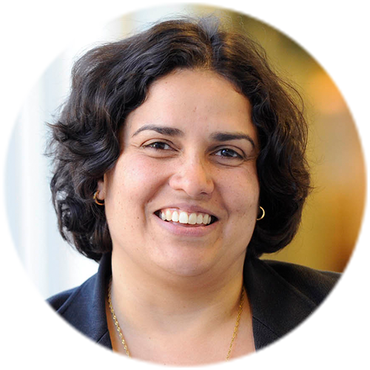
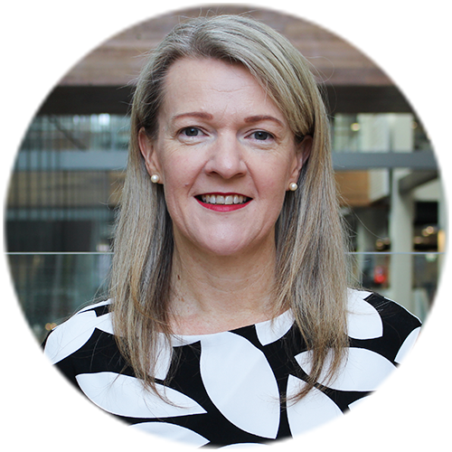
Leadership
Cancer symptom trials
Meera Agar, Chair
Professor Agar is a palliative medicine physician with a particular interest in delirium and supportive care needs of people with brain tumours and geriatric oncology. She leads a clinical research portfolio, including clinical trials and health services evaluation in cancer and palliative care. Professor Agar is a Fellow of the Royal Australasian College of College of Physicians and a Fellow of the Australasian Chapter of Palliative Medicine. In 2019, Professor Agar was appointed Chair of the Board of Palliative Care Australia (PCA).
Linda Brown, National Manager
Linda leads the national office team to implement the CST strategic and operational plans and provision of clinical trial infrastructure support. She provides professional leadership and management of the research network and ongoing development of the CST research program.

Slide 10
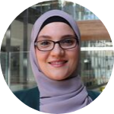
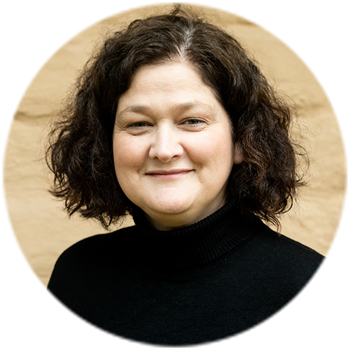
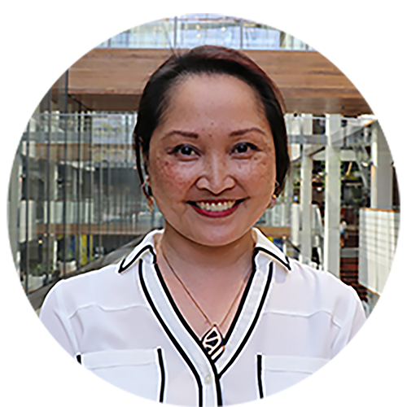
CST team
Cancer symptom trials
Rayan Saleh Moussa, Postdoctoral Research Fellow
Rayan’s is responsible for the development of relationships, collaborations and partnerships with a view to conducting preliminary work to underpin a pipeline of developing work in cancer symptom therapeutics. Rayan’s research aims to identify cancer symptom interventions that may benefit people living with cancer.
Linda James, Project Officer
Linda manages the CST web page content, communications initiatives and development of resources for CST researchers and members. She is secretary to the CST Management Advisory Committee and Scientific Advisory Committee and provides event management support.
Vanessa Yenson, Research Assistant-Writer
Vanessa assists clinical trial researchers to develop clinical trial protocols, generate literature reviews, and prepare grant applications and ethics submissions. She provides research, writing and editing support to help convert new study ideas into clinical trials.

Slide 11
IMPACCT Trials Coordination Centre (ITCC)
Cancer symptom trials

Slide 12
Research focus

Slide 13
Symptom nodes
Cancer symptom trials
The CST clinical research program is focused on symptom management across eight symptom nodes. Each node is coordinated by a dedicated symptom node subcommittee and operates under the governance of the CST Management Advisory Committee, Scientific Advisory Committee and study-specific trial management committees.
Find out more on the Research symptom nodes web page.
Appetite and cachexia
Breathlessness
Cognitive and neurological disorders
Fatigue
Gut dysfunction
Nausea
Pain
Sleep

Slide 14
Clinical trials

Slide 15
Current clinical trials
Cancer symptom trials
CST conducts and provides support for clinical trials that contribute to the improved symptom management for people with symptoms caused by cancer or its treatments.
Information about current and closed clinical trials is available on the CST Clinical trials web page where you can also find links to related publications.
Closed clinical trials:
Cancer Dexamethasone Trial (CADET)
Ketamine for complex cancer pain
Megestrol dexamethasone and placebo for anorexia
Octreotide for bowel obstruction
The PRESERVE pilot study
Open clinical trials (program growing):
Cancer pain assessment study
Lidocaine for neuropathic cancer pain
Management of nausea in cancer patients-study 4
Medicinal cannabis for anorexia in advanced cancer
Melatonin for prevention of delirium

Slide 16
Researcher support

Slide 17
Researcher resources
Cancer symptom trials
What we provide
CST members benefit from both face-to-face and remote support from the IMPACCT Clinical Trials Coordination Centre.
We also provide a range of online resources including:
Standard operating procedures
Manuals
Guidelines
Templates
Referral resources
Research data management system access
We support new and early career researchers to develop their research questions and new study ideas into clinical trials. This includes support via our concept development workshops and Annual Research Forum.

Slide 18
Membership

Slide 19
Become a member
Cancer symptom trials
Members
CST has a growing membership that includes health professionals, researchers, consumers and industry representatives who share skills and knowledge that contribute to new ideas in cancer symptom management.
Benefits
- keep up to date via our newsletter
- attend our annual research forum
- participate in our concept development workshops
- collaborate with like-minded researchers
- access support for your clinical trials
Apply
It only takes a few minutes to submit your online application via the CST website.

Slide 20
Contact us

Slide 21
Stay up to date
@ @UTS_CST
@UTSHealth
UTS Health
W: uts.edu.au/cst
E: CST@uts.edu.au

Slide 22
Thank you

