Slide 1
DIGITAL HUMANITIES FOR DUMMIES: TIMELINES AND STORYMAPS
Dr Alana Jayne Piper
Twitter: @alana_piper
Website: criminalcharacters.com

Slide 2
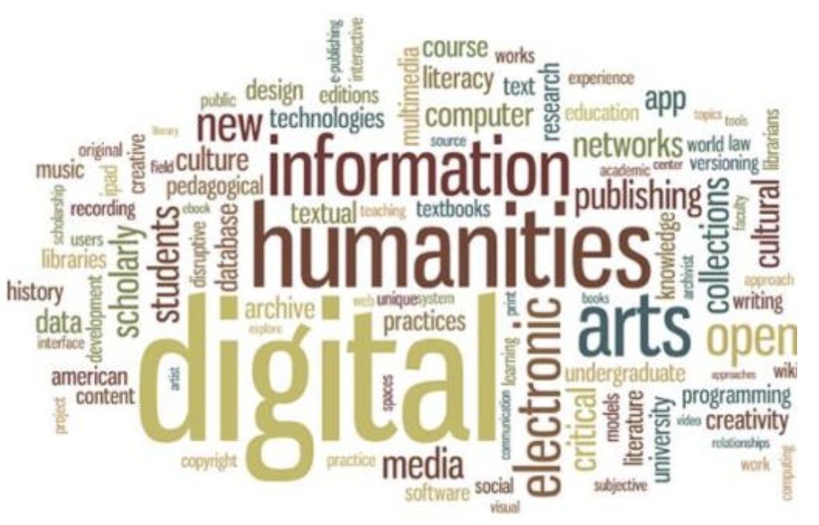
Digital Humanities for Everyone!
The Australian Centre for Public History is supporting Digital Humanities learning because we believe:
You don’t need to be a tech wizard to get involved in digital humanities – these sessions are aimed at even the novice user
Digital skills enhance public engagement by dynamically communicating data, as well as being useful tools for teaching and research
Digital methods offer support for interdisciplinary approaches, and history is a discipline that ALL disciplines can benefit from when trying to understand the wider context of their topic/data and how to shape it into an engaging narrative for public audiences
Everything has a historical context in which it has developed – starting with a timeline is a good way to think about what that historical context is!

Slide 3
A Timeline of Timelines
Graphic representations of time and historical developments gained popularity in the early nineteenth century
The popularisation of timelines coincided with the rise of mass education, with timelines being developed predominantly as teaching tools
Timelines also emerged during a period of growing nationalism within different countries, and were predominantly used to provide students with a sense of historicism about their nation’s past

Slide 4
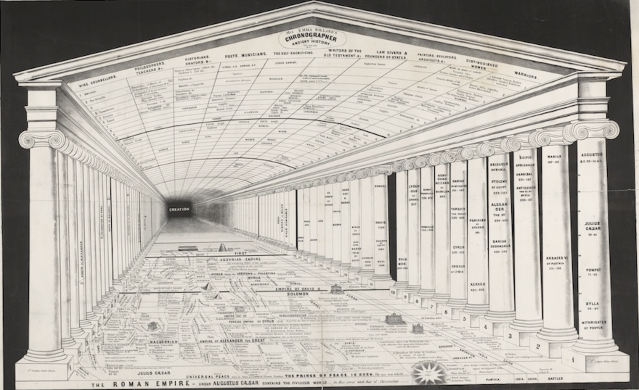
Time and Space
Timelines have often been related not just to concepts of time, but space and location
One of the earliest champions of the timeline as a teaching tool was America’s first female mapmaker, nineteenth-century educator Emma Willard
Willard experiment with different ways to annotate maps to impart chronological narratives, and later with different ways to visualise chronology to tell stories about place
Emma Willard’s, ‘Temple of Time’ timeline

Slide 5
Criticisms of Timelines
The utility of timelines as a tool for sharing historical narratives has been critiqued by the public history field, as the linearity of timelines tends to convey a sense of the past as an objective reality, eschewing the complexities of historical interpretation
Digital timelines have been posited as a way to overcome some of the limitations of timelines as a historical storytelling tool
While a printed timeline is static and proceeds in only one direction, digital timelines can play with non-linear formats or multiple starting points
Digital timelines can also incorporate multiple perspectives and interpretations of events into their annotations, particularly through the embedding of multimedia elements such as videos, sound files or primary source records that invite viewers to make sense of history for themselves

Slide 6
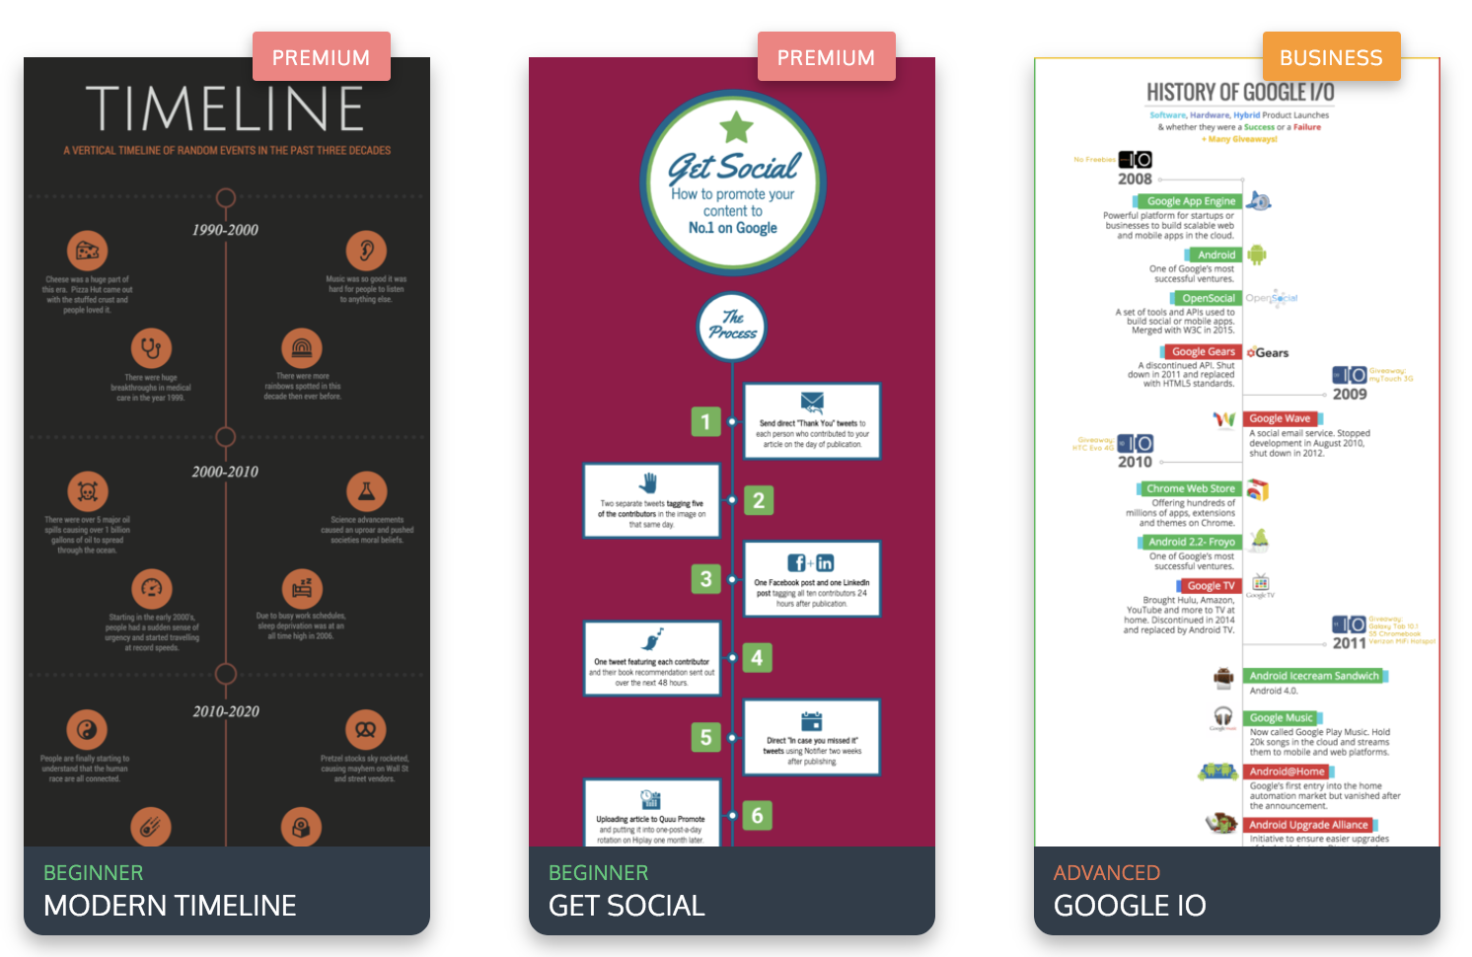
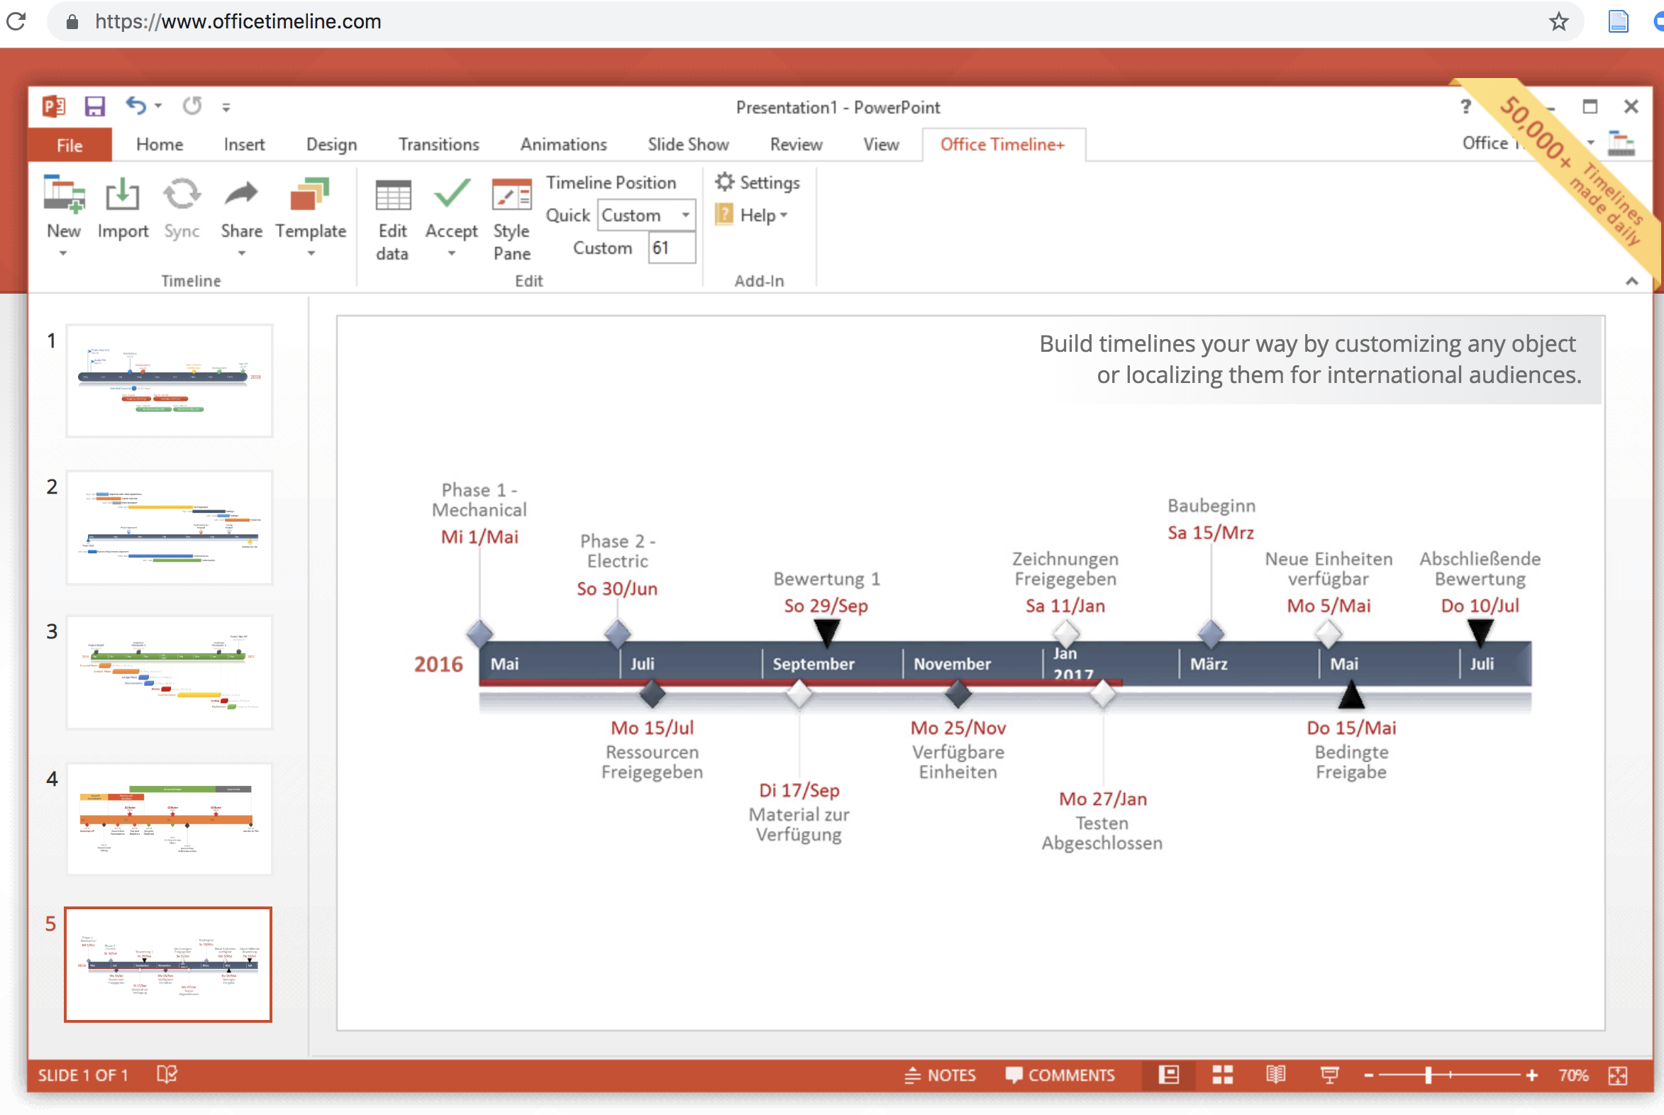
Report-Based Timelines
Report-based timelines are non-digital timelines that can be incorporated into a report or research output that will appear in printed format. There are of course still digital tools for generating such timelines.
Many infographic tools also offer visually-appealing templates for creating report-based timelines. One option is Venngage.com, which allows users to create up to 5 infographics for free.
Office Timeline is a popular option for report-based timelines. It is free to download and acts as a plug-in within Powerpoint.

Slide 7
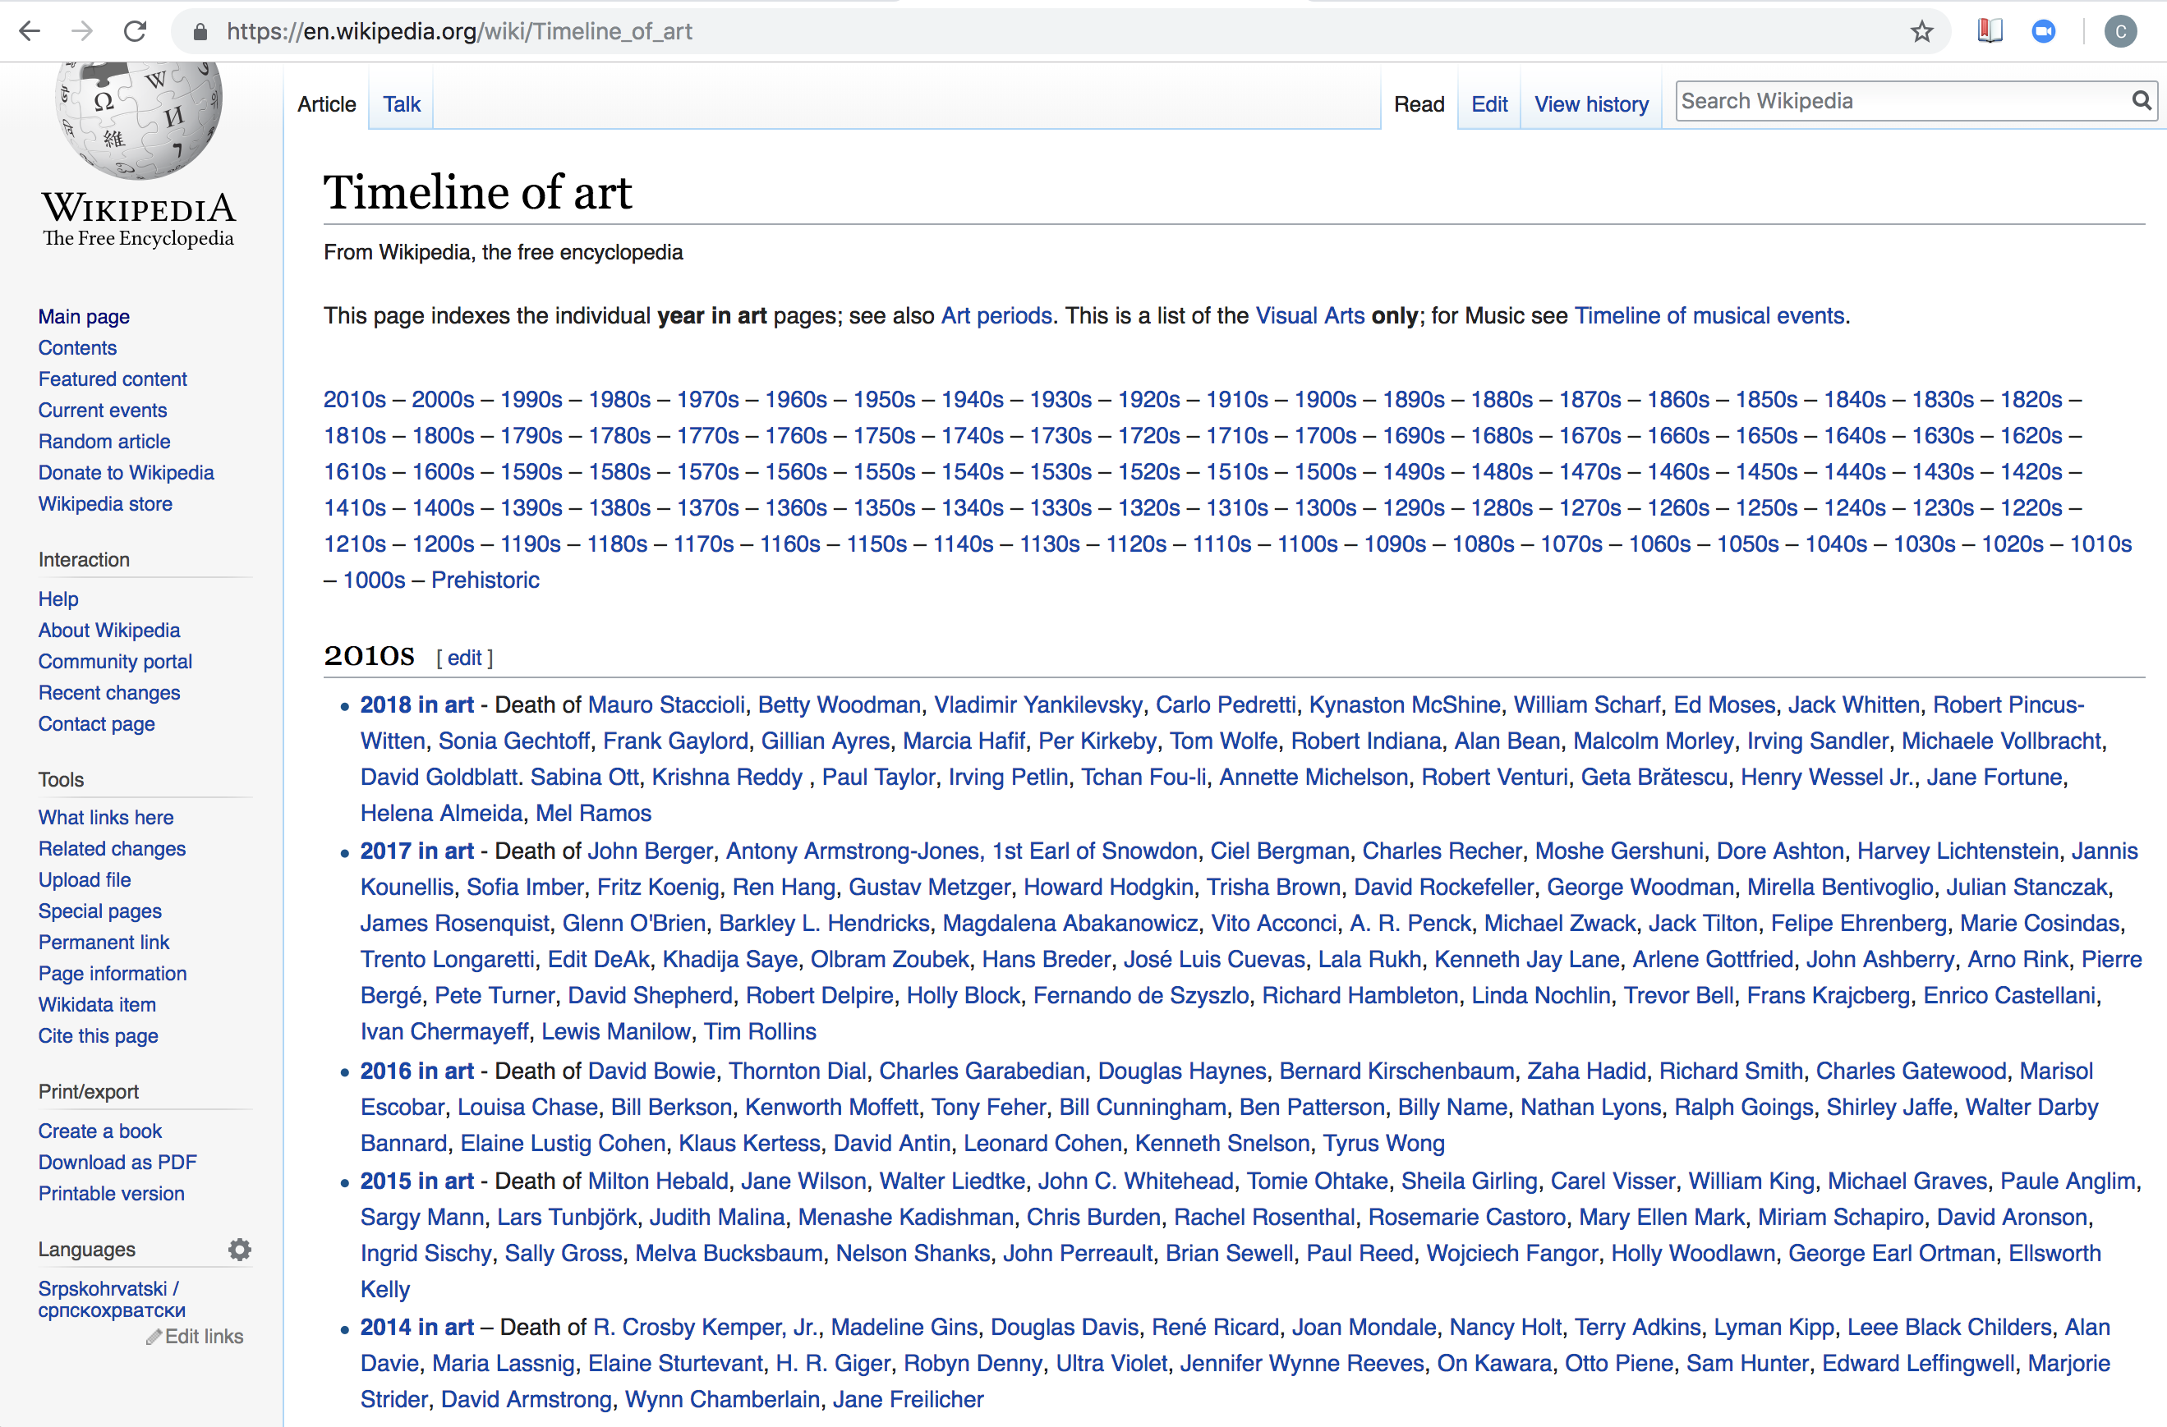
List-Based Timelines
Some digital timelines that have been generated in the wake of big data are simple list-based timelines that use web-scraping to auto-generate a chronological ordering of data from a particular internet source. A prime example would be Wikipedia’s Timeline of Art.

Slide 8
Interactive Timelines – Paid vs Open-Source
There are a variety of paid and open-source options available for creating interactive digital timelines for conveying information to viewers in a narrative, visually-rich format
Popular paid software options include Timeglider, Timetoast, WhenInTime, Preceden and Dipity
Open-source digital tools are usually developed by universities, which means they are often well-suited to academic research because they have been developed with academics in mind
Open-source tools can also have greater longevity than paid software, which may disappear and no longer be supported if the market for that software product disappears
Open-source tools also often have the benefit of large user support communities

Slide 9
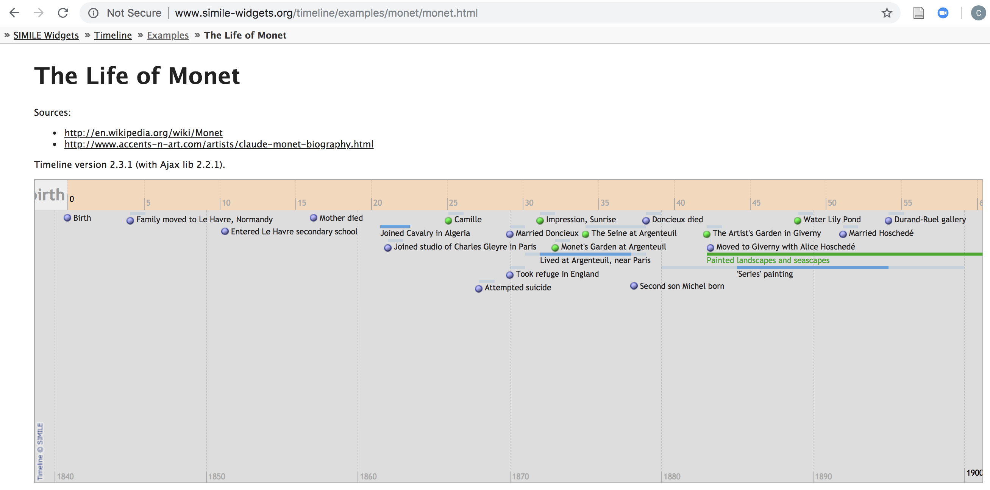
Simile Timeline
One of the first open-source digital timeline tools was developed by MIT’s Simile project. The Simile Timeline widget is highly customisable, but requires timeline creators to be able to read and play with code.

Slide 10
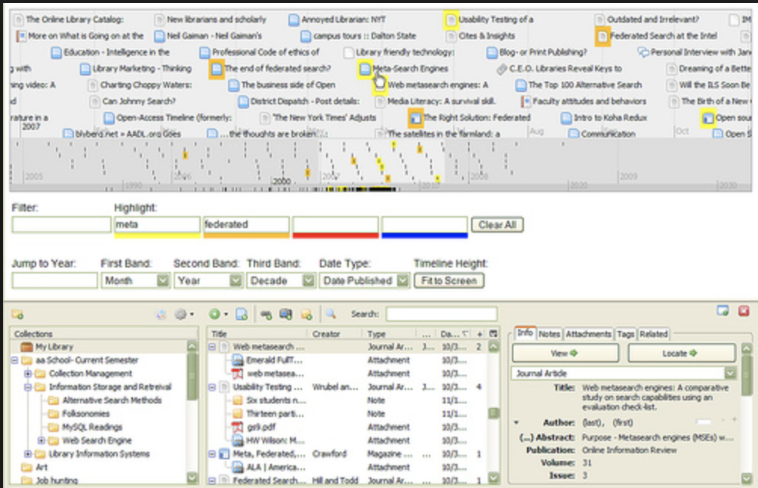
Adapting Simile Timeline
The Simile Timeline code has been adapted by other open-source digital tools, such as Omeka and Zotero, to allow users to create timelines of their collections or reference databases.
You can create a timeline from your Zotero citation manager simply by clicking on ‘Tools’ then ‘Create Timeline’.

Slide 11
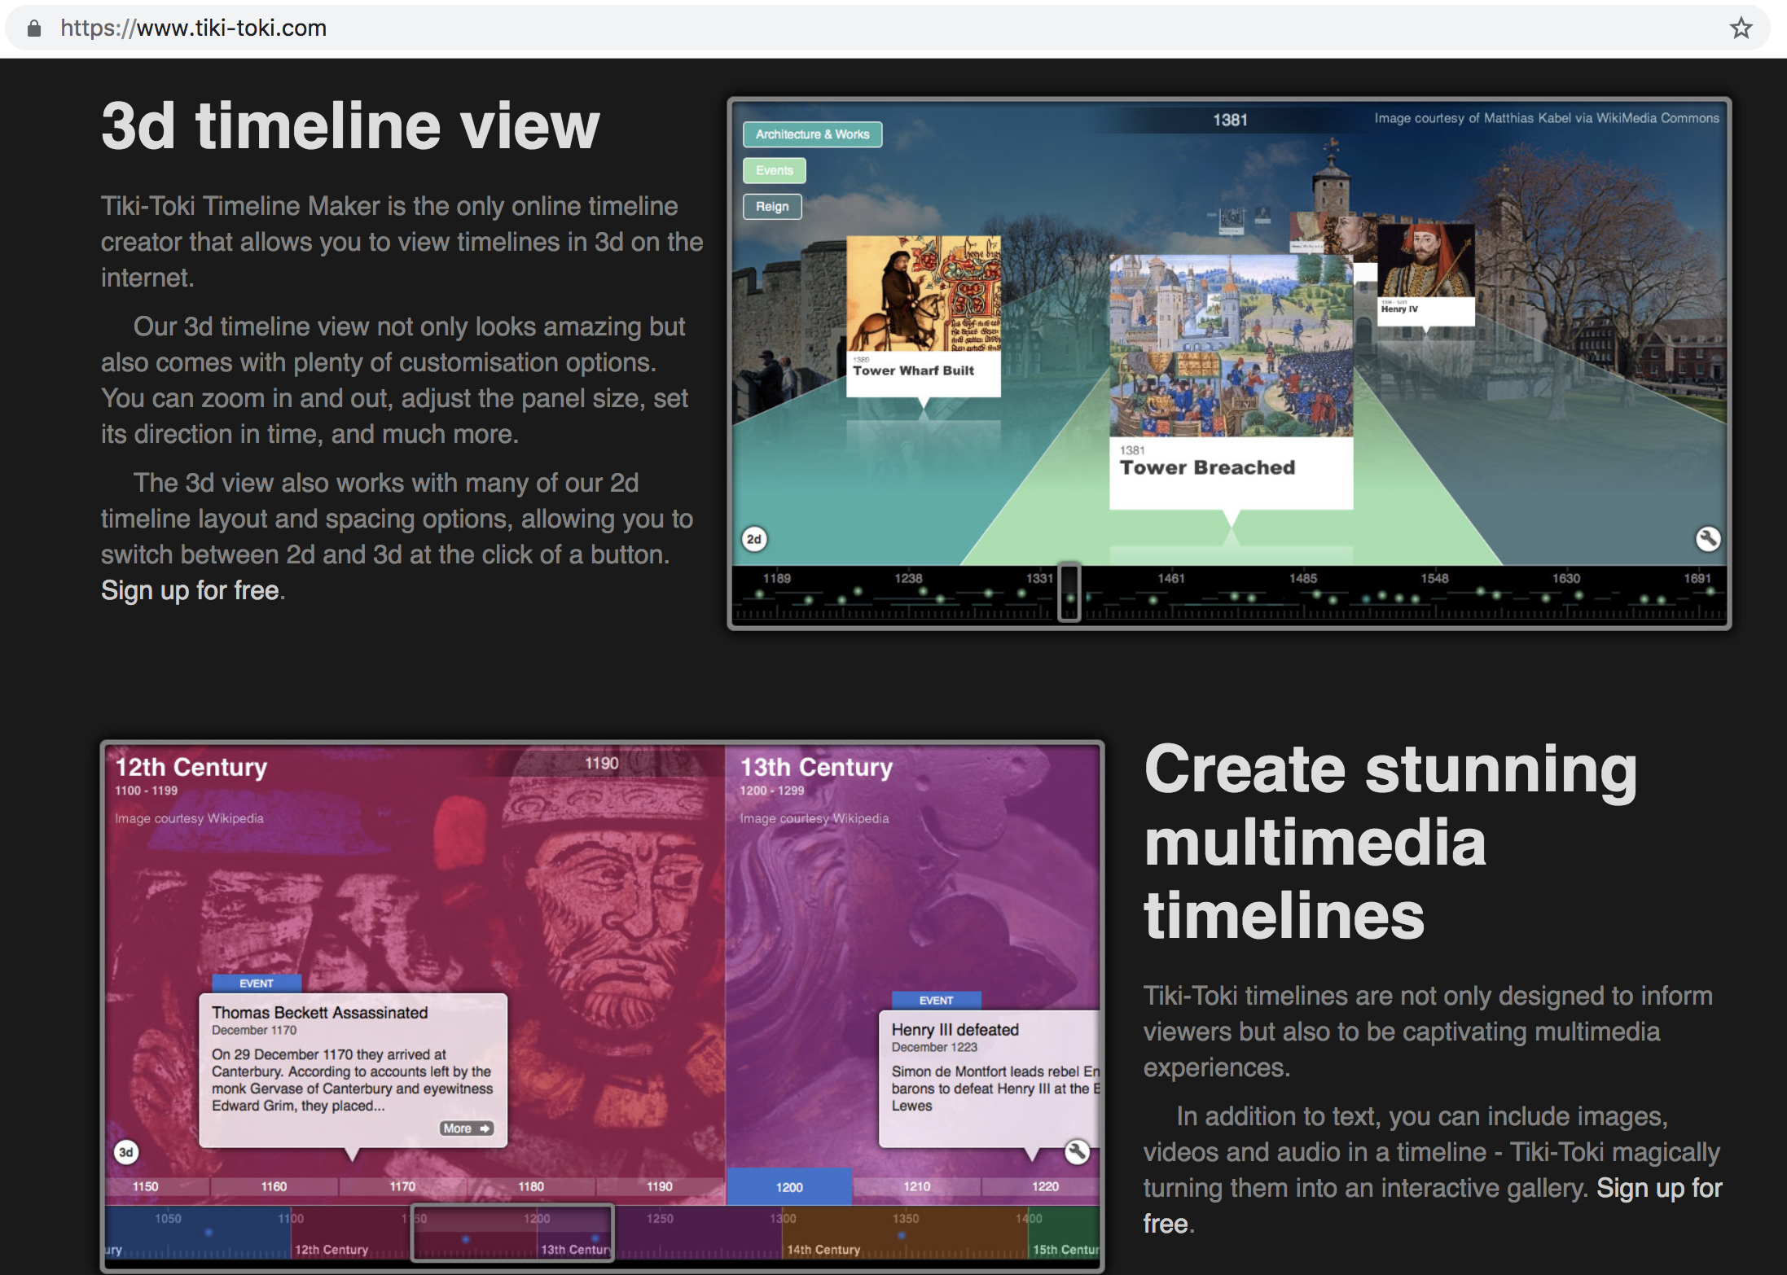
Tiki-Toki
An open-source tool for creating digital timelines that does not require an ability to code
Has a unique 3-D view format that can be used
Also has a group edit function to integrate a multiplicity of perspectives by allowing many authors to contribute events to the timeline

Slide 12
Timeline and Storymap JS
Developed at NorthWestern University by their KnightLab team, which has developed a range of successful open-source tools
TimelineJS was developed for use by journalists and media outlets, making it very user-friendly
TimelineJS was also created to be narrative-driven, and focused on engaging public audiences with its visualisations
KnightLab also created StorymapJS, a map-based visualisations that can also be used for creating chronological narratives in which the events are also strongly linked to particular places
The rest of the lesson will focus on showcasing how to use these two dynamic tools

Slide 13
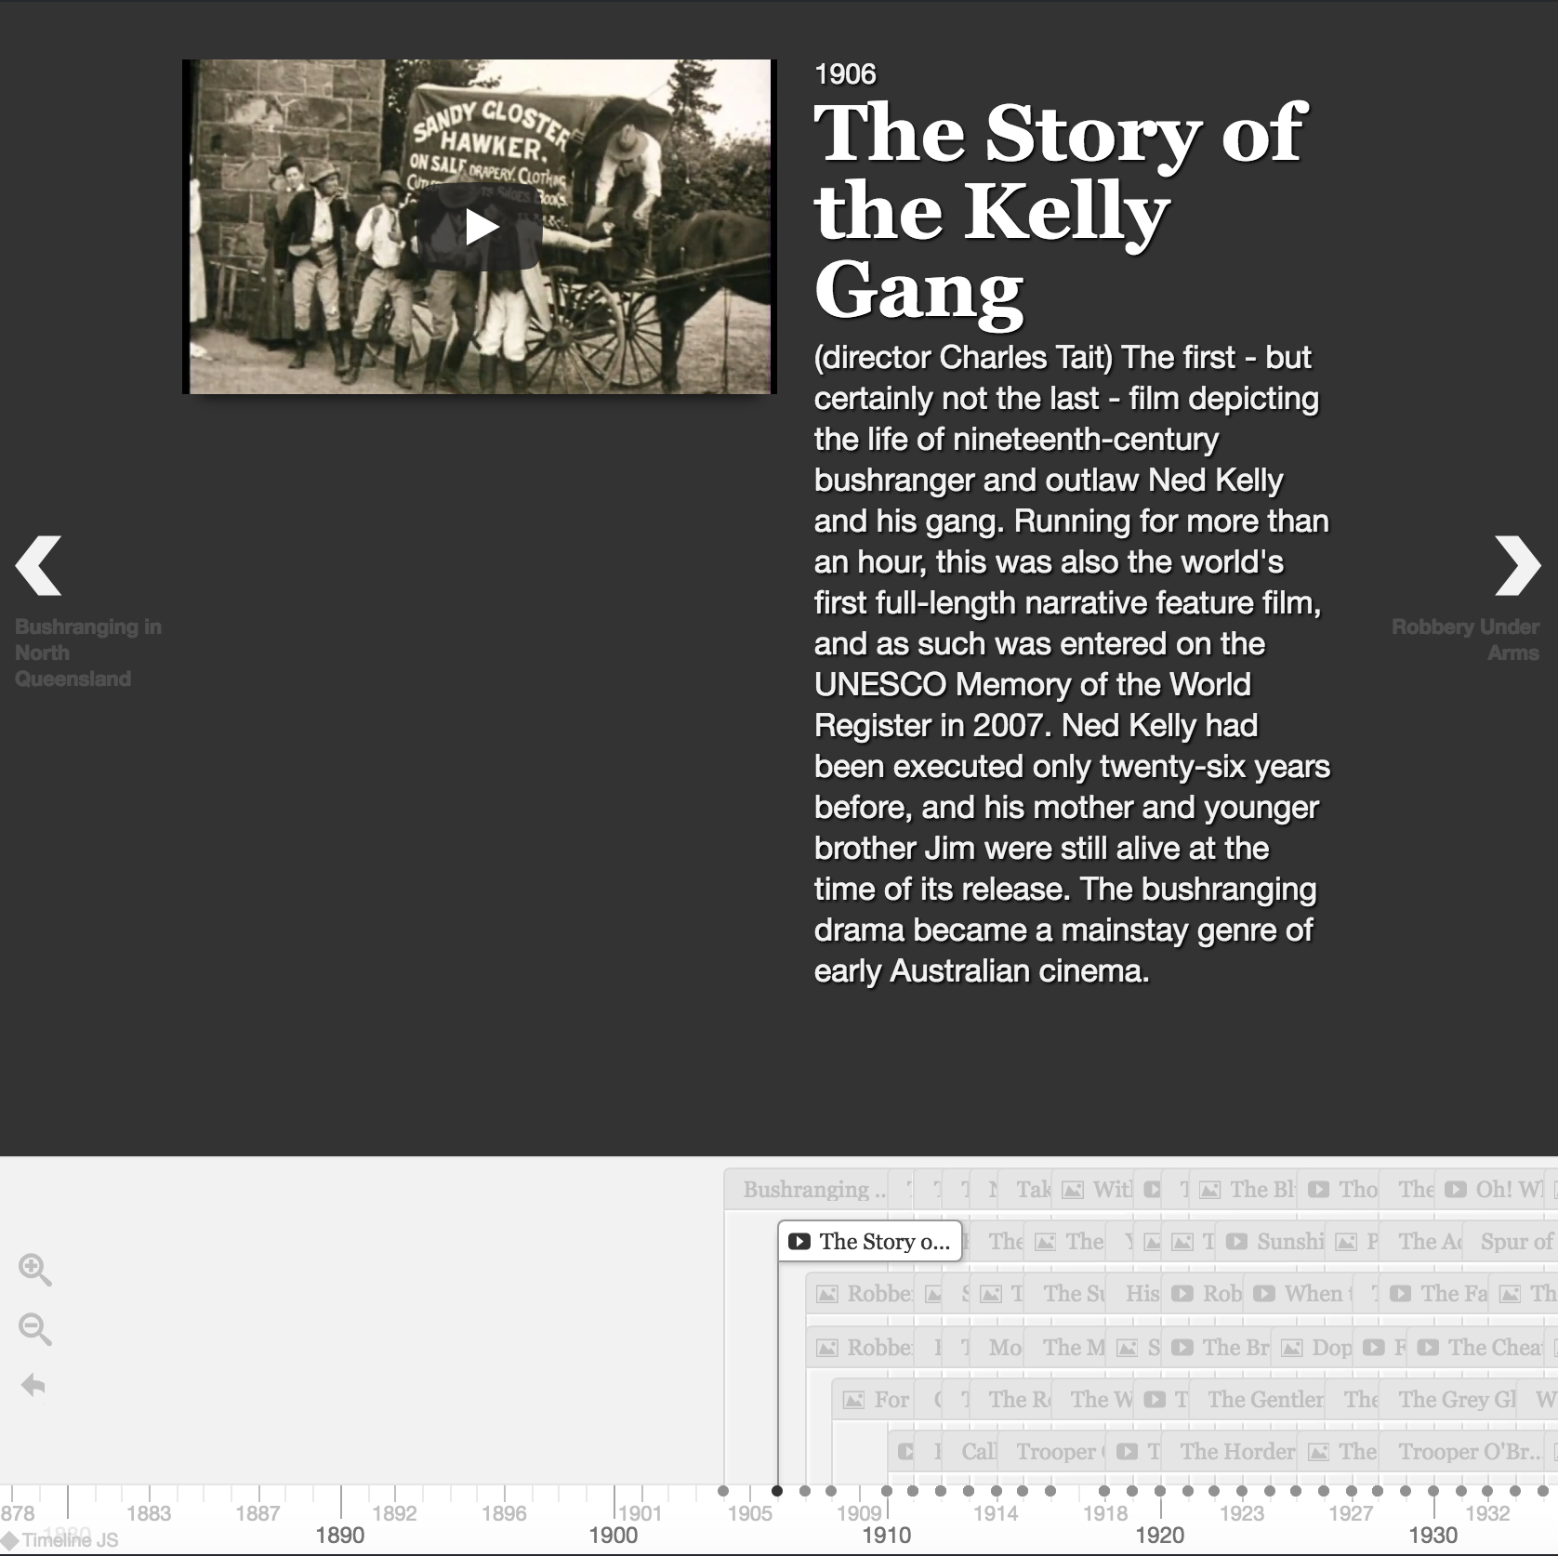
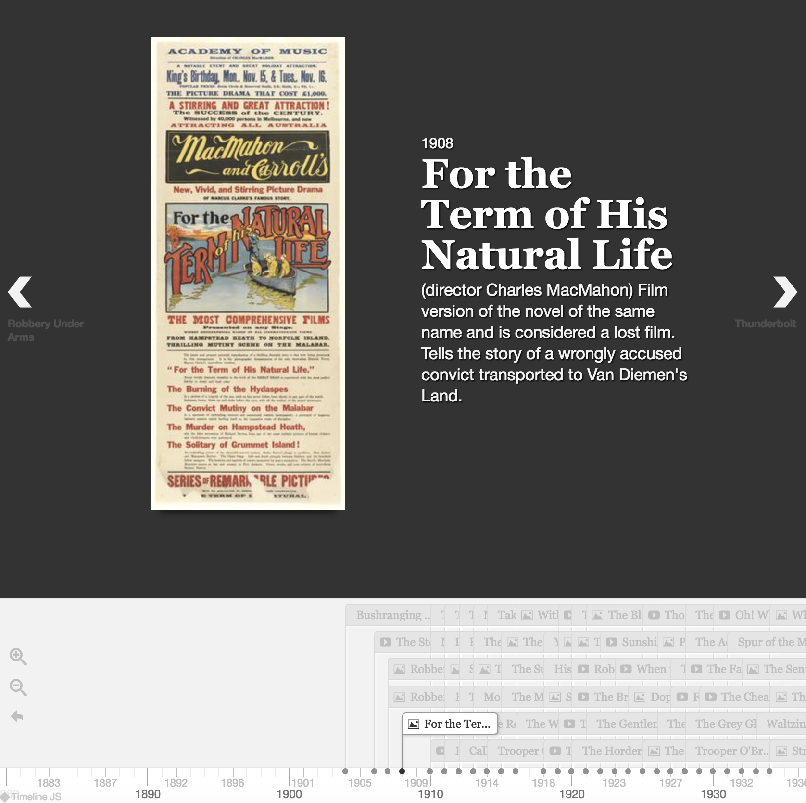
Here’s some I prepared earlier
I used Timeline JS for my research project site to create a timeline of crime films produced in Australia - https://criminalcharacters.com/prisons-and-punishment/map-of-australian-prisons/

Slide 14
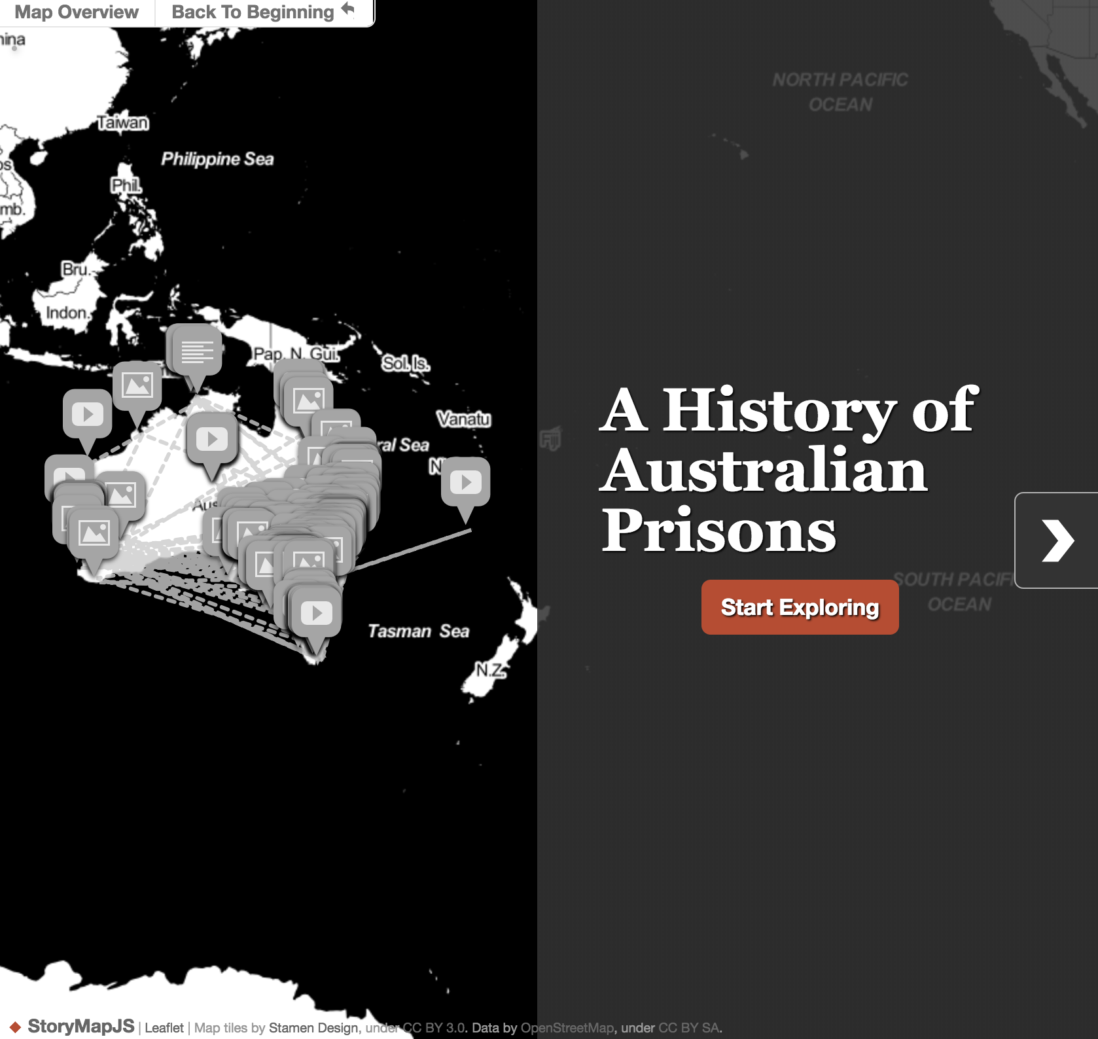
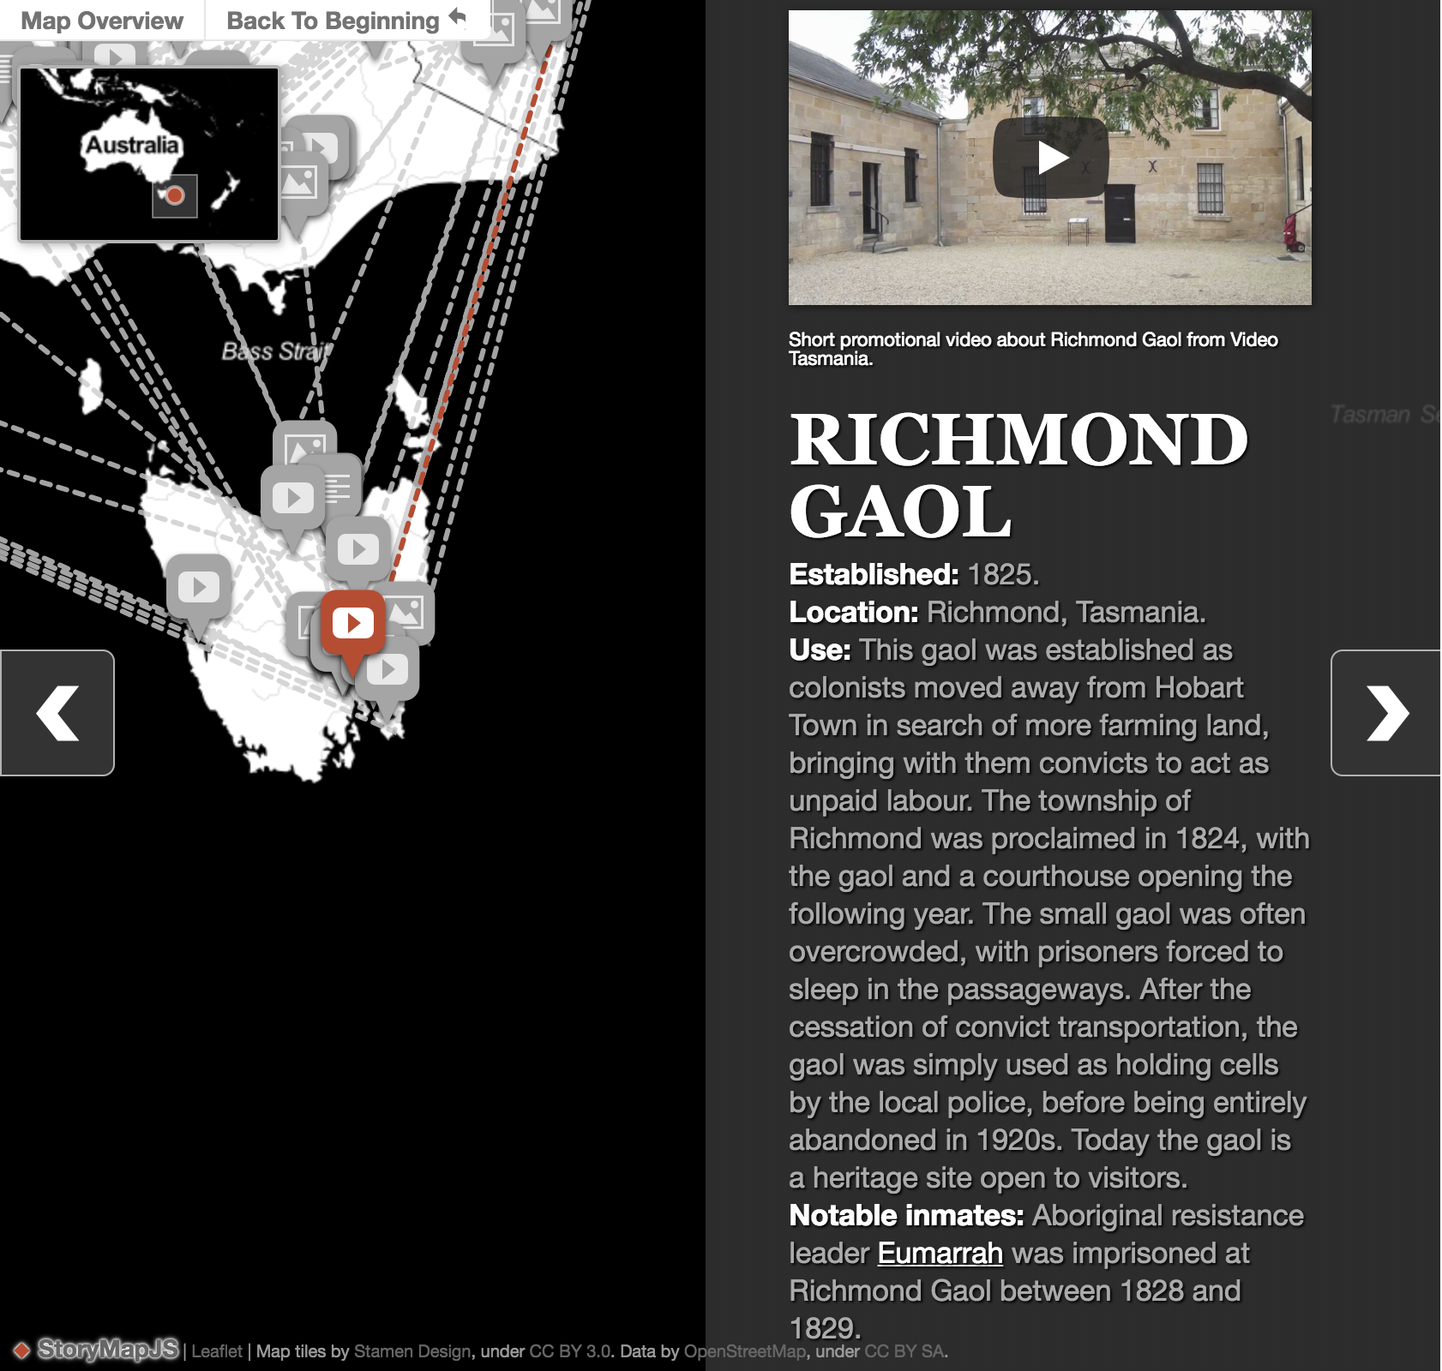
I similarly used StoryMap JS to create a map that displays the sites on which prisons have been established across Australia from 1788 to 2017 - https://criminalcharacters.com/prisons-and-punishment/map-of-australian-prisons/

Slide 15
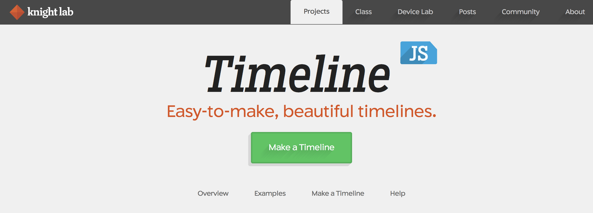
Getting started with TimelineJS
Go to Timeline JS - https://timeline.knightlab.com/ - an overview of tips, some further examples and instructions are all available here
If you have a question that is not covered in this tutorial, the site provides a range of help documentation including an FAQ section, a 2-minute instructional video and chat forums.
Click ‘Make a Timeline’ to get started

Slide 16
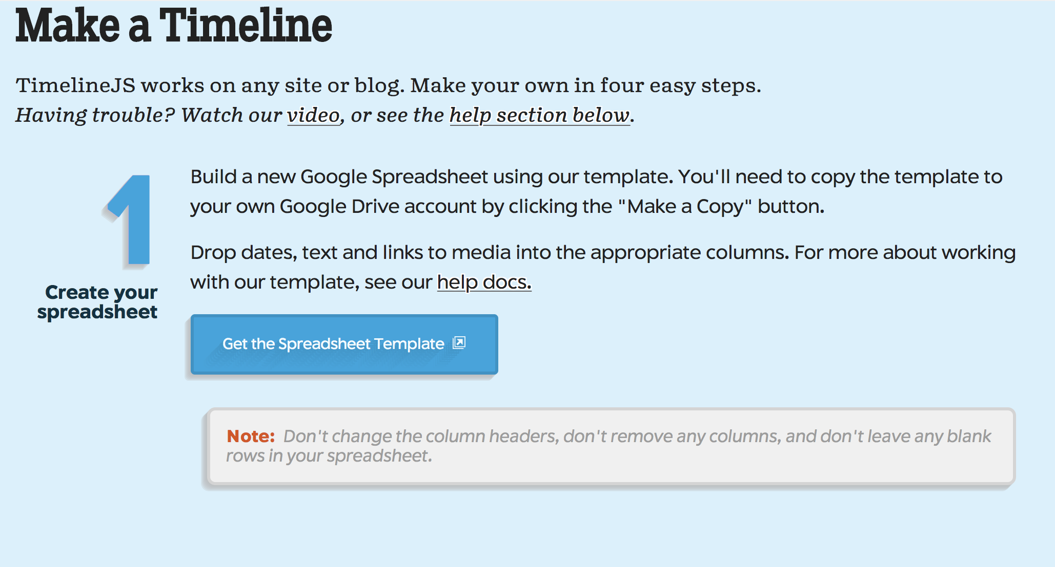
Google Spreadsheet
Clicking ‘Make a Timeline’ will take you to the four-stage process for TimelineJS
Start with step 1 by clicking ‘Get the Spreadsheet Template’
Clicking this will prompt you to log into your Google Account, or create one if you don’t already have one. From here you will be able to download a copy of Timeline’s Google Spreadsheet template into your Google Drive.

Slide 17
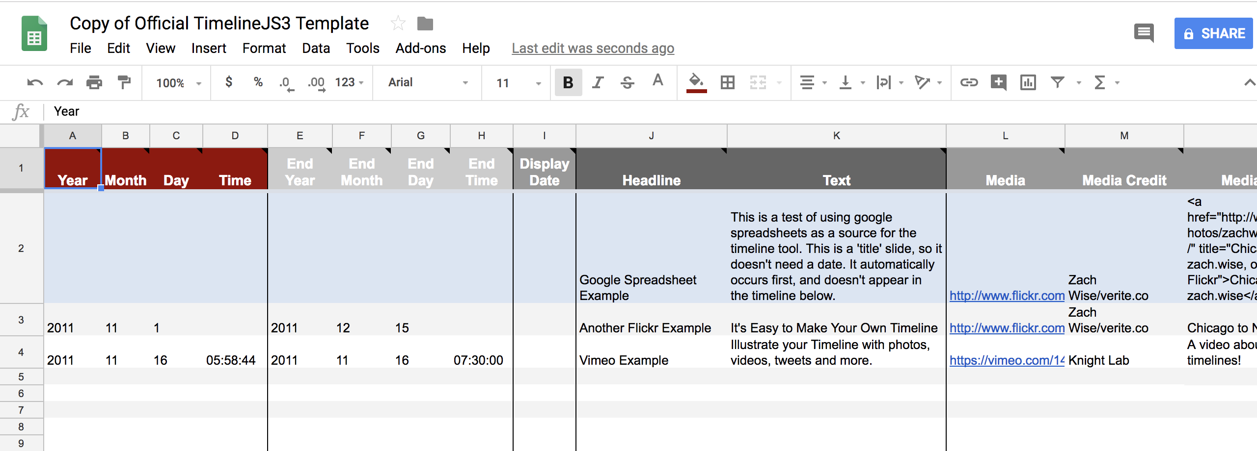
Google Spreadsheet
The top row of the spreadsheet has all the headings that are used to render the timeline. It is important that you do not delete any of the columns because all the headings have to be present for the timeline to render. However, you do not need to input data for each column if that column is not relevant for you – just leave the column blank and it will not affect your final timeline.

Slide 18
Google Spreadsheet
The Timeline spreadsheet has sample information in the rows below the top row to show you the types of information that can go into each column. Once you have looked over this example information you can delete or clear them to begin adding your own data. Each row in your timeline will represent a separate event.

Slide 19
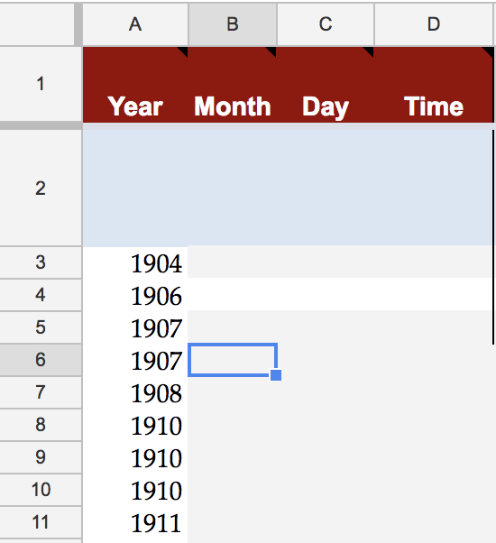
Date columns
The first four columns are for putting in the date or start date of your event. Depending on how precisely your event is dated you can fill out just the year, or day, month and year, or even add the time of day to the date.

Slide 20
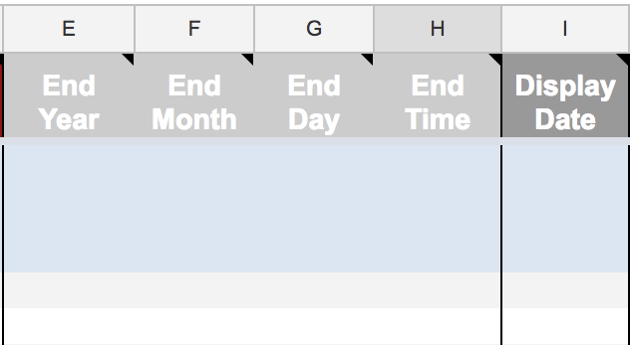
Date columns
The next four columns offer you the option of adding an end date for your event, if it is the type of even with a clear starting and end point, such as a war. If your event does not have such an end point, you can simply leave blank. The column after these four is the ‘Display Date’ column – again you do not have to use this, but you can if you want to change the default way the date is displayed on the timeline to another format, e.g. dd/mmm/yyyy, mmm/dd/yyyy etc.

Slide 21
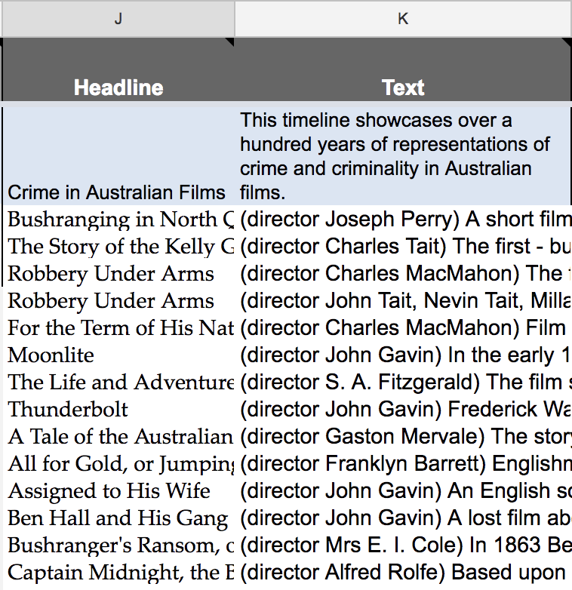
Annotation Columns
The next two columns will create the annotation that will appear about your event. The headline column creates a large, bold headline for the event, so it is best to keep it something short and simple. The text column then lets you create an annotation about the event. If you like the annotation can be quite lengthy – in this case the timeline will just auto-generate a scroll bar that will let the viewer scroll down the annotation to read it. However, you may want to self-limit your annotations in order to ensure viewers are kept engaged through a pacey narrative structure.

Slide 22
Media Columns
The next four columns relate to any media you wish to accompany your annotation. TimelineJS does not allow you to upload your own files into the timeline – they must be hosted somewhere online and the link the files copied into the Media column. Supported media formats include twitter, flickr, youtube, vimeo, vine, dailymotion, Wikipedia, soundcloud and more. Image URLs can be copied into this column provided the URL ends in a .jpg, .png, .tiff, or other image format (image URLs can be found by right-clicking on internet images). The next two columns can be used to credit and caption your media file. The final column lets you insert a thumbnail version of the media that will link to the original if you have a very large image that viewers will need to zoom into and expand outside of the timeline environment.

Slide 23
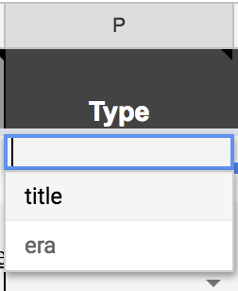
Type Column
For most rows or events you will probably leave the type column blank. The exception would be if you want to include a title slide at the start of your timeline – you would then click Title within the type column. This is so that Timeline JS knows that there does not have to be a date for that slide. The other option in the Type column is to create an ‘Era’. This will act as a sort of sub-title slide if you want to break up your timeline into different set periods, e.g. ‘First World War’ era slide by clicking ‘Era’ here then nominating the war’s start and end dates in the date column. This would let Timeline JS know that any events added to the timeline that fall between these dates are part of this ‘Era’, and it will automatically colour code events from the same era together. Note that the platform does not allow for overlapping eras.

Slide 24
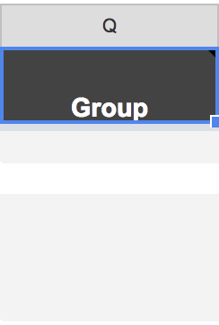
Group Column
The Group column can be used to show that different events are related to each other by tagging them as part of the same Group. For instance, you may want to group all political events in your timeline by tagging those events ‘Politics’, but create another group for cultural developments by tagging those events ‘Culture’.

Slide 25
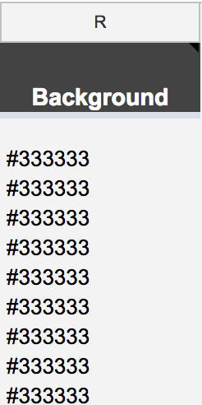
Background Column
This column lets you decide what the background behind your annotation and media will be within the timeline. You can make the background into an image by adding an image URL to this column. Or you can make it a particular colour by adding a 6-digit html colour code. If you are not familiar with html colour codes, you can find all the colour values and choose the one you want here - https://www.w3schools.com/colors/colors_picker.asp

Slide 26
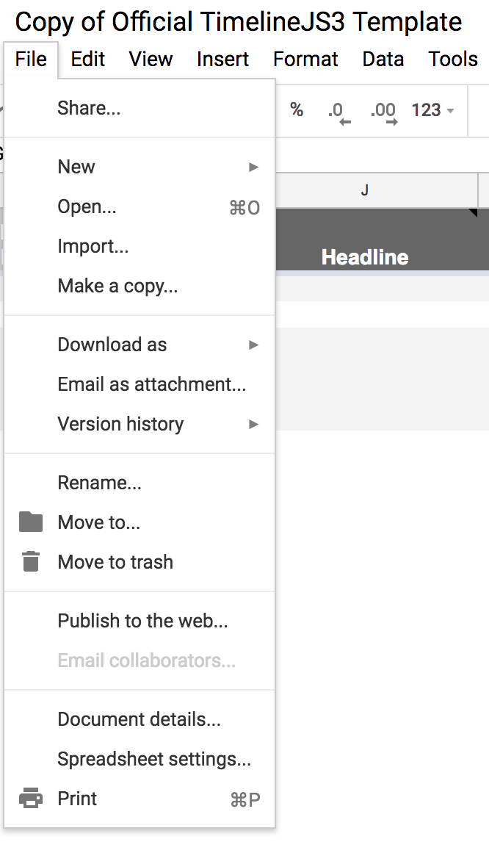
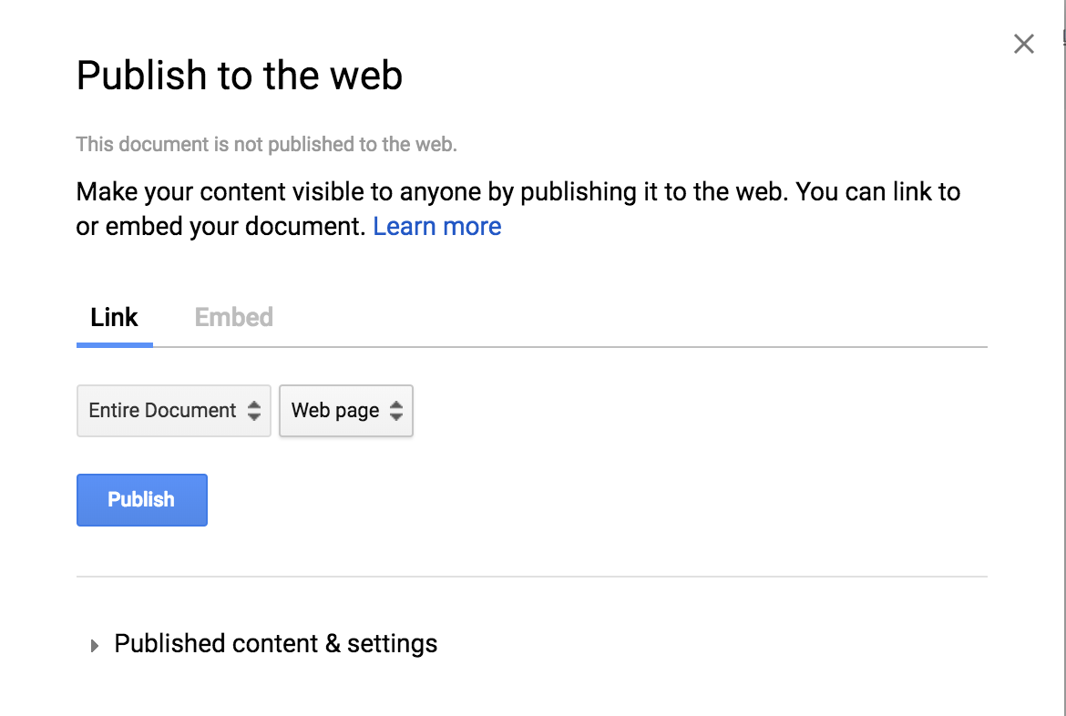
Generate Your Timeline
Once your timeline is ready you need to go to ‘File’ then ‘Publish to the Web’ then ‘Publish’.

Slide 27
Generate Your Timeline
Copy your spreadsheet URL directly from the URL bar at the top of your spreadsheet. Don’t worry if you want to make changes later on – once the Google Spreadsheet is published it will just automatically any time you save changes to it, and any versions of the timeline that you have embedded to your website will automatically update too.

Slide 28
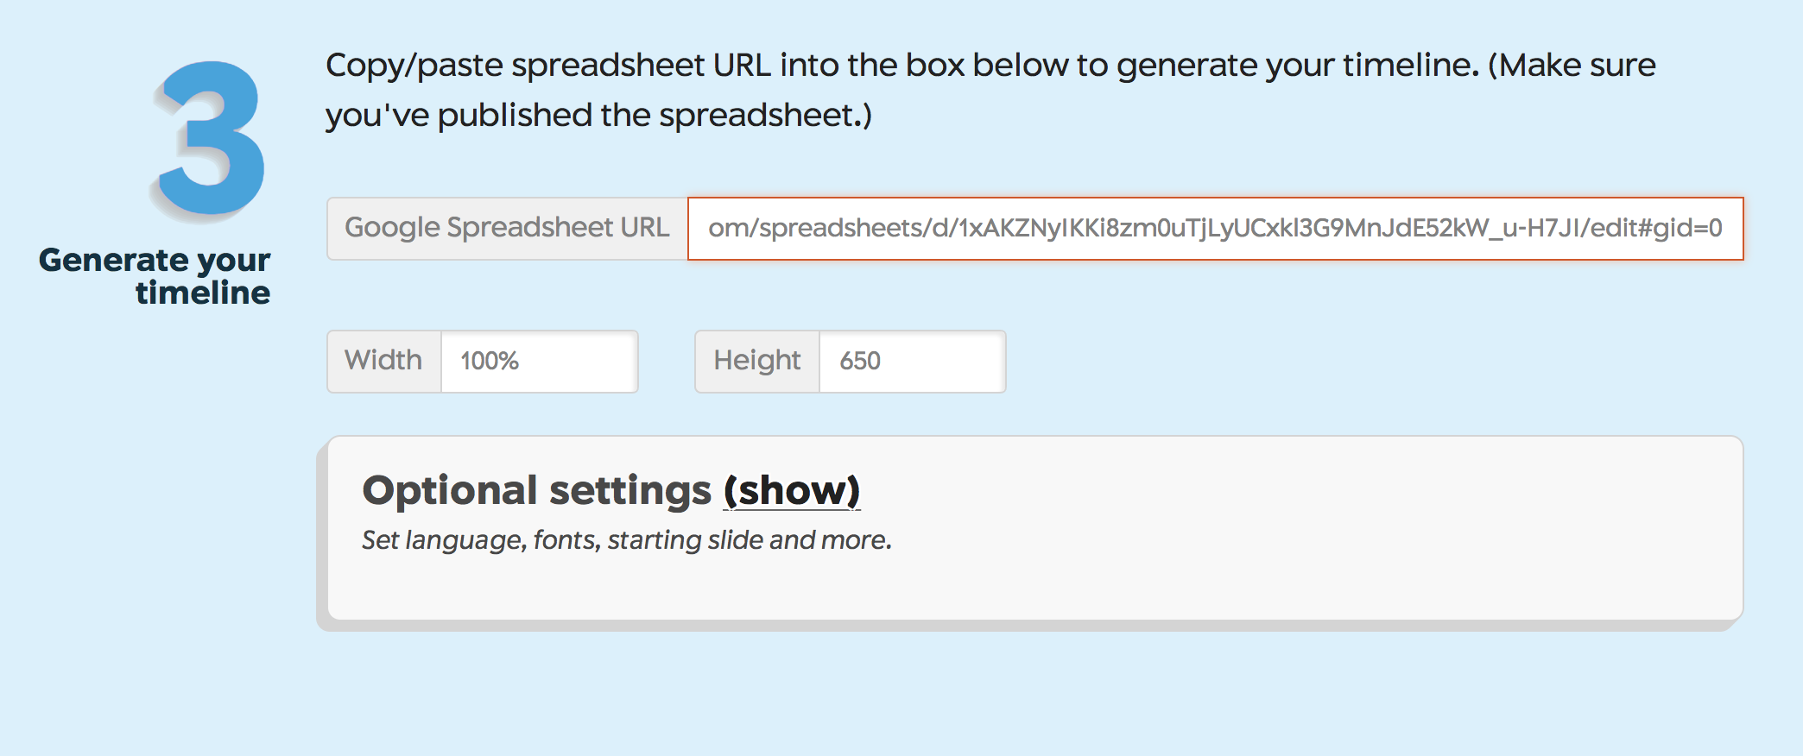
Generating Your Timeline
Now you have the URL from the top of your Google Spreadsheet, you are going to paste it into the Step 3 box on Timeline JS. Under Step 3 you will also see an ‘Optional Settings’ button that you can click into to play with some of the display features of your timeline, such as selecting different fonts

Slide 29
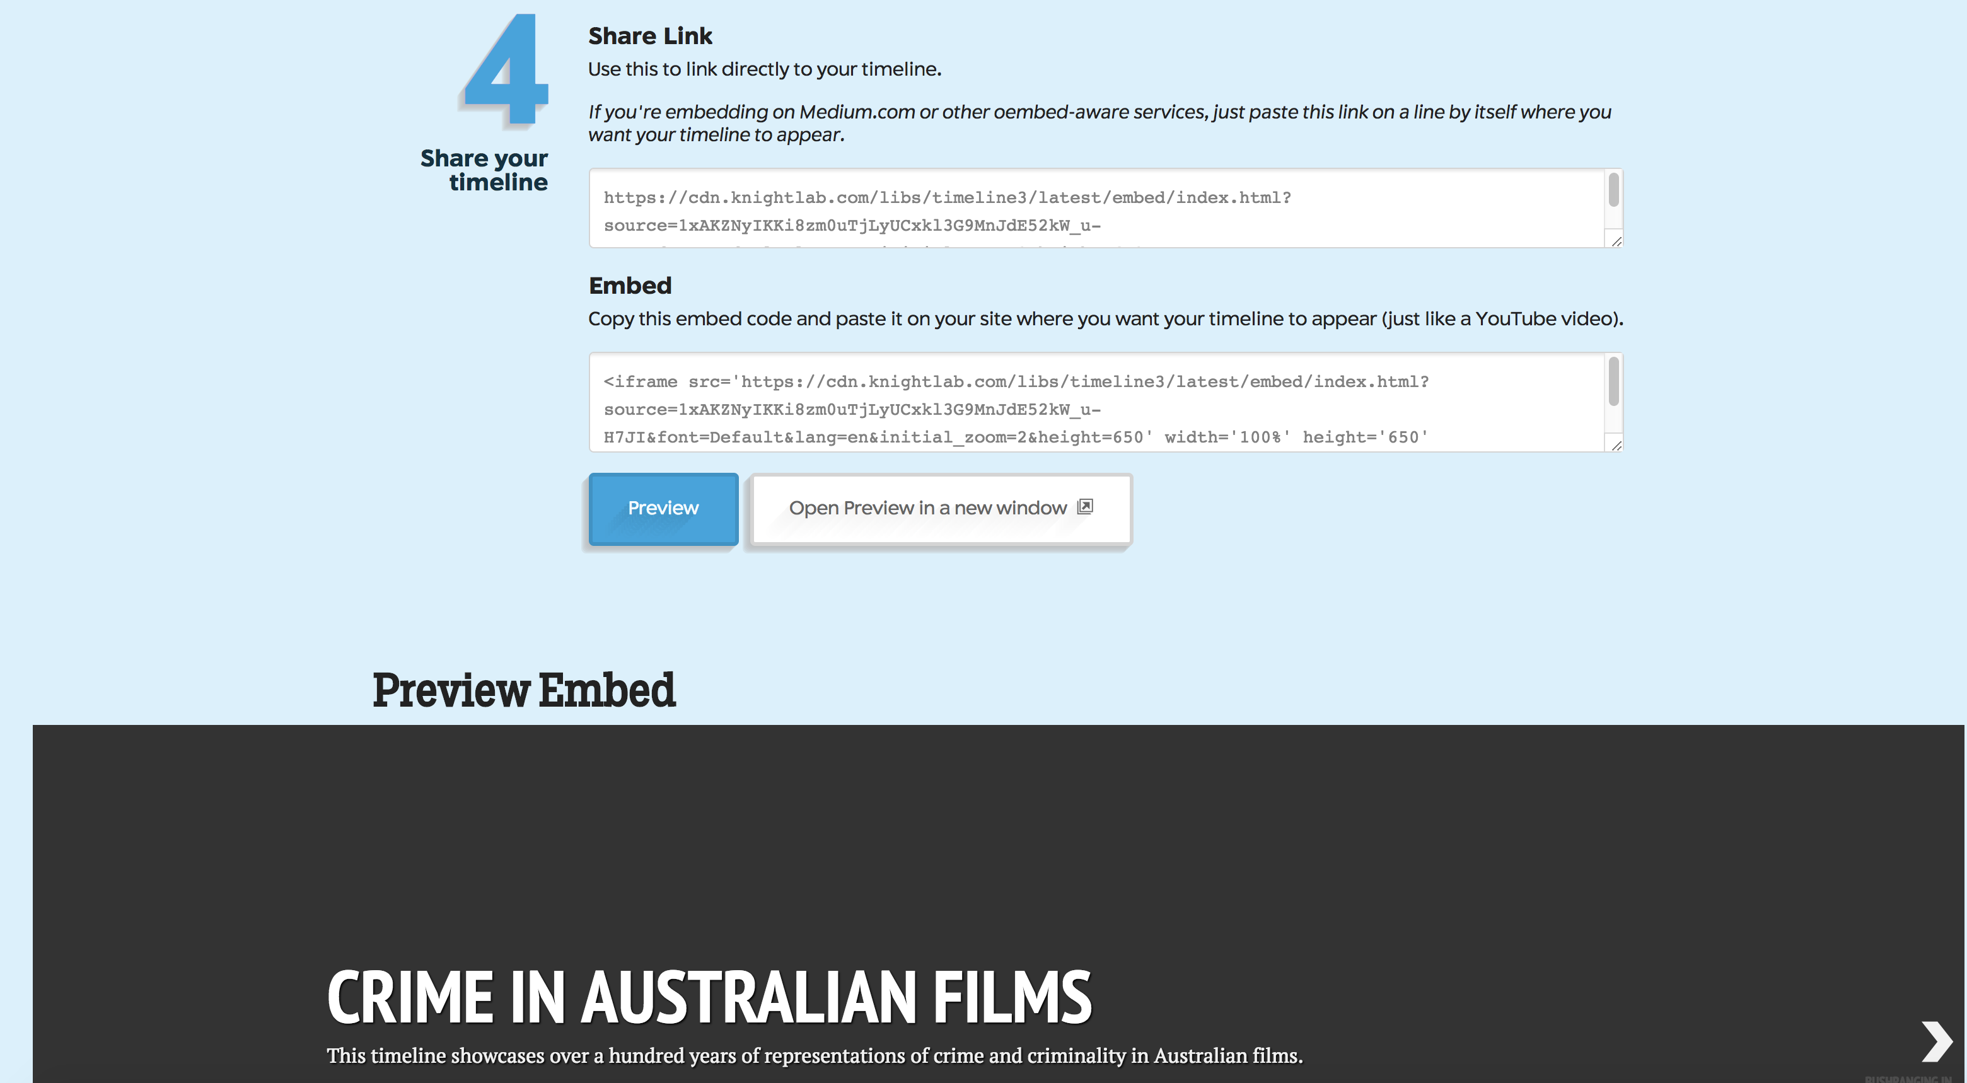
Generating Your Timeline
Now scroll down to Step 4 of TimelineJS and click ‘Preview’. Below you will see a Preview of your Timeline that you can click through and check that everything appears as you want it too. Once you are satisfied, you can either copy the embed code displayed above into your web page.

Slide 30
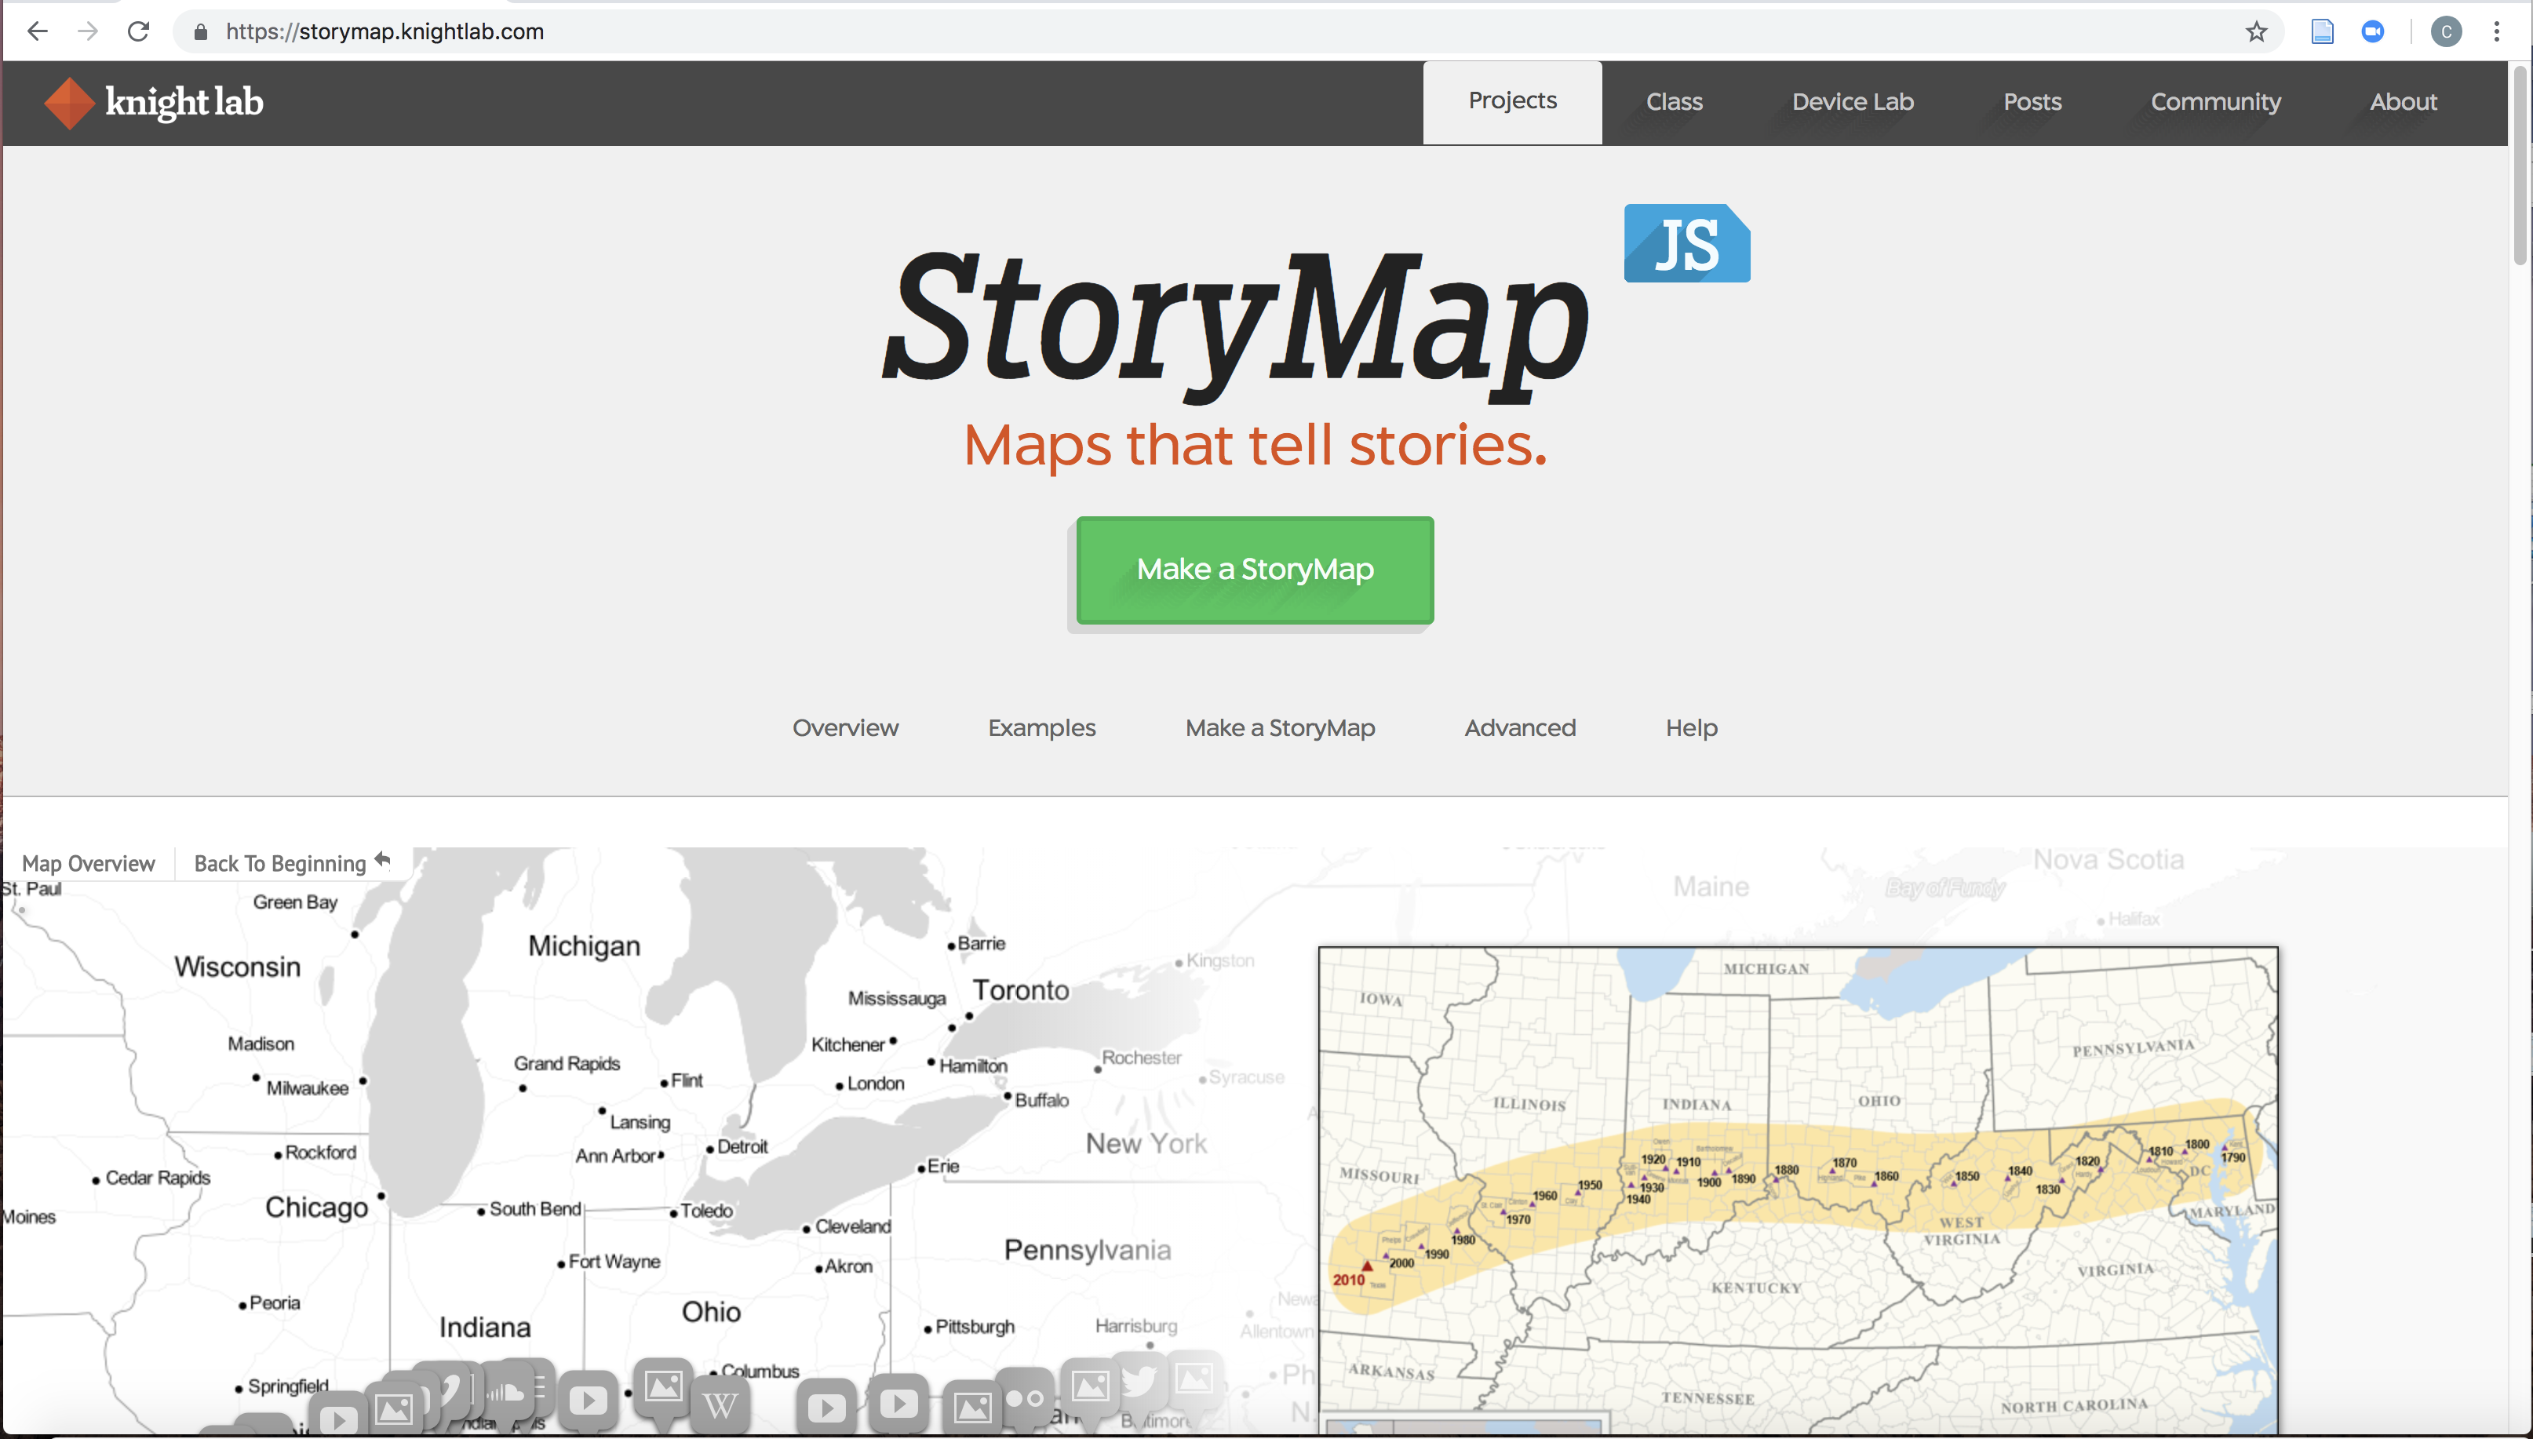
StoryMap JS
StoryMapJS was developed after TimelineJS, and in many ways is even easier to use. Begin by heading to https://storymap.knightlab.com/

Slide 31
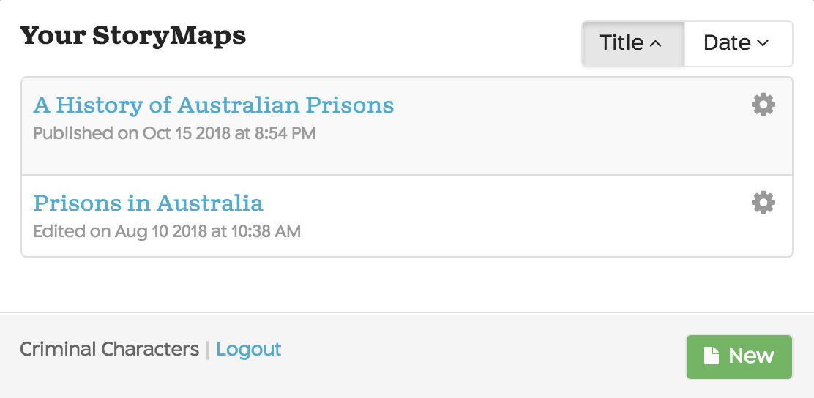
StoryMap JS
Click ‘Make a StoryMap’. If you are not signed into your Google Account, you will be prompted to sign in. You will then get the option of opening an existing StoryMap (if you have any saved) or creating a new one. Click ‘New’. You will be asked to give the StoryMap a title – this is a display name only.

Slide 32
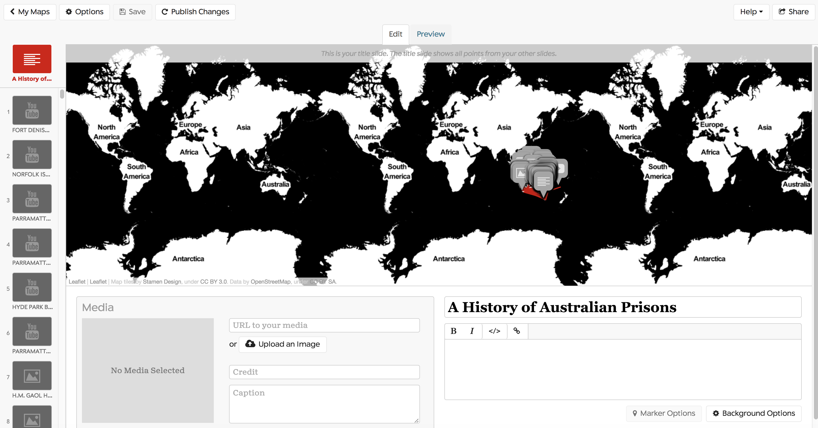
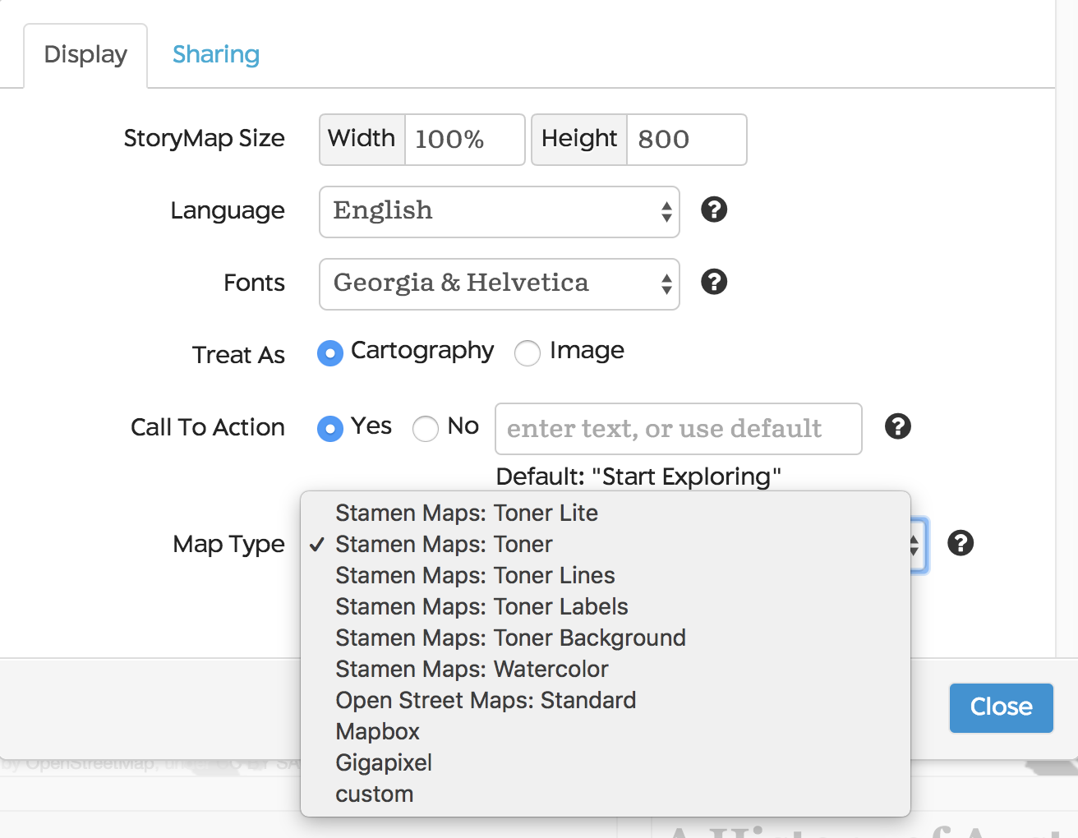
Map Types
You will now be in the StoryMap platform. The platform comes with several pre-set map options that you can choose between. Head to the ‘Options’ tab, and then within that click ‘Map Type’. The Stamen Maps and the Open Street Map are the pre-set options. You can also create and use your own custom map from platforms such as Mapbox or Gigapixel.

Slide 33
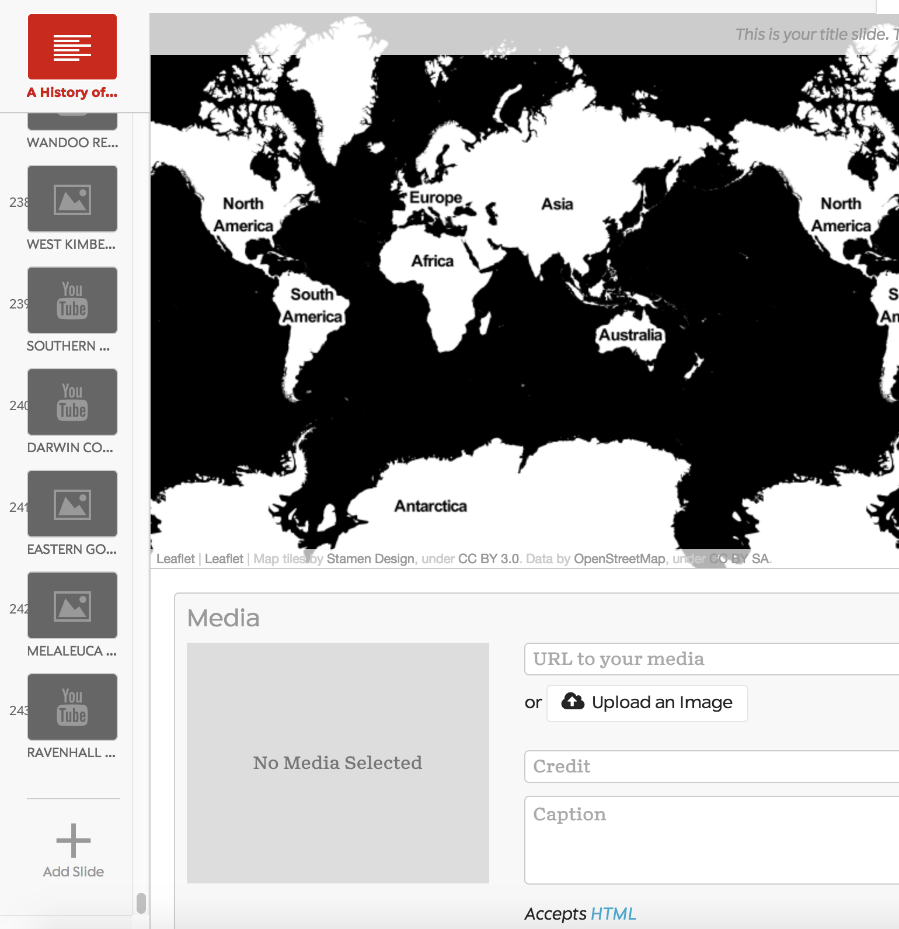
Title Slide and Adding New Slides
Start by creating a title slide for your map with just a heading. Once that is done, you can create your first location slide by clicking the + Add Slide button on the left-hand side of the screen.

Slide 34
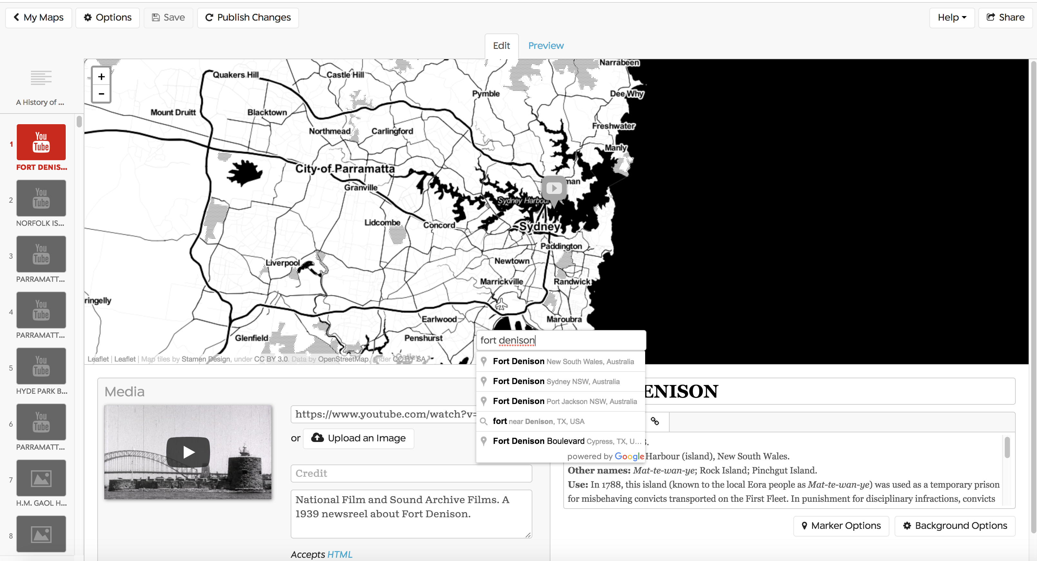
Adding Location Marker
You can select the location for your first slide by searching within the ‘Search’ bar within the map view. The map pulls location data from Open Street Map, so you can get fairly refined location data including by searching for names of buildings etc.

Slide 35
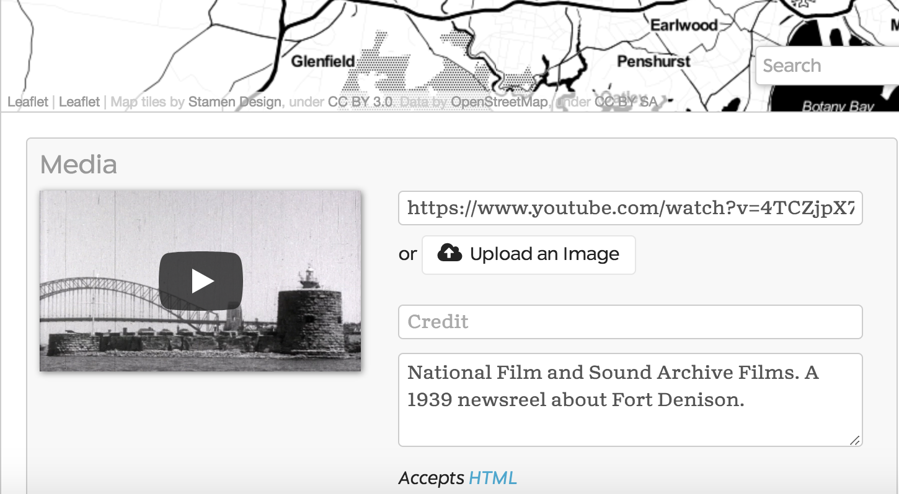
Adding Media
In StoryMap you have the option of inserting a URL to your media (such as youtube videos, Wikipedia pages etc.) OR of uploading your own image files from your computer. You can also add credits and captions to the media.

Slide 36
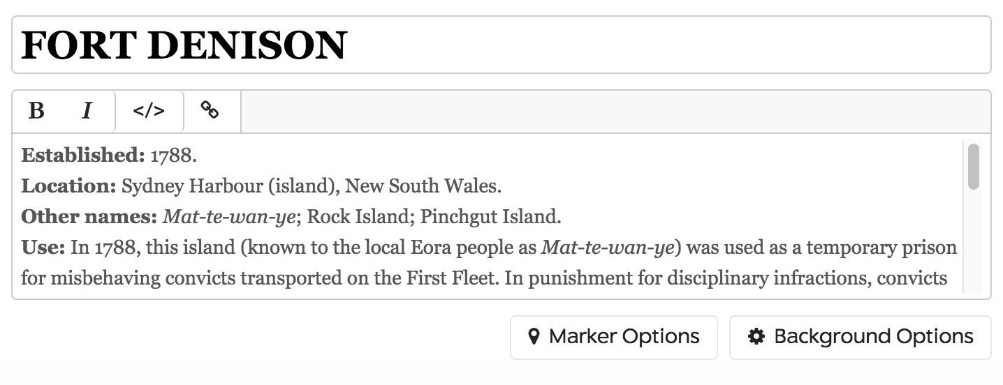
Adding Annotations
You can add headlines and annotations to StoryMapJS, and also add hyperlinks using the text within your annotation.

Slide 37
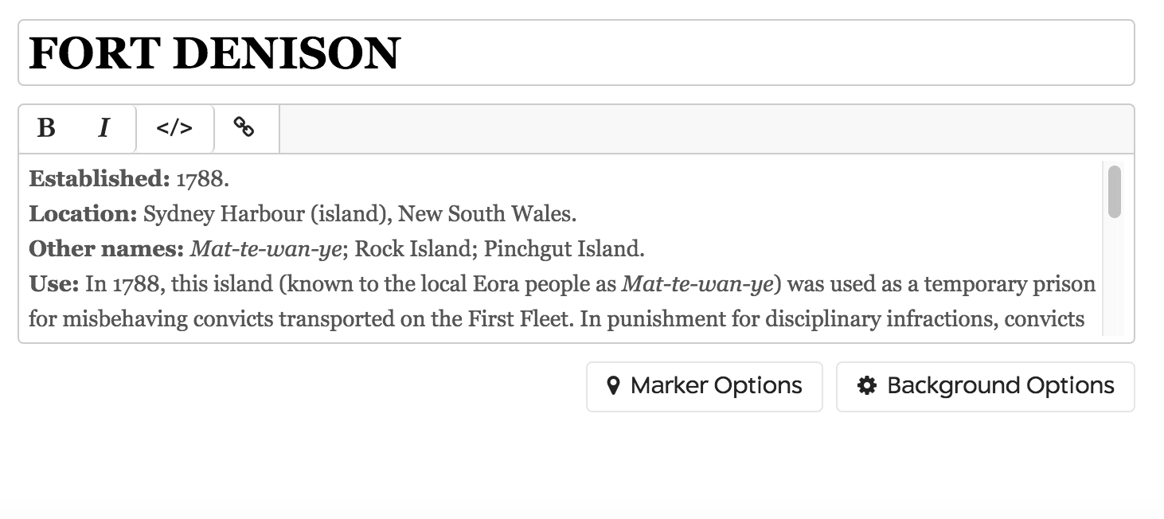
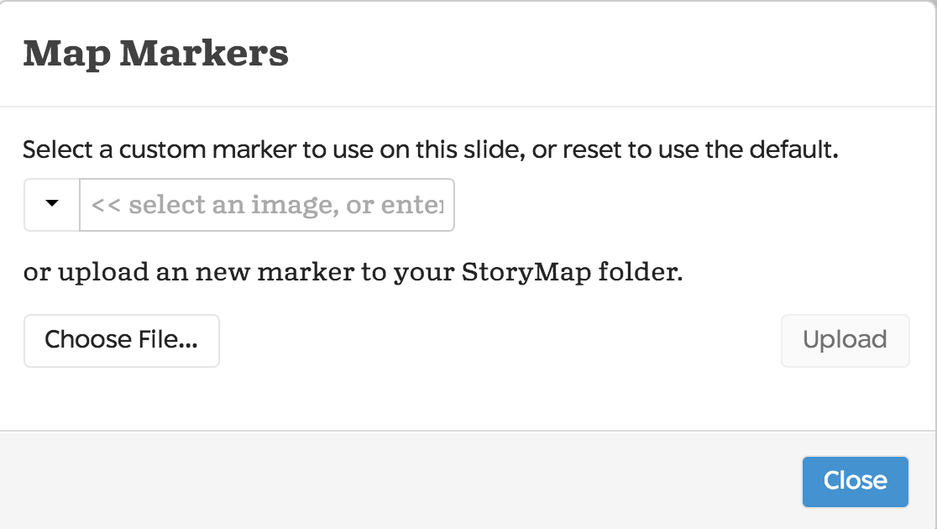
Marker Options
Marker options lets you create your own custom location marker or markers by uploading image files. For instance, if one of the locations on your map was the Sydney Opera House, you could upload an image of the Opera House that would then appear as the marker for that location on the map.

Slide 38
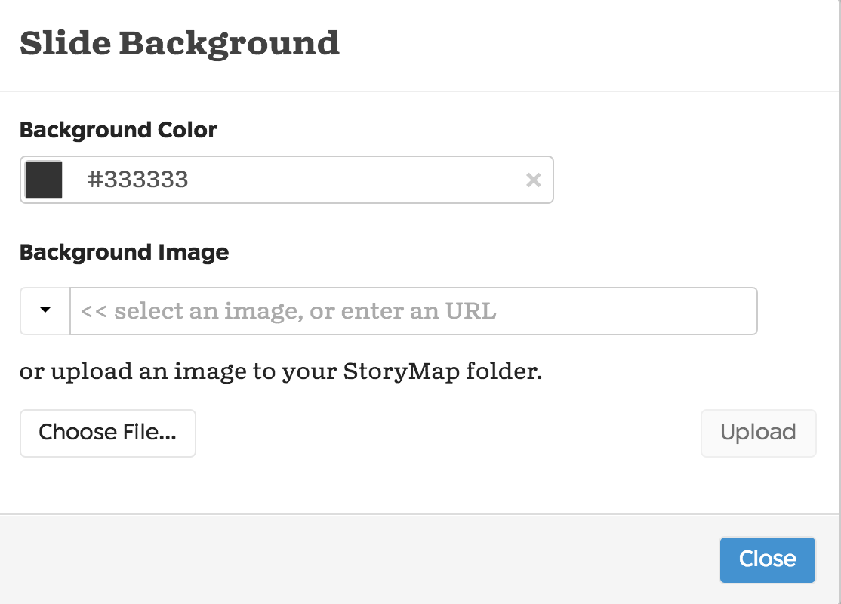
Background Options
Similarly to Timeline JS, you can choose a colour or have an image as the background to your annotation in StoryMap.

Slide 39
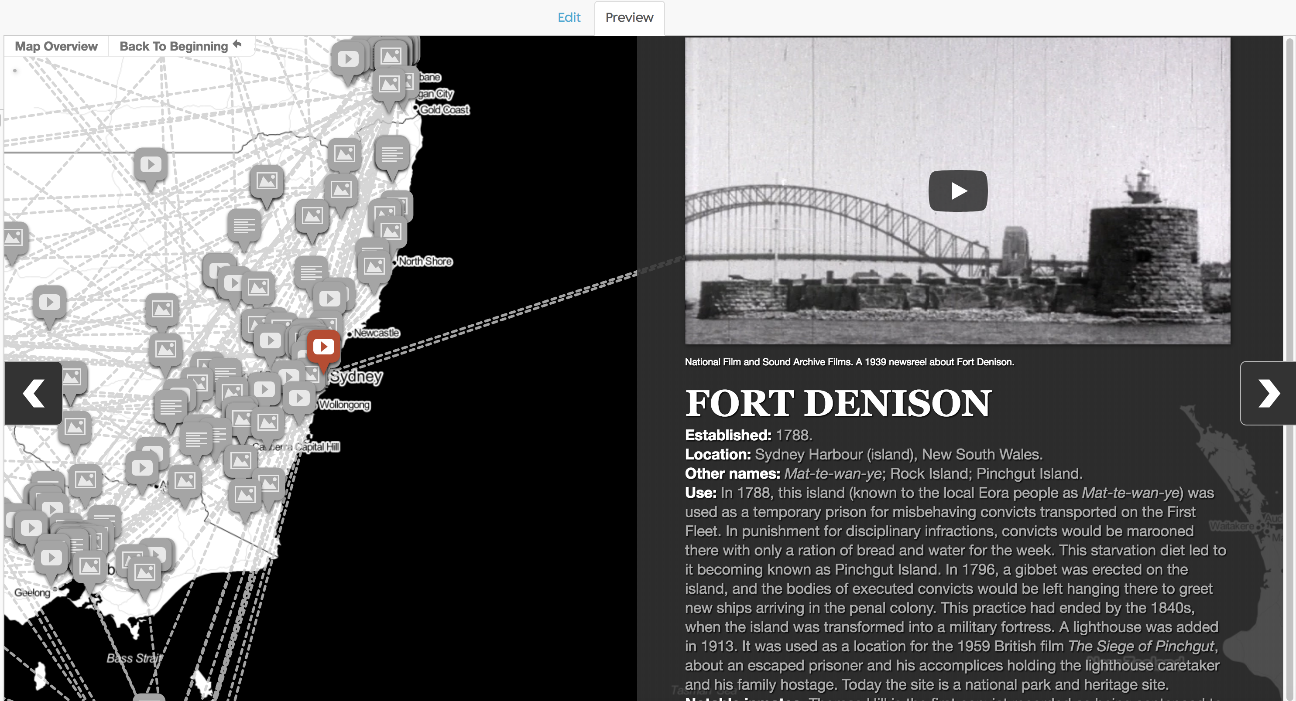
Preview
You can switch to the Preview view mode at the top of the page to see what your StoryMap is looking like and navigate through it.

Slide 40
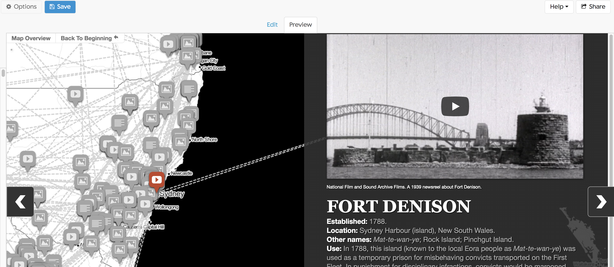
Share
Once you are ready to publish your StoryMap to the web and upload it onto your own website, you can get the embed code to copy over through the Share button.

Slide 41
Thank you

