Slide 1
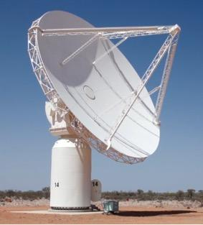
Stargazing with the SKA
Seeking spirals
Coral Connor
Mary Coupland
UTS

Slide 2
Where have you seen spirals?

Slide 3
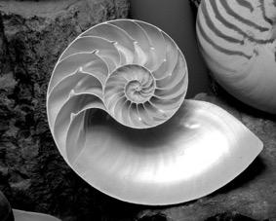

Slide 4
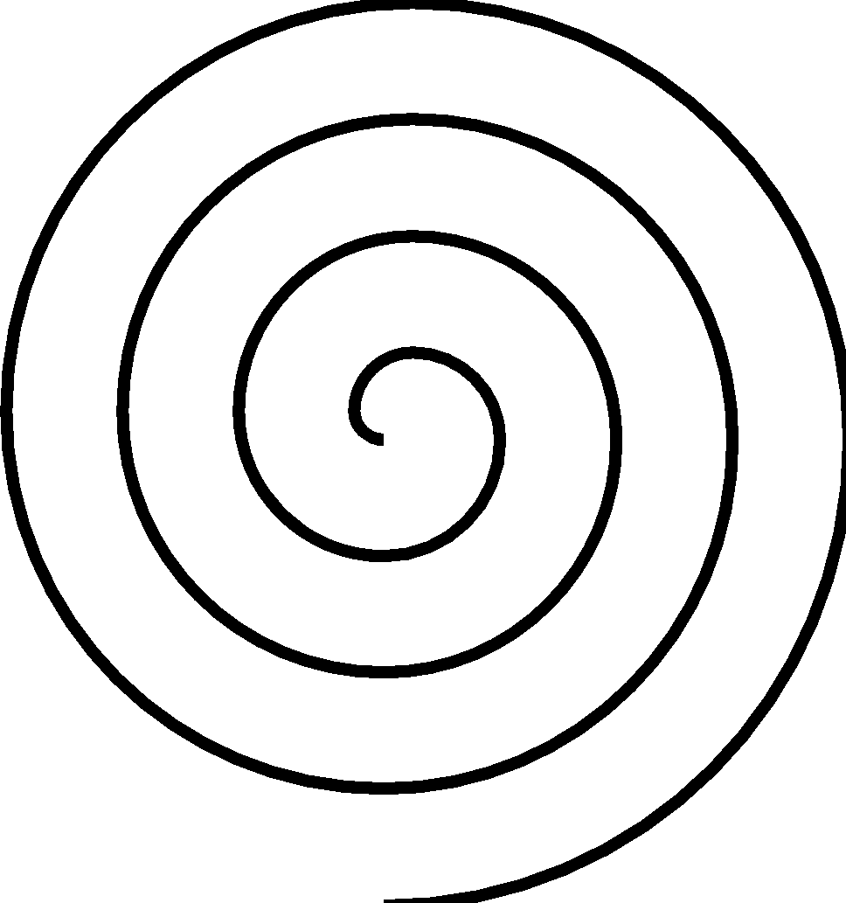

Slide 5
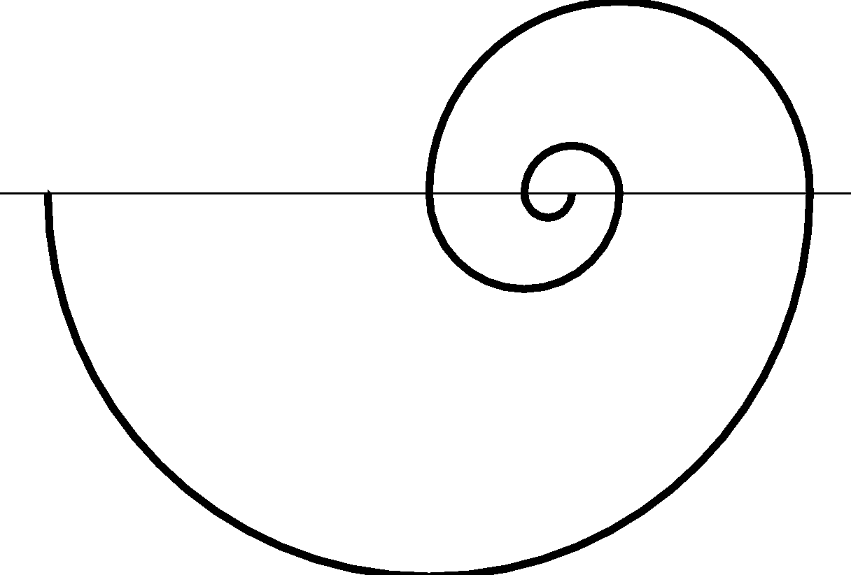

Slide 6
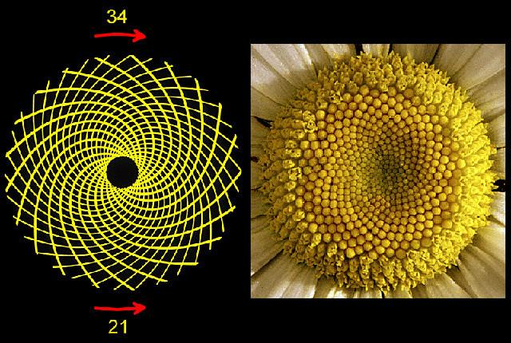

Slide 7
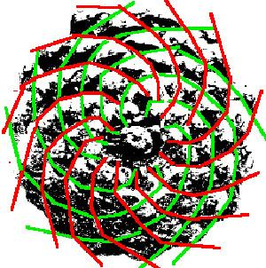

Slide 8
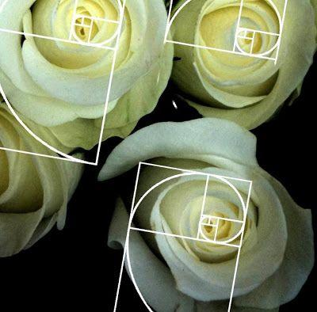

Slide 9
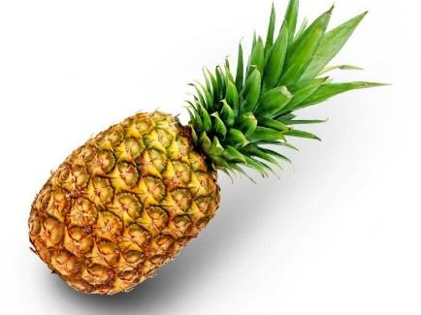

Slide 10
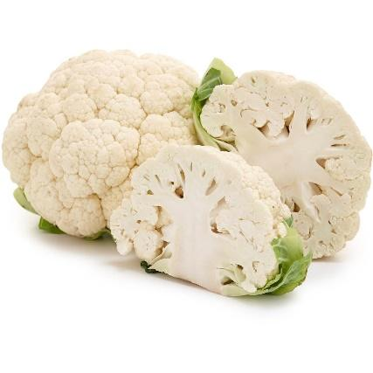

Slide 11
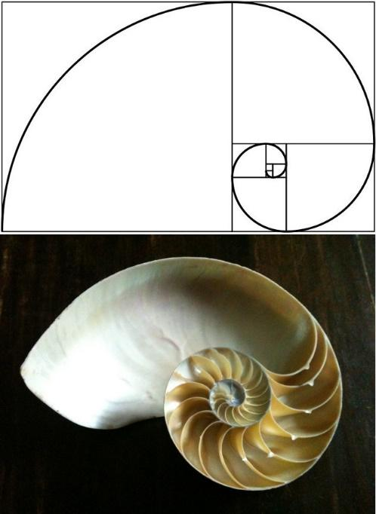

Slide 12
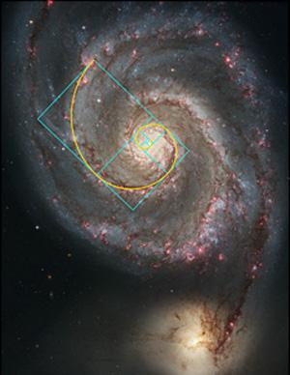

Slide 13
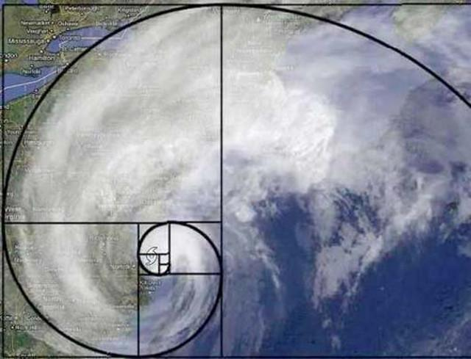

Slide 14
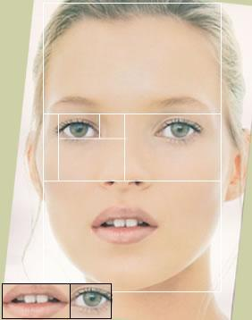

Slide 15
https://io9.gizmodo.com/5985588/15-uncanny-examples-of-the-golden-ratio-in-nature?IR=T
Vi Hart
Part 1 https://www.youtube.com/watch?v=ahXIMUkSXX0
Part 2: http://youtu.be/lOIP_Z_-0Hs
Part 3: http://youtu.be/14-NdQwKz9w

Slide 16
Drawing spirals 1

Slide 17
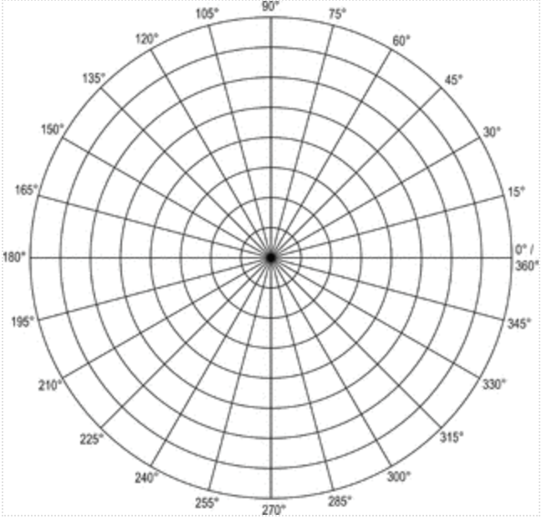

Slide 18
Drawing spirals 2

Slide 20
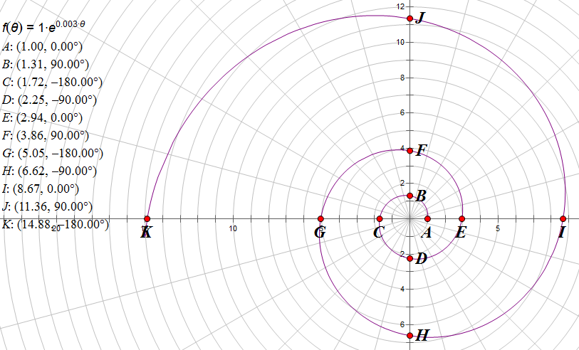
Drawing spirals 3 (using technology)
https://www.geogebra.org/m/PCdxBP84
https://www.geogebra.org/m/f8MDV6YS https://www.geogebra.org/m/dZuH5hWa
Trial version http://info.mheducation.com/sketchpad.trial.html

Slide 21
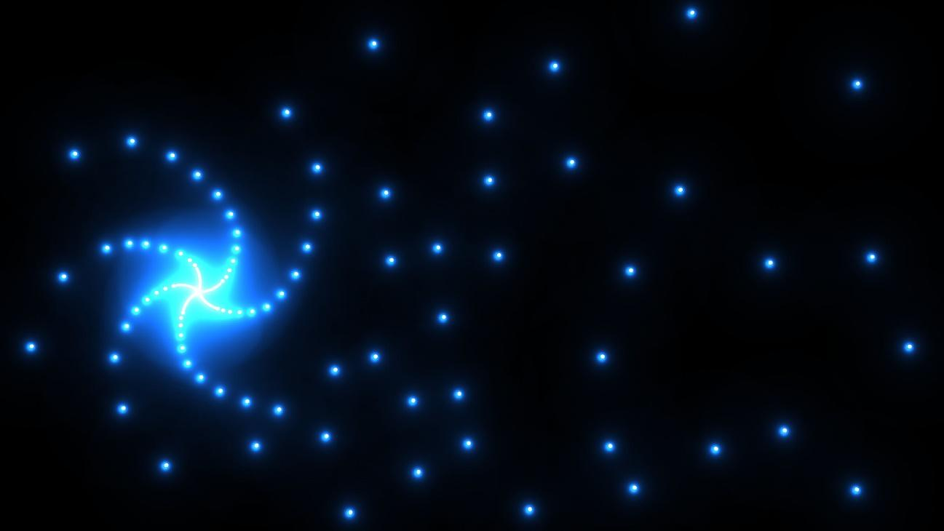
Placing the telescopes
https://www.skatelescope.org/layout/

