Slide 1
Engaging Students in Maths by Using Real World Problems Dr Mary Coupland, Assoc. Prof. Anne Prescott Dr. Marco Angelini University of Technology Sydney

Slide 2
Outline
What is Maths Inside?
Funded by the Federal Government - AMSPP (Australian Maths and Science Partnerships Program)
Linking CSIRO, AAMT & UTS
Research into student engagement and learning at each stage to inform the next round of curriculum development.

Slide 3
Please “think, pair, share”
Year 8 students ask “What is the point of this maths? What are we going to use it for?”
Year 11 students ask “What is the point of this maths? What are we going to use it for?”
HOW DO YOU RESPOND?

Slide 4
Maths inside – how will it work?
Inspirational case studies will show the contributions of practising mathematical scientists to industry and commerce
Teaching and learning materials linked to the Australian Curriculum that encourage exploration of relevant mathematical ideas

Slide 5
Support for Out-of-field teachers
Professional learning activities for teachers, to be available through AAMT
Build on what is known to be useful in terms of Pedagogical Content Knowledge (Hill, Ball and Schilling, 2008).

Slide 6
What kinds of classroom activities?
Target years are 8-12
Emphasis on authentic RICH TASKS include multiple entry and exit possibilities, interactivity, appropriate use of technology
Investigations rather than drill exercises, emphasis in creative and critical thinking

Slide 7
What classroom tasks work?
In small groups, please:
Spend 3 minutes discussing your experience of successful and unsuccessful learning
Identify 3 elements of successful lessons, and the resources required to deliver them
3. Share your discussions with the room

Slide 8
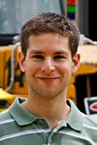
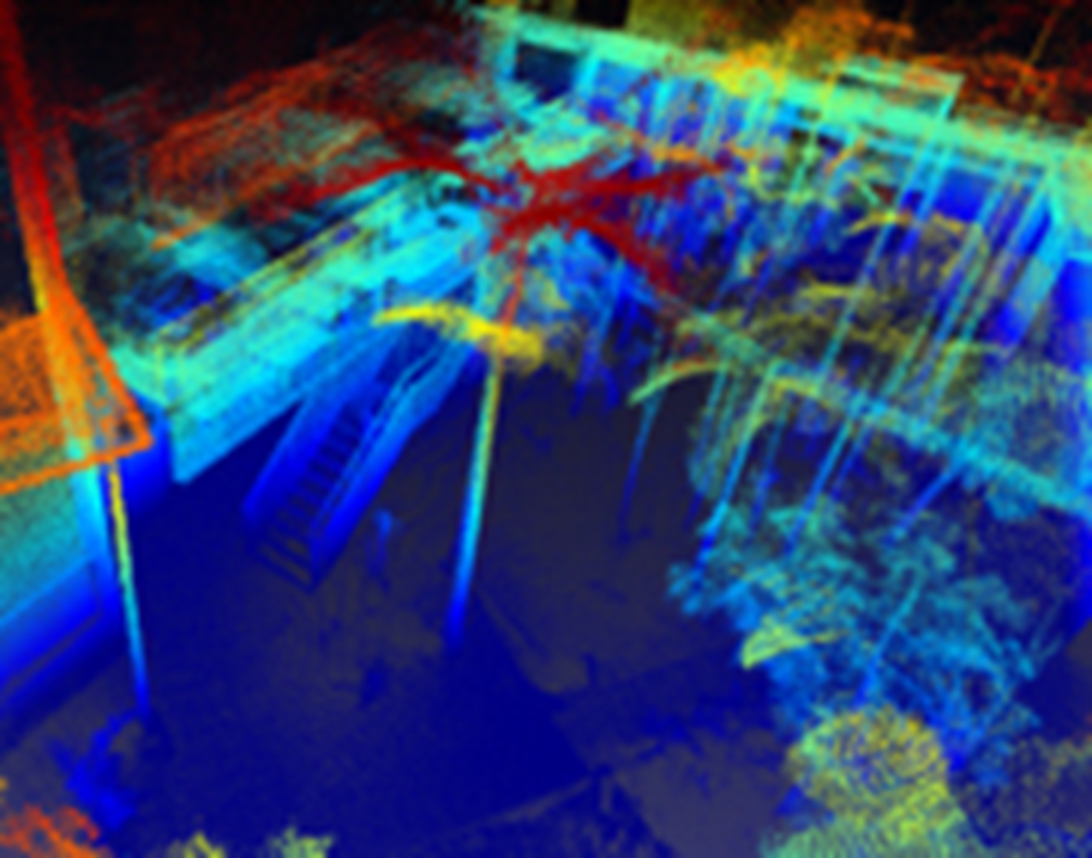
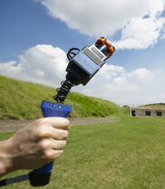
The Zebedee project: 3D mapping in real time, using a hand-held laser scanner and innovative software. Dr Robert Zlot
Crime scenes, Caves, Historical sites

Slide 9
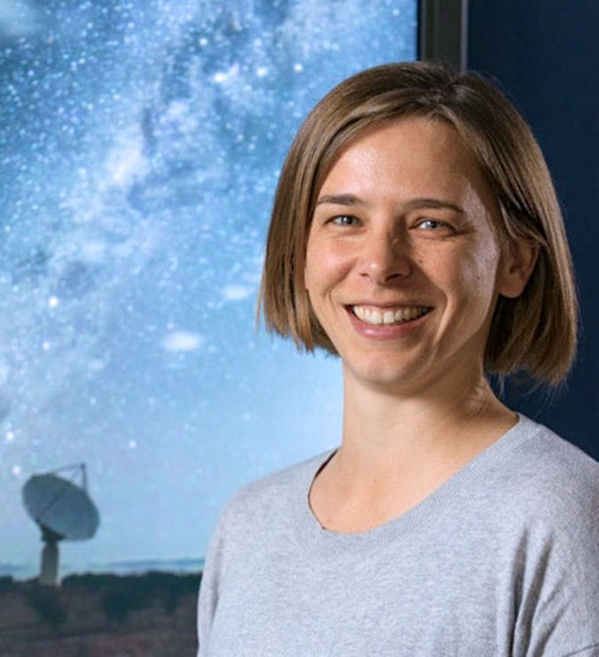
Australian Square Kilometre Array Dr. Lisa Harvey-Smith
Notes:
Global next-generation radio telescope project, based in 20 countries
Will be the largest and most capable radio telescope ever constructed
Thousands of antennae linked together by high bandwidth optical fibre
Will gives insights into the formation of the early Universe, including the emergence of the first stars, galaxies and other structures

Slide 10
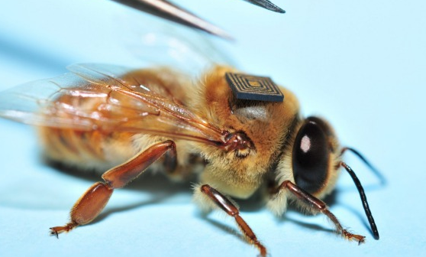
Bees with Backpacks Dr. Paulo de Souza

Slide 11
How to access the learning resources
www.mathsinside.uts.edu.au
Or
www.aamt.edu.au

Slide 12
Feedback so far
Over 1500 teachers and students have engaged with videos and class activities
Resources trialled in 21 schools and colleges
1150 evaluation forms received from students and teachers
82% expressed satisfaction with project resources
We’ve been told activities could be more directly linked to videos

Slide 13
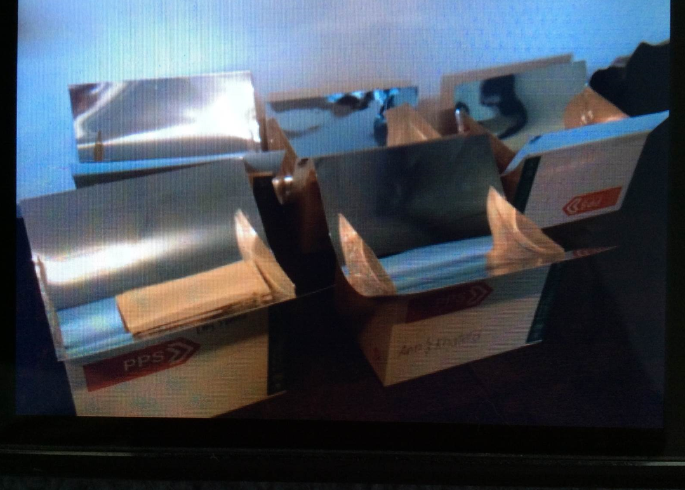
Our most popular event: parabolic solar reflectors and cooking sausages!
Notes:
Stuart Palmer (Maths Inside resource developer) facilitating the ASKAP Practical Parabolas (3B) he developed, in 2016.

Slide 14
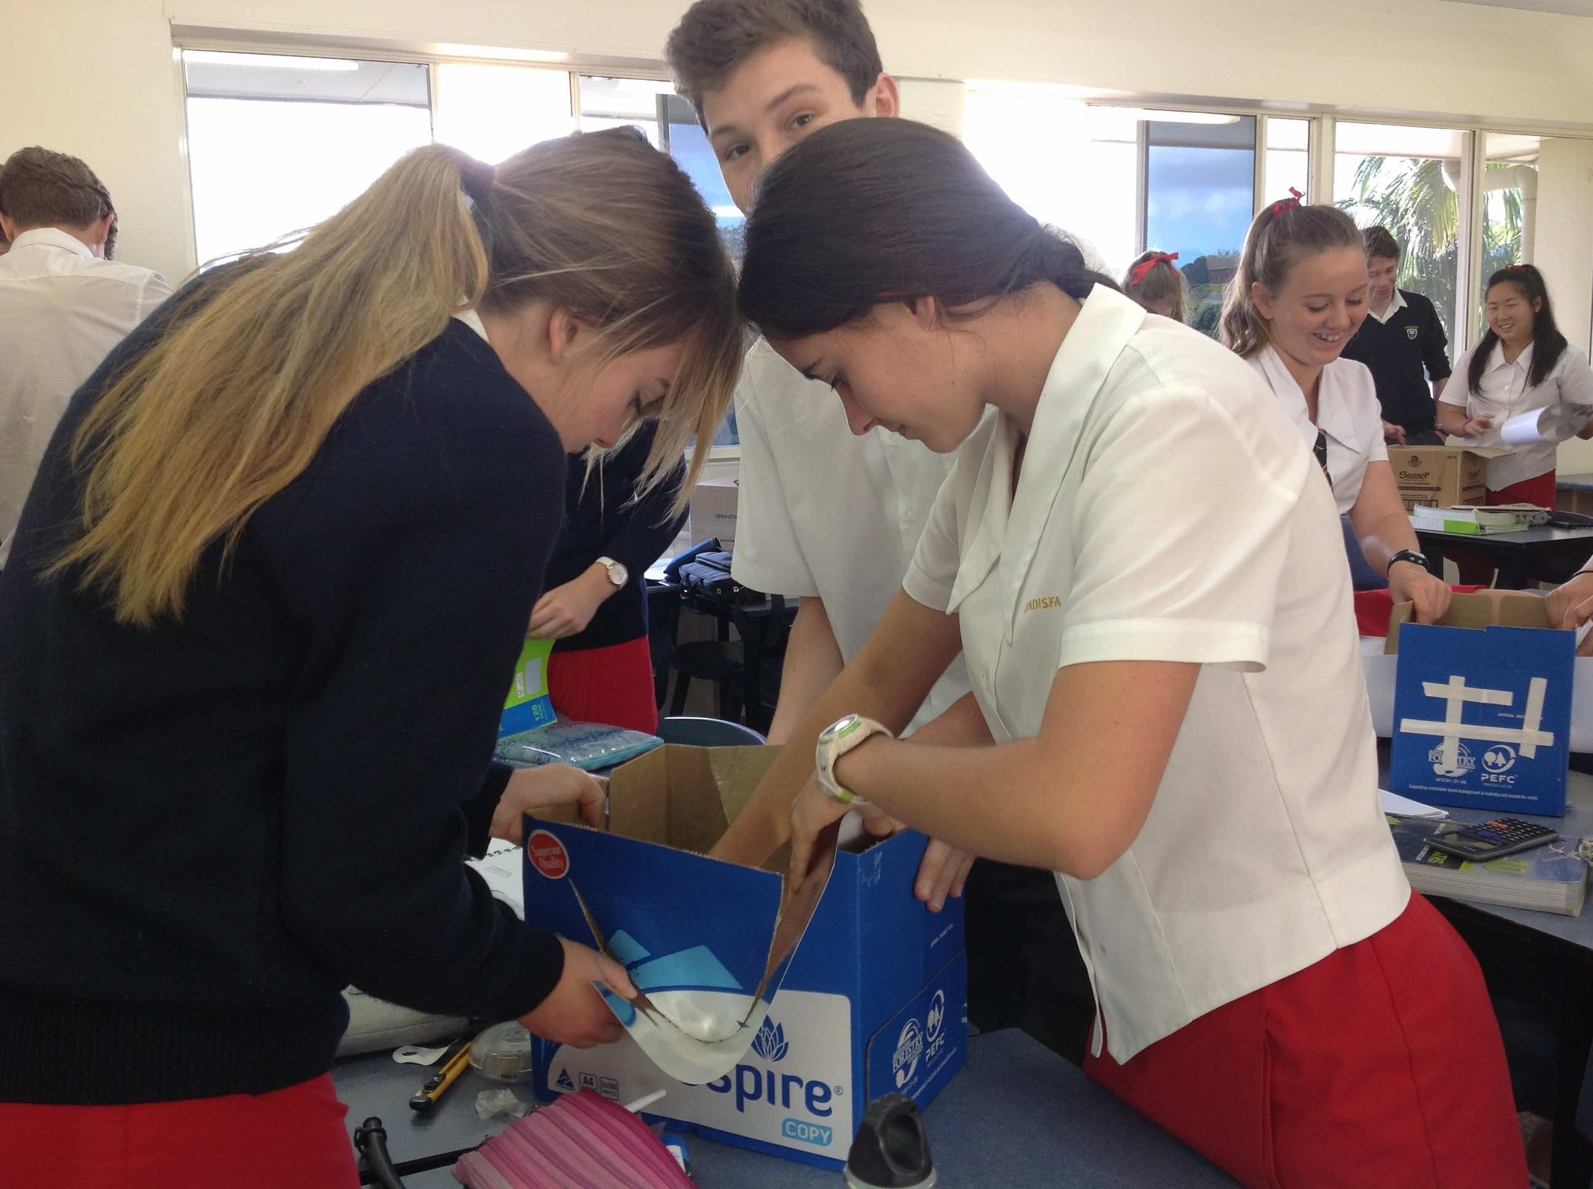
Notes:
Year 10 students at Lindisfarne Grammar School, NSW participating in the ASKAP Practical Parabolas (3B) activity in October 2016.

Slide 15
Maths Inside activities
In small groups:
Spend a few minutes reviewing the class activities
Share your views with the room on how useful they might be for your students; are they “Rich” enough? how they could be improved?

Slide 16
How to get involved
The project is seeking schools to collaborate on delivering these resources in schools.
To find out more, please visit:
www.mathsinside.uts.edu.au
Project Directors:
Dr Mary Coupland: mary.coupland@uts.edu.au
Assoc. Prof. Anne Prescott: anne.prescott@uts.edu.au

